Slide 1


Spring Campus, 2019
Workshop IV: “Transitions to a Low-Carbon Economy from a Comparative Perspective”
Low-Carbon Physical Infrastructure
Nikolai Bobylev
Saint Petersburg State University
E-mail: n.bobylev@spbu.ru

Slide 2


United Nations Global Goals
UN SDGs
Goal 11: Make cities inclusive, safe, resilient and sustainable
Goal 9: Build resilient infrastructure, promote sustainable industrialization and foster innovation
Goal 7: Ensure access to affordable, reliable, sustainable and modern energy for all
Goal 13: Take urgent action to combat climate change and its impacts

Slide 3
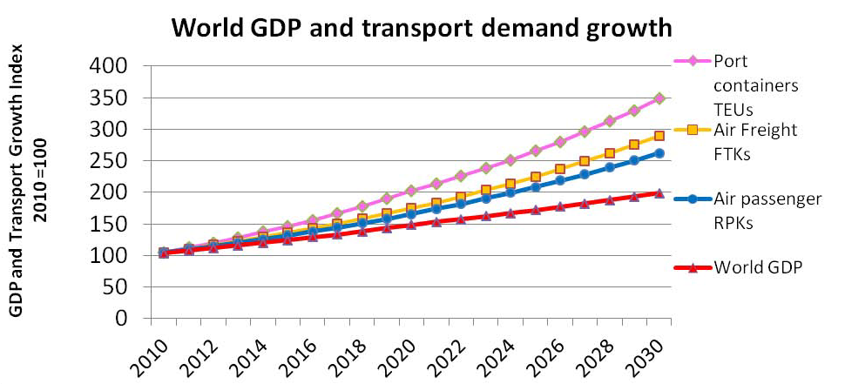
Global Infrastructure Needs to 2030
Source: OECD (2011) Strategic Transport Infrastructure Needs to 2030. OECD Futures Project on Transcontinental Infrastructure Needs to 2030/50. www.oecd.org/futures/infrastructure

Slide 4
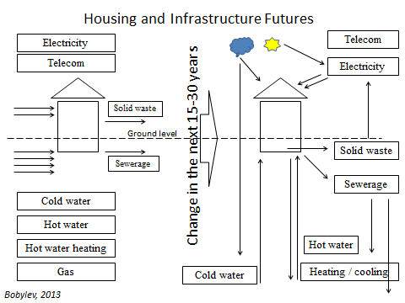
Contemporary agenda for UPI policy - Urban Futures
Next: Urban Innovations:
land use and critical infrastructure management
Housing support infrastructure development trends (from Bobylev, upcoming)

Slide 5
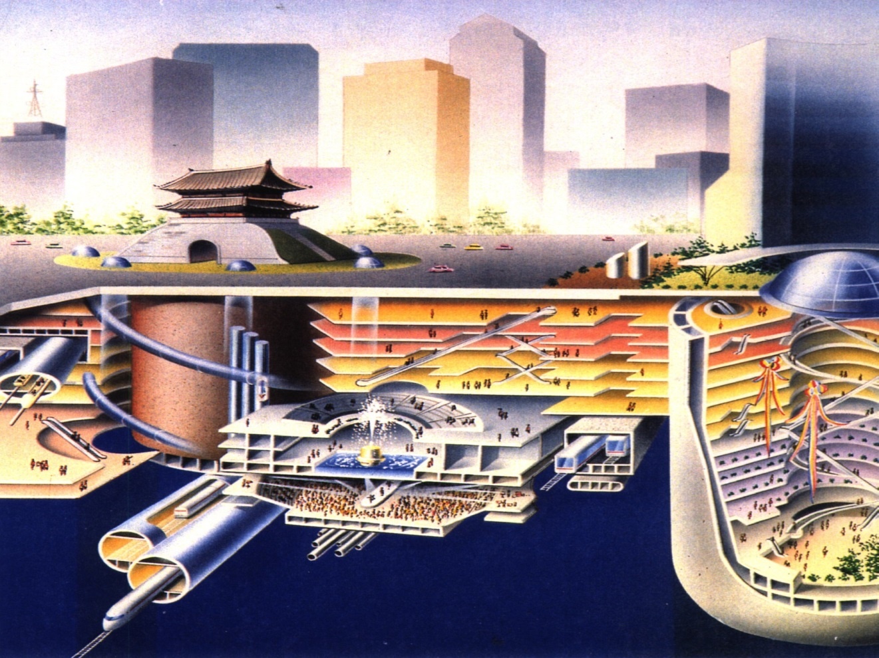
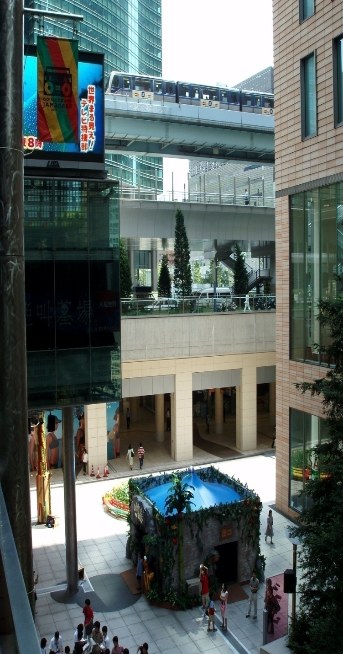
Urban Futures:
3D city – active use of underground space
3-Dimensional Planning is required!
Photo: Nikolai Bobylev - Tokyo

Slide 6
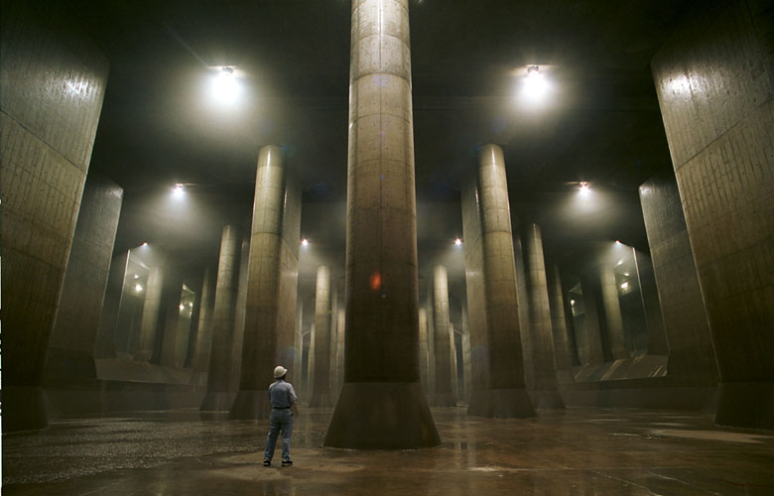
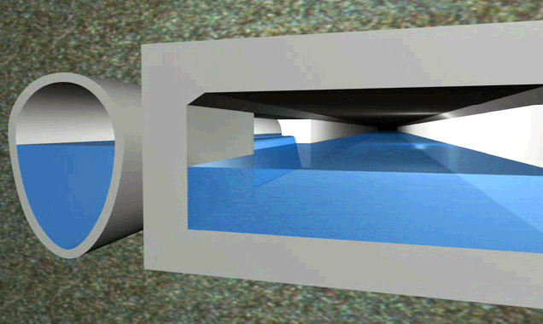
Adaptation versus Mitigation
and Resilience versus Sustainability
An example: Adaptation to climate change
A problem of urban water runoff after heavy rain
Conventional solutions:
Reduce runoff (trees, green zones); (resilient & sustainable)
Increase capacity of drainage infrastructure (resilient & not sustainable)
Smart city solutions (resilient & sustainable)
Manage runoff between city areas (valves, barriers, automated water management (smart grids)).
Inform citizens to temporary cut domestic water use (e.g. for one-two hours).

Slide 7
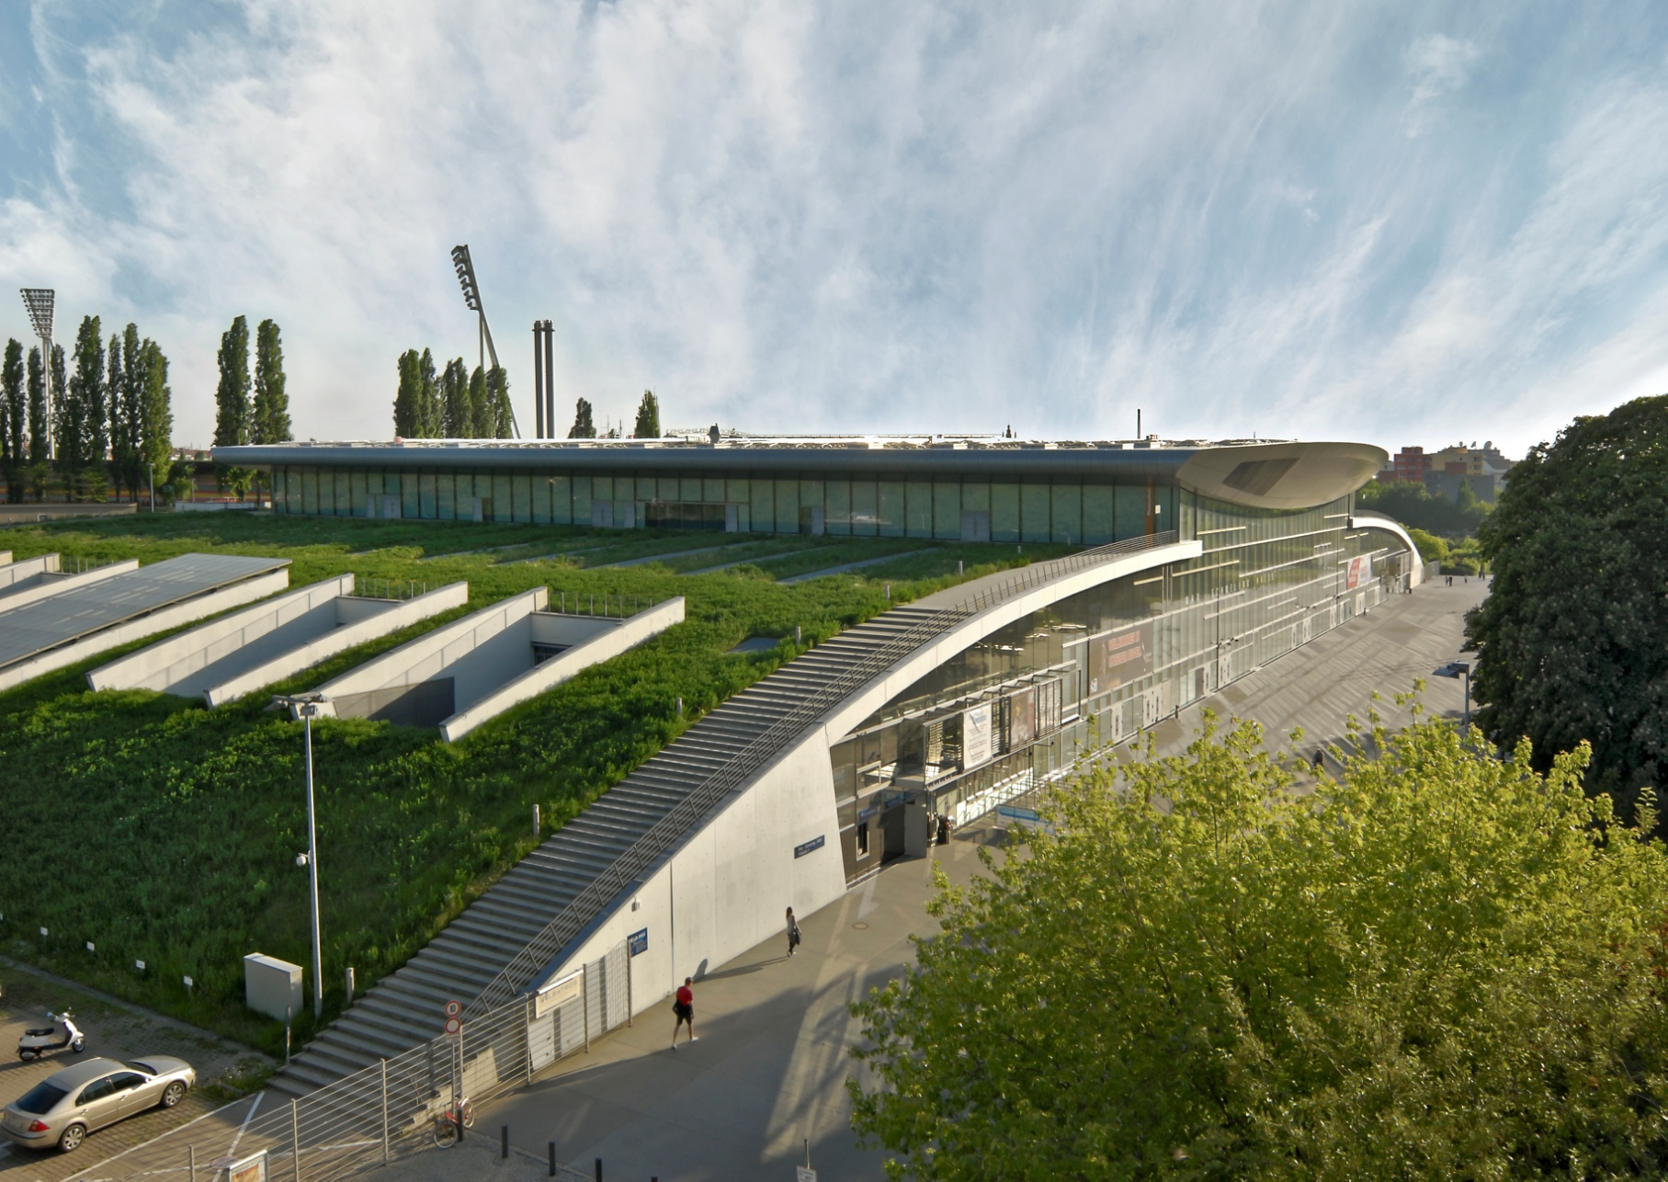
Contemporary agenda for UPI planning - Energy
Max-Schmeling Halle, Berlin
Photo: Sebastian Greuber – Max-Schmeling Halle, Berlin

Slide 8
Ecosystem and infrastructure services consumption trends (major consumption)
Infrastructure and ecosystem services
Service to human welfare | Rural areas developed countries | Urban areas developing countries | Urban areas developed countries
Clean air to breath | E | E | E
Comfortable climate conditions | E | E | E
Water level in water bodies (for shipping, amenity, biota) | E | E | E I
Groundwater level | E | E I | E I
Water quality to use as amenity and recreation | E | E | E
Drinking water provision | I | I | I
Soil formation | E I | E | I
Waste decomposition | E | E I | I
Biological populations control | E | E I | I
Habitat | E | E I | I
Food | I | I | I
Raw materials | E | I | I
Recreation and outdoor activities | E | E I | E I

Slide 9
references
Projects:
Alexander von Humboldt Foundation project on Interplay between ecosystem and infrastructure services in the urban environments,
ERA.Net RUS Plus initiative and the Russian Foundation for Basic Research AUCAM project on “Opportunities for and challenges to urban development and social cohesion in Russia’s Arctic under climate change impacts” (ID # 527, 18-55-76003),
Freie Universität Berlin – Saint Petersburg State University Joint Seed Money Funding Scheme project on Sustainable Urbanization & Comparative Development.

Slide 10















Thank you for your attention!
E-mail: nikolaibobylev@gmail.com

