Slide 1



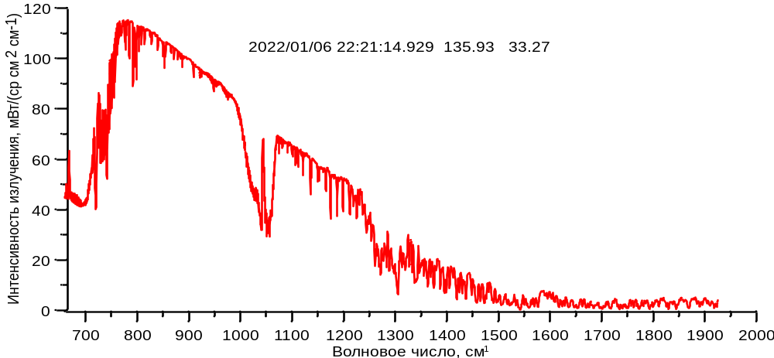
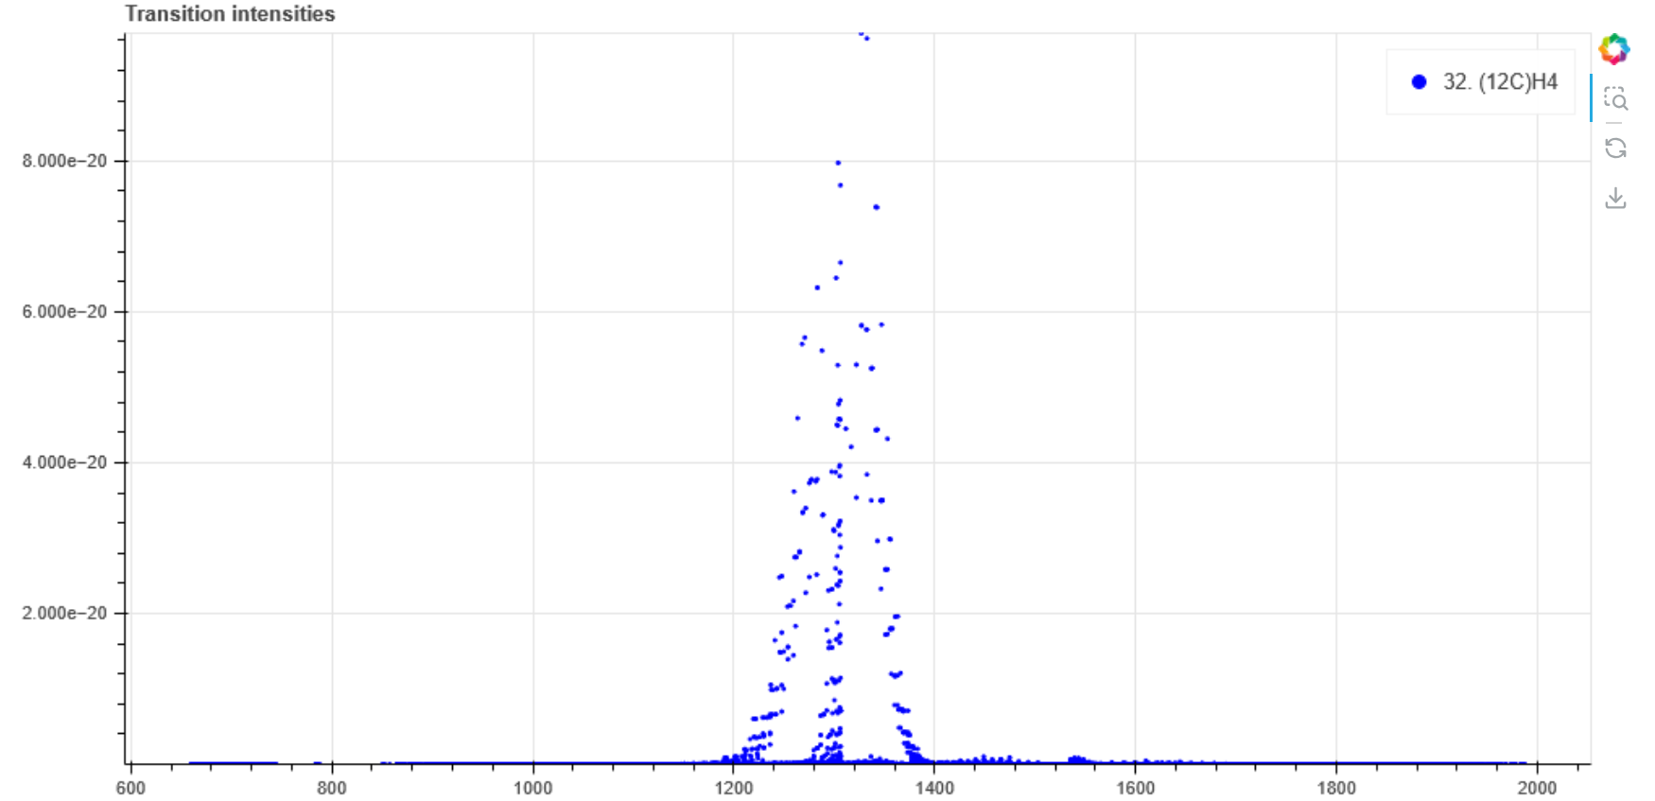

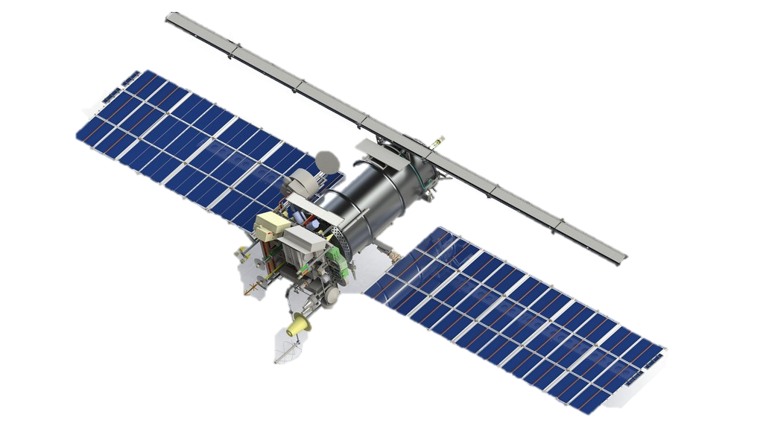
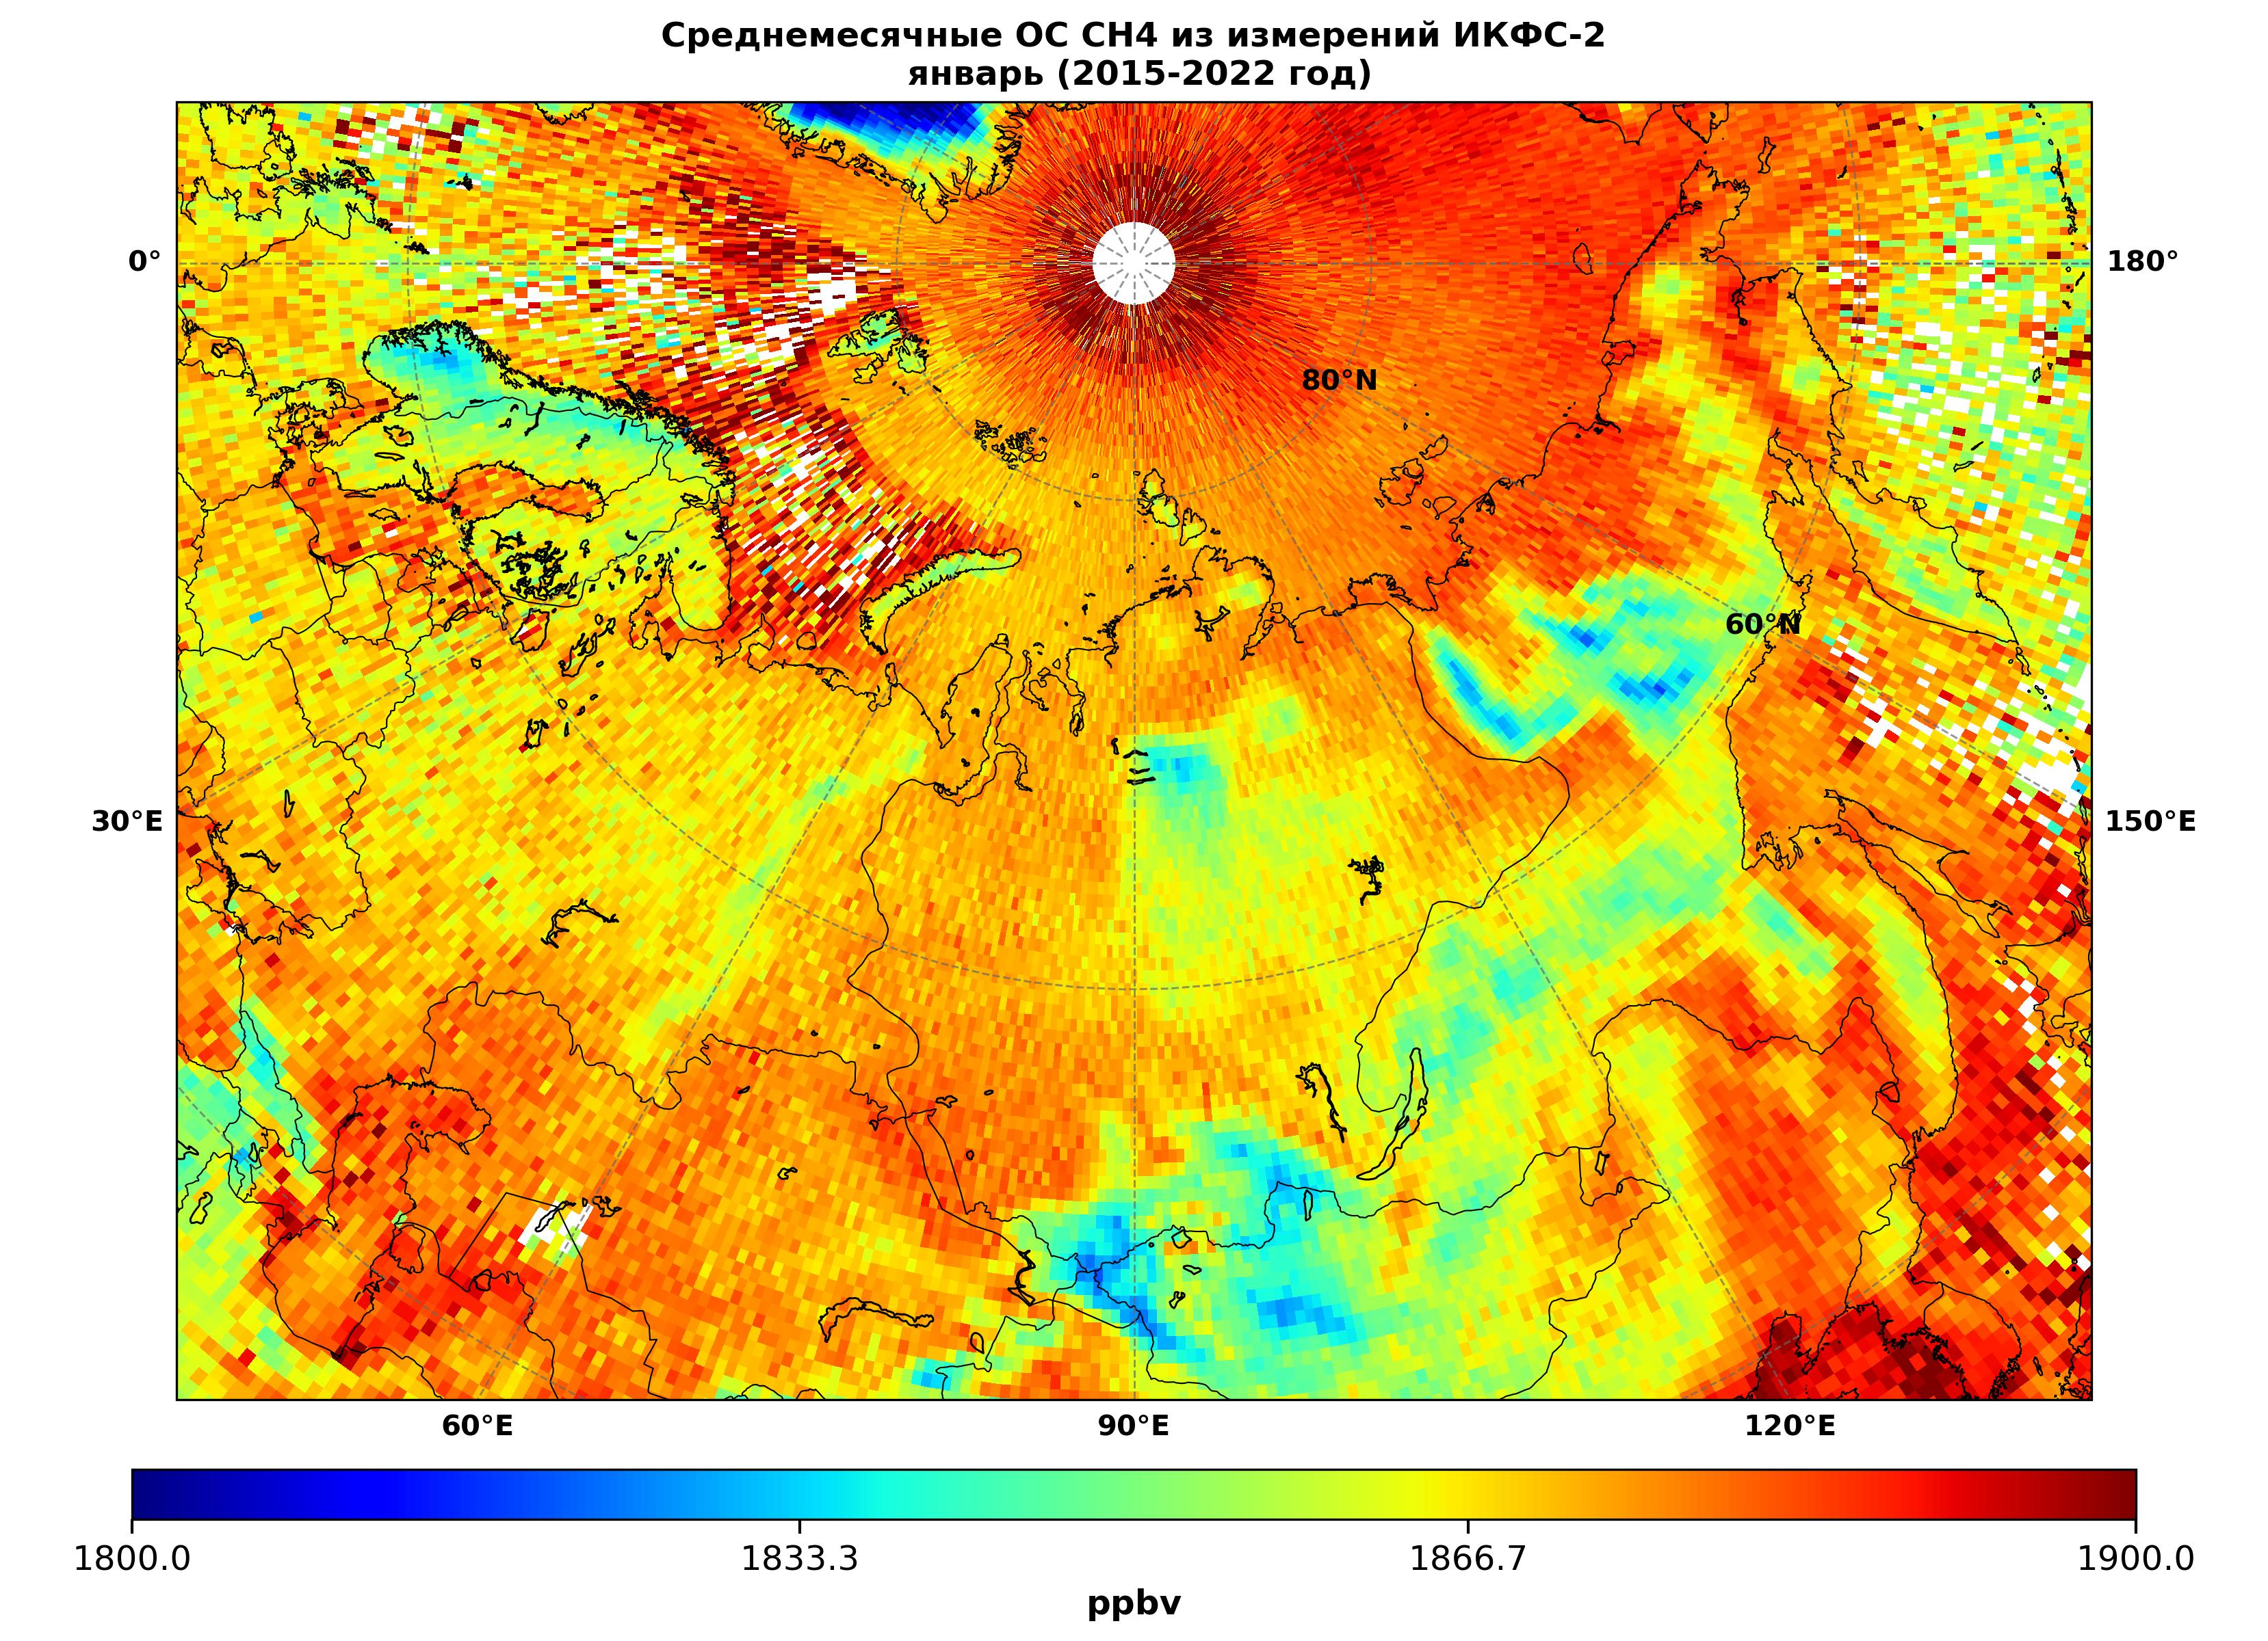
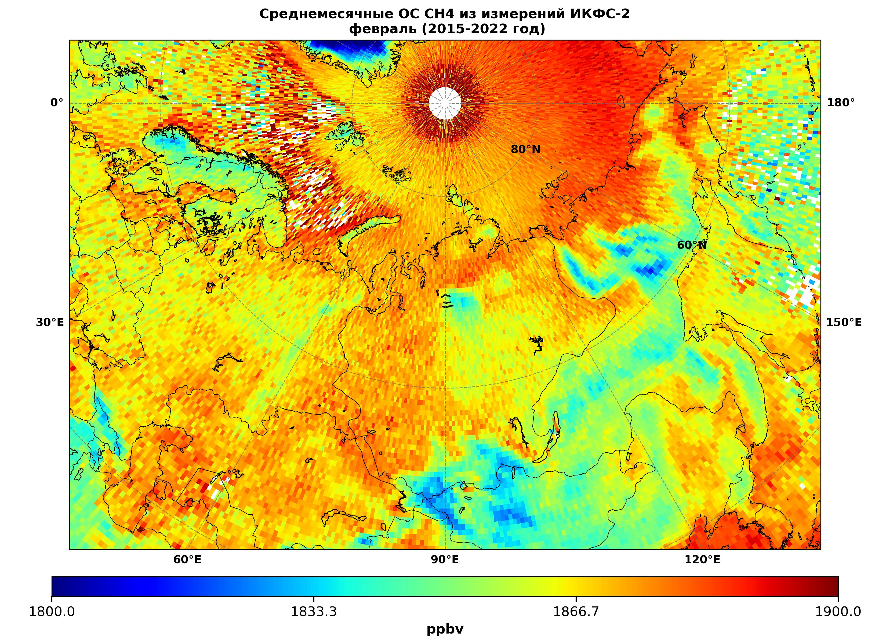
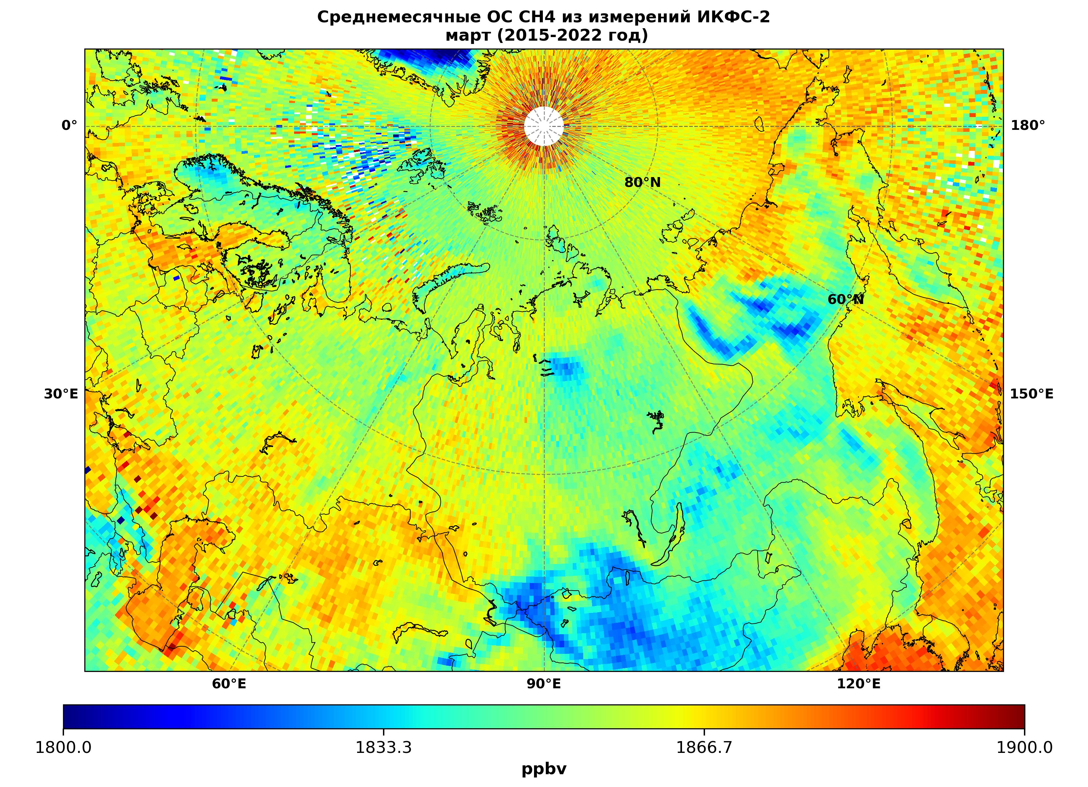
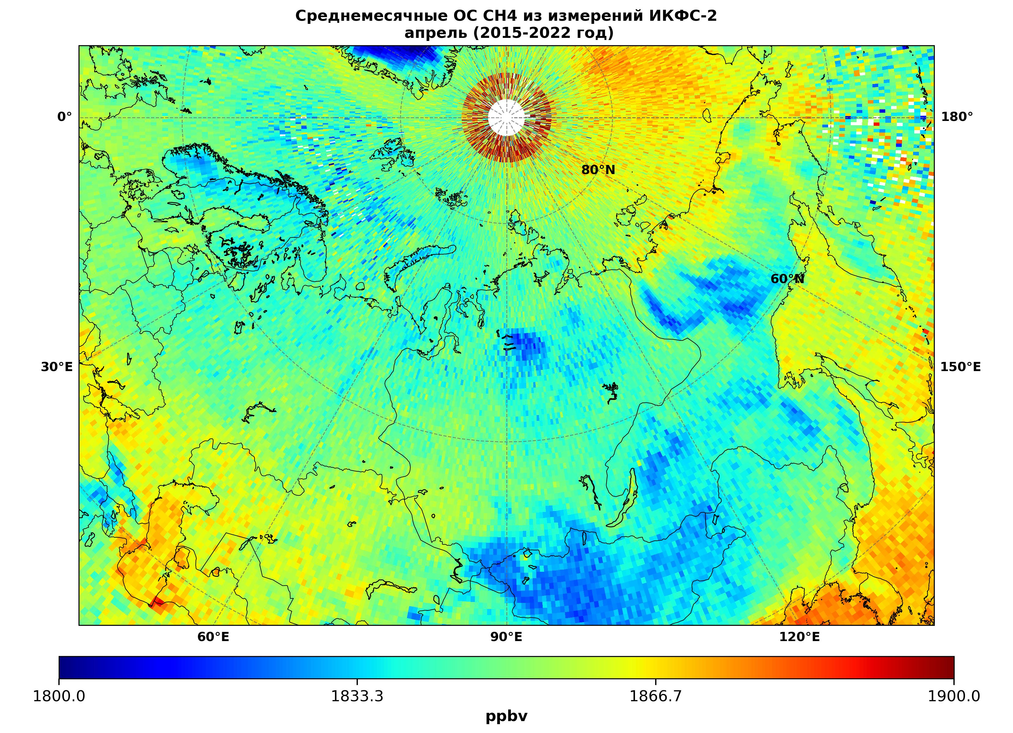
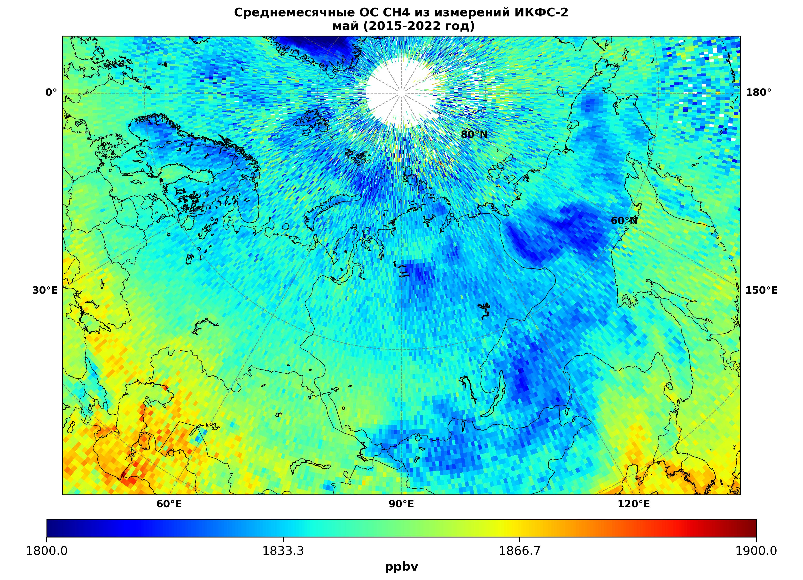
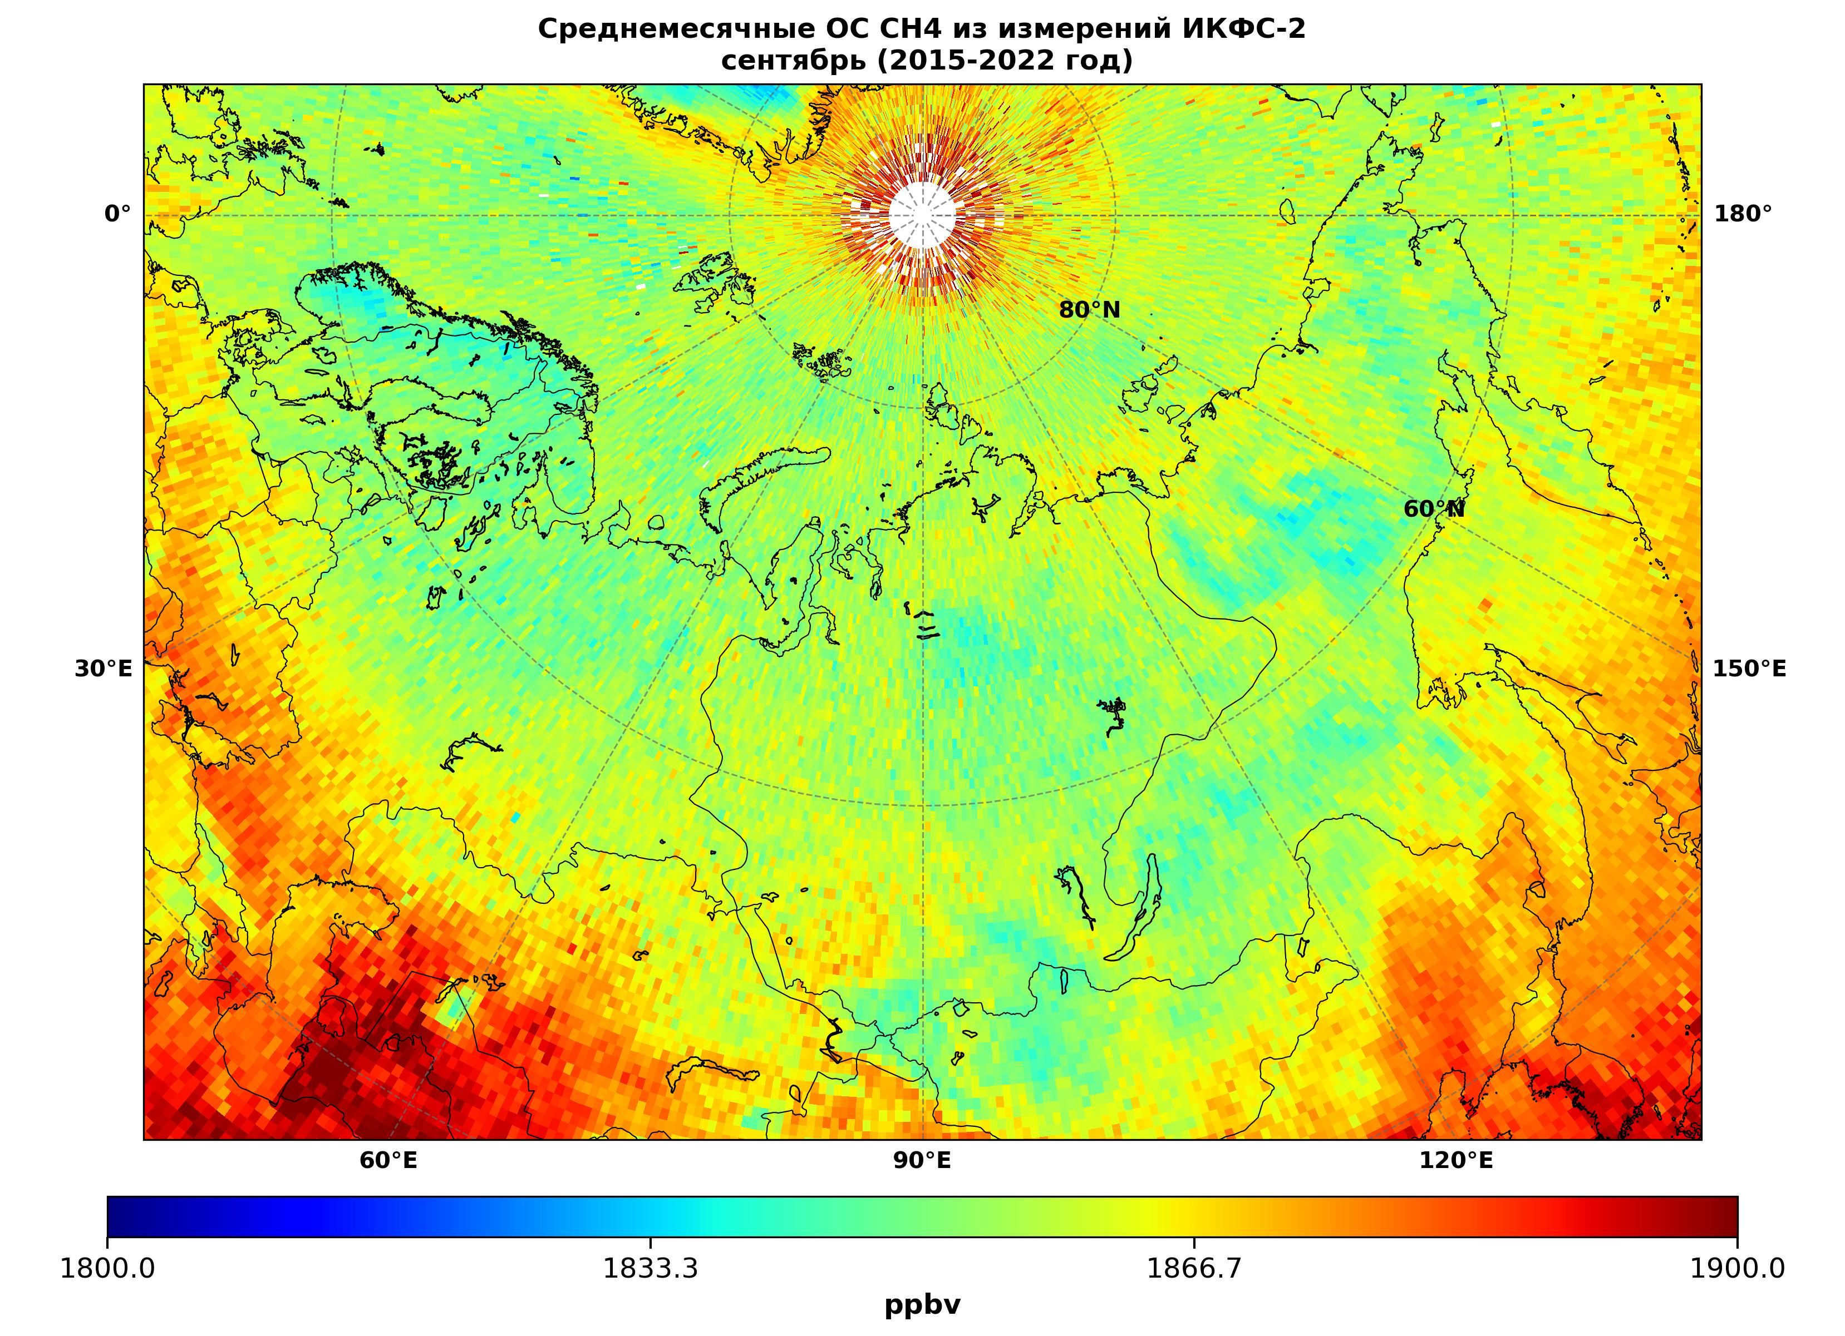
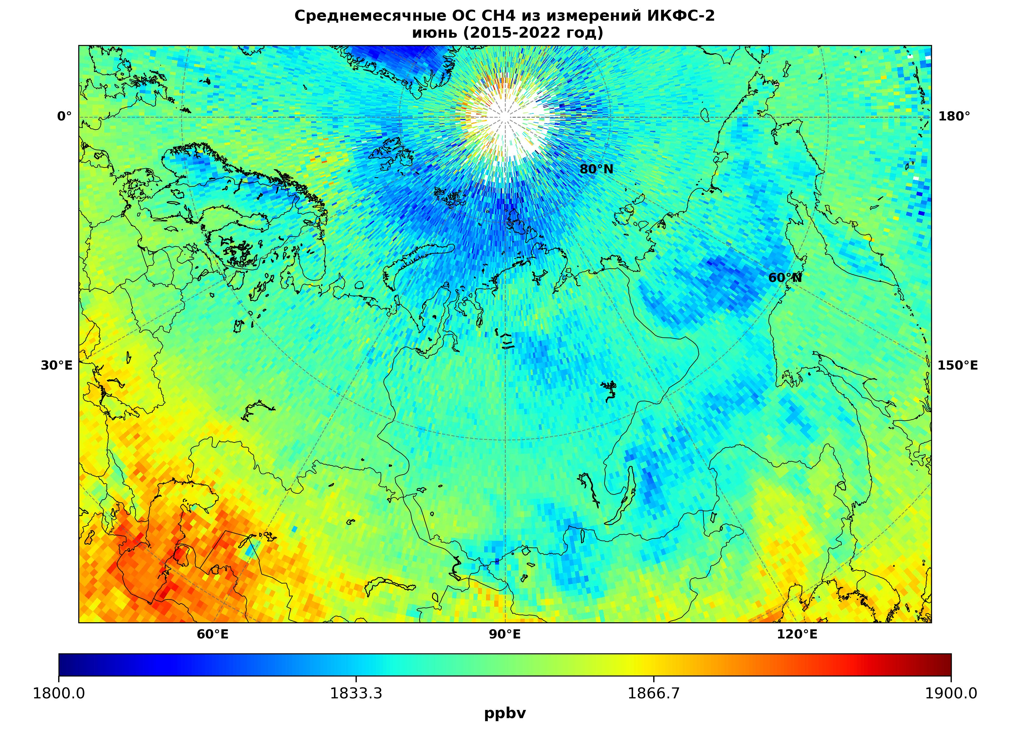
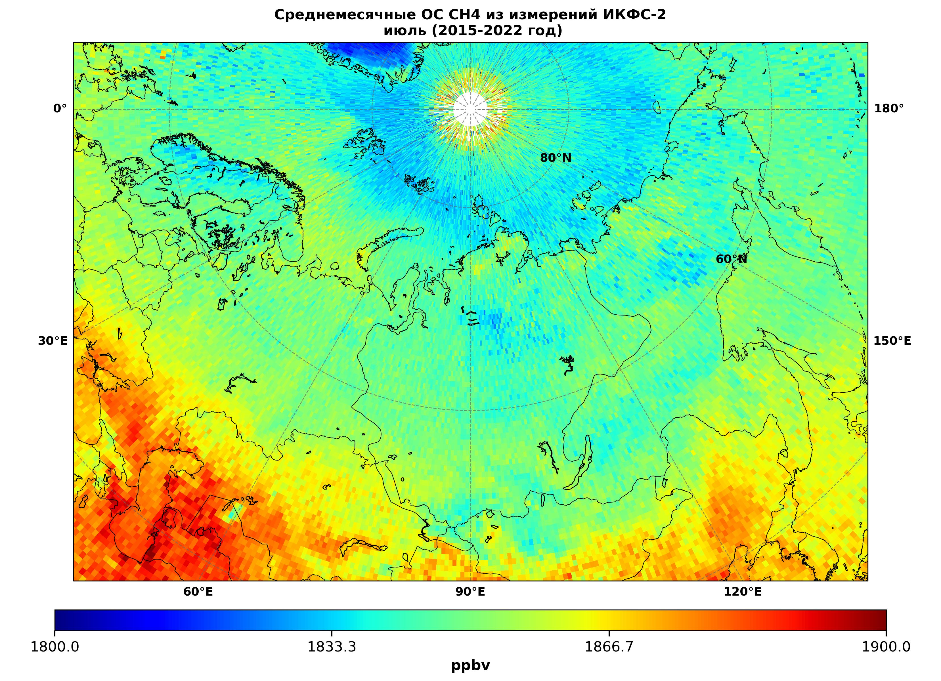
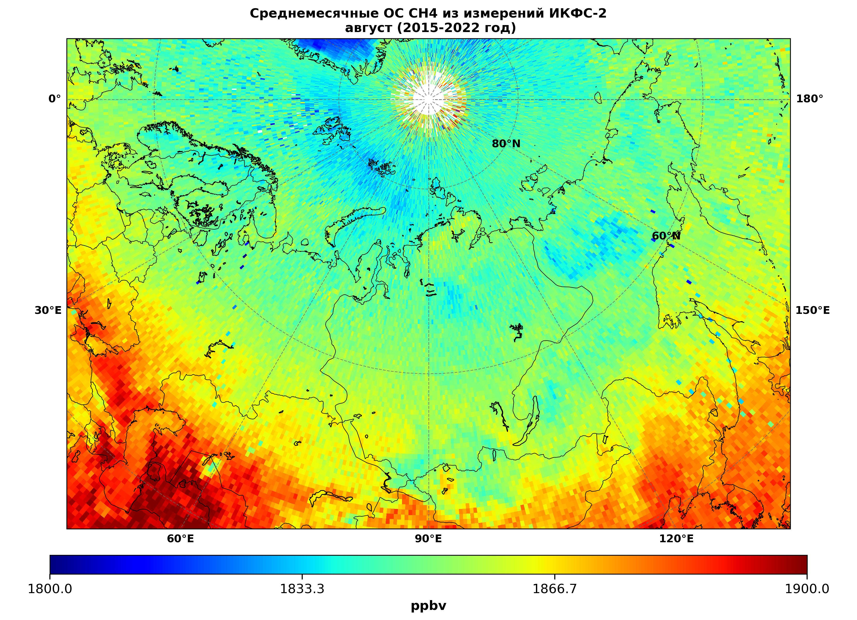
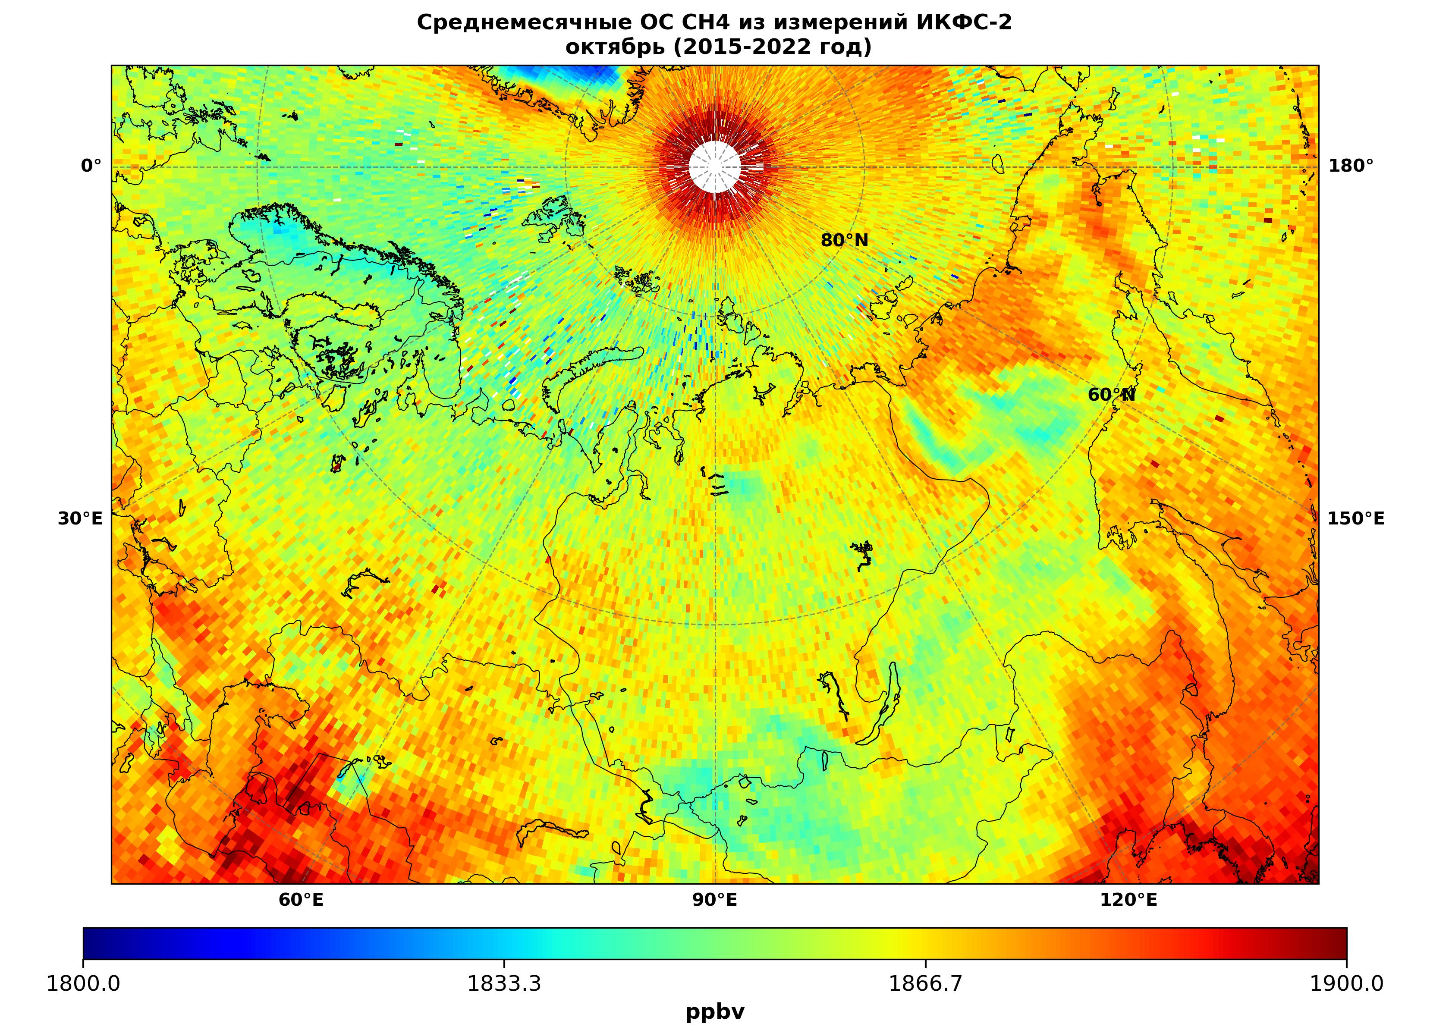
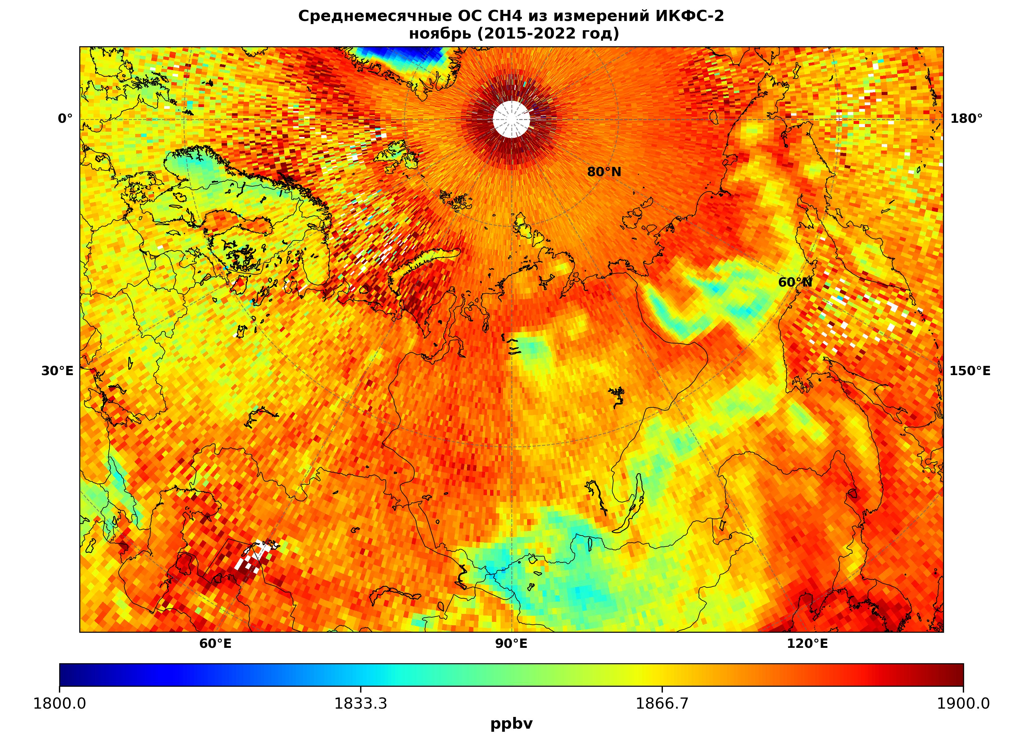
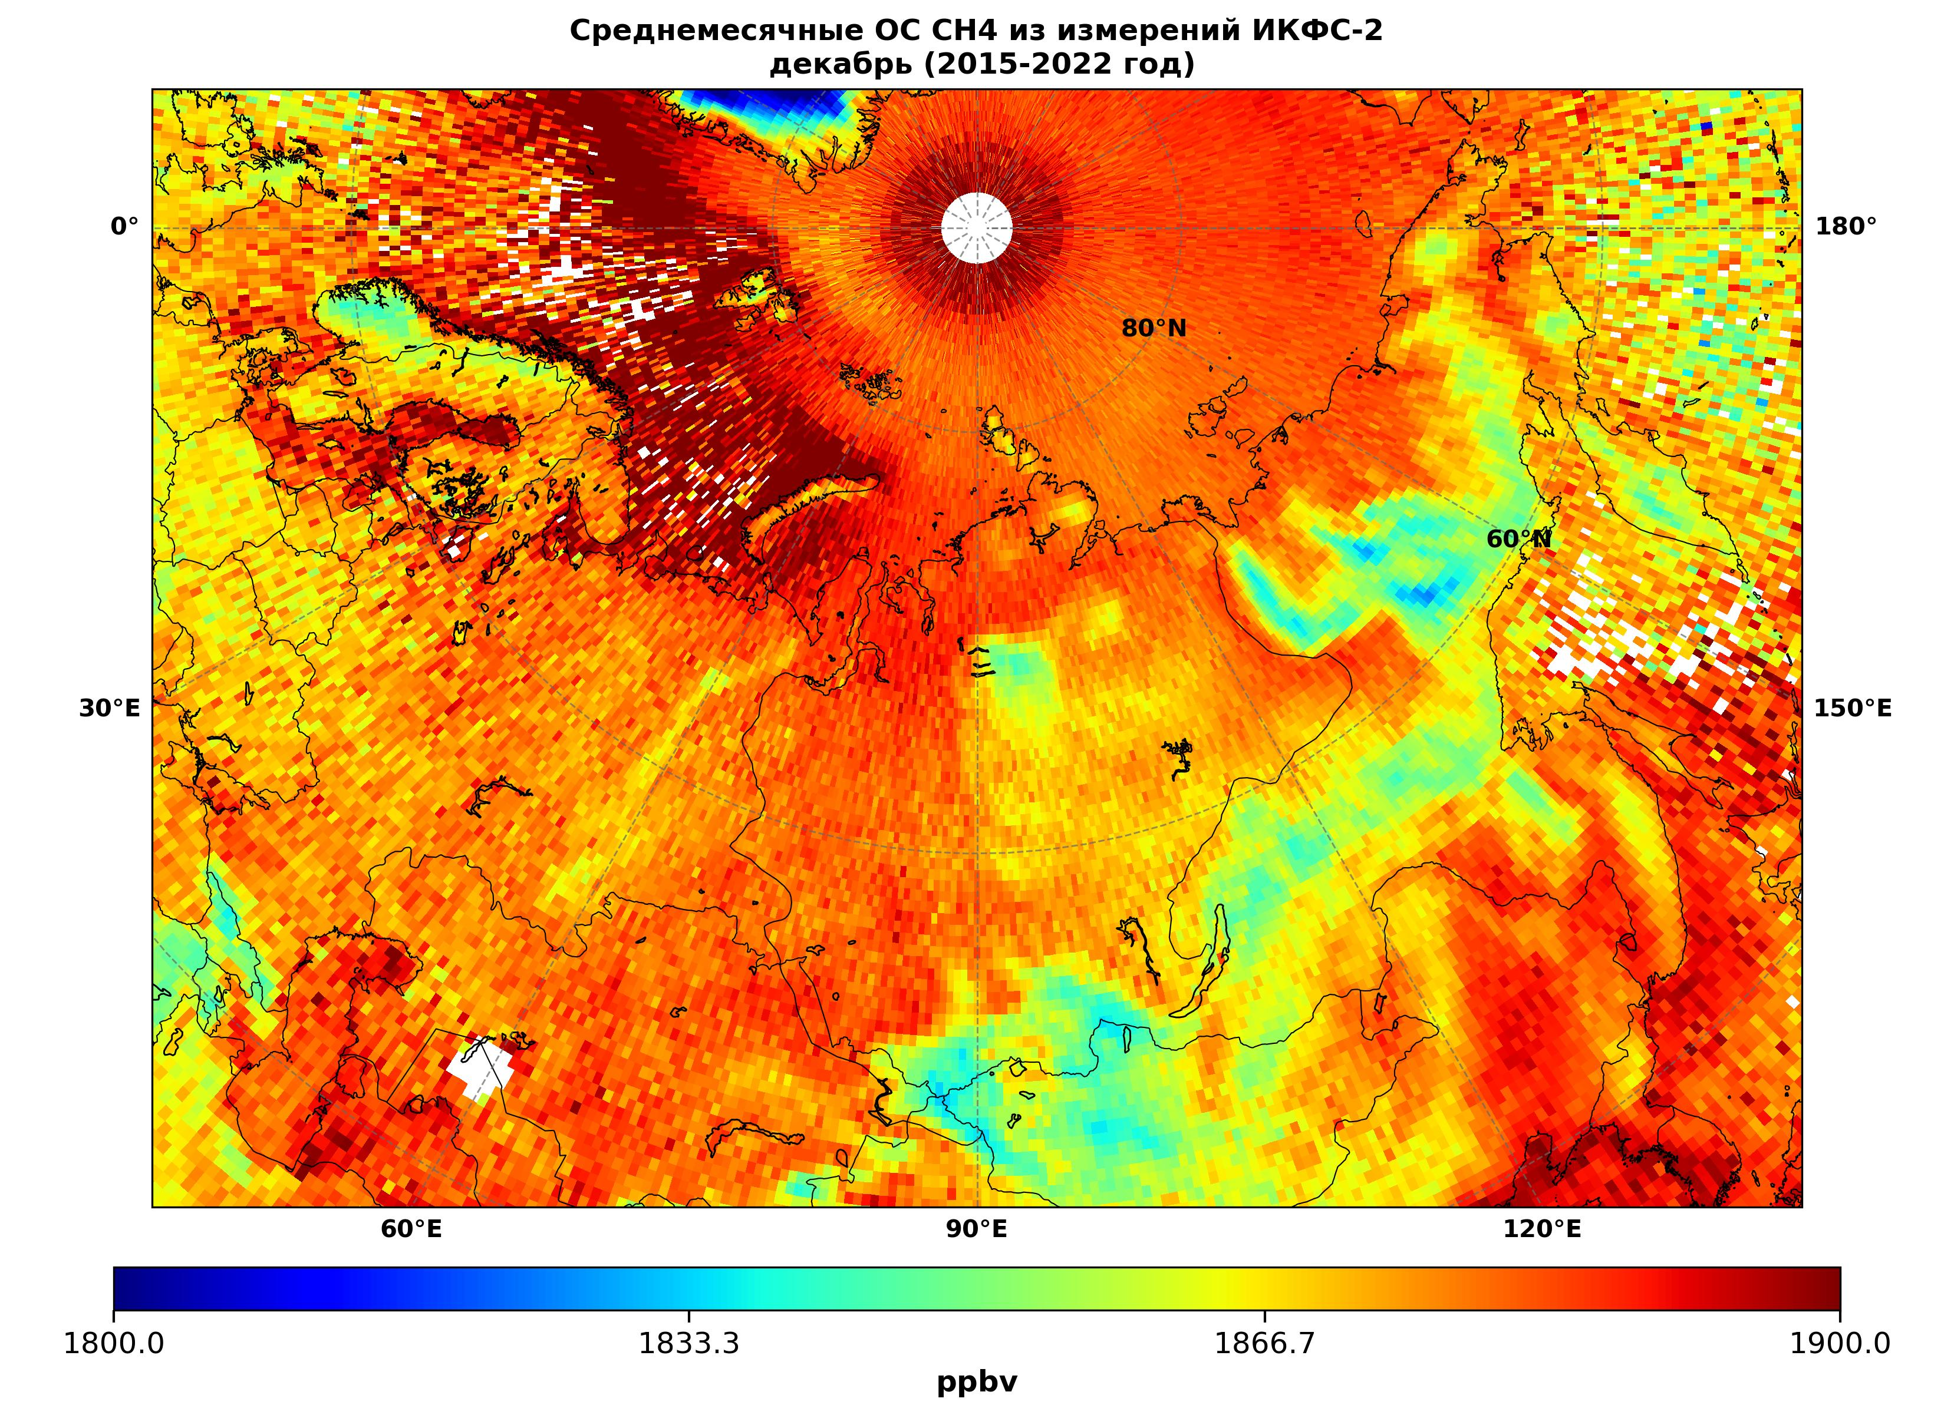
Atmospheric Methane Total Column Measurements from Meteor-M No. 2 Satellites
Based on Outgoing Thermal Infrared Spectra
Alexander Polyakov, Yulia Bordovskaya, Svetlana Akishina
St. Petersburg State University, St. Petersburg, Russia
Contacts: a.v.polyakov@spbu.ru | bordovskayay@gmail.com | s.akishina@spbu.ru
INTRODUCTION & AIM
INSTRUMENT & METHOD
Methane (CH₄) is the second most important greenhouse gas after carbon dioxide.
IKFS-2 design specifications [Golovin et al., 2014]
Microorganisms, animals, and forest fires produce methane naturally. Human activities, mainly agriculture, add further emissions. Methane now accumulates faster than the atmosphere removes it, which strengthens the greenhouse effect. Reactions with hydroxyl radicals (OH) and stratospheric oxidation remove about 90% of atmospheric methane.
Parameter | Specification
Spectral range | 5–15 µm (660–2000 cm⁻¹)
Unapodized spectral resolution | 0.4 cm⁻¹
Calibration uncertainty | 0.5 K
NESR, mW/(m² sr cm⁻¹) | 0.35 at 6 µm; 0.15 at 13 µm; 0.45 at 15 µm
Nadir spatial resolution | 35 km
Swath width | 1000–2500 km
Measurement interval | 0.6 s
Aim: retrieve atmospheric methane total columns from IKFS-2 thermal infrared spectra aboard Meteor-M No. 2 satellites and validate the retrievals against NDACC and TCCON ground-based observations.
Meteor-M #2
IKFS-2 measures outgoing thermal infrared radiation from the atmosphere and surface. It has operated on Russian Meteor-M No. 2 satellites since 2015. The Keldysh Research Center developed the instrument with the Krasnogorsk Plant and Bauman Moscow State Technical University.
Wavenumber, cm⁻¹
Example IKFS-2 the methane absorption band from HITRAN
Background source: carbonplatform.ru/parnikovye-gazy
Retrieval method
The method combines principal component analysis with an artificial neural network and follows the IKFS-2 ozone retrieval framework [Polyakov et al., 2023]. Inputs include spectral PCs for 660–1400 cm⁻¹ and the 1220–1370 cm⁻¹ methane band, plus satellite zenith angle, latitude, and surface pressure. TROPOMI/Sentinel-5P methane columns provide the training target [Veefkind et al., 2012].
RESULTS & DISCUSSION
ANN structure and inputs were optimized by varying spectral intervals, principal component counts, and auxiliary predictors. SA is satellite zenith angle, P0 is surface pressure, lat is latitude, dY is day of year, and HN is the number of hidden-layer neurons.
Validation against independent ground-based observations
NDACC: 20 stations and more than 107,000 matchups. Mean station differences ranged from −0.8% to 6.3%, with standard deviations of 1.1–5.7%. Both values fell below 3.5% after excluding Arrival and Harestua.
TCCON: 30 stations. Mean differences ranged from −0.8% to 4.0%, with standard deviations of 0.3–1.5%. Excluding Lauder and Réunion narrowed the mean differences to −0.8% to 2.5%.
The 50 km and 3 h collocation window and local elevation differences explain most discrepancies. Overall retrieval uncertainty is 1–1.5%.
No. | Predictors | HN | Coefficients | Epoch 100, ppb | Epoch 200, ppb
1 | SA+30+15 | 30 | 1441 | 25.5 | 25.5
2 | P0+SA+30+15 | 30 | 1471 | 24.6 | 24.6
3 | lat+SA+30+15 | 30 | 1471 | 24.34 | 24.32
4 | dY+SA+30+15 | 30 | 1471 | 25.19 | 25.14
5 | dY+P0+SA+30+15 | 30 | 1501 | 23.98 | 23.95
6 | dY+lat+SA+30+15 | 30 | 1501 | 24.45 | 24.42
7 | P0+lat+SA+30+15 | 30 | 1501 | 23.43 | 23.37
8 | dY+P0+lat+SA+30+15 | 30 | 1531 | 23.31 | 23.28
Monthly mean CH₄ total columns for 2015–2022, January to December from left to right and top to bottom
January
February
March
April
May
June
July
August
Lowest error: P0+lat+SA+30+15, 30 hidden neurons, 1501 coefficients, 23.43 ppb at epoch 100 and 23.37 ppb at epoch 200.
Two ANN implementations were tested. Keras trained faster and produced a more accurate approximation than the original implementation [Polyakov et al., 2023].
September
October
November
December
CONCLUSIONS
REFERENCES & ACKNOWLEDGMENTS
• The selected ANN uses 30 hidden neurons and 1501 coefficients. Inputs combine spectral PCs with surface pressure, latitude, and satellite zenith angle.
• Ground-based comparisons indicate 1–1.5% retrieval uncertainty.
• TCCON shows the strongest agreement, with mean differences of −0.8% to 2.5% after station filtering.
• Further work will improve collocation and terrain-height treatment.
1. Golovin, Y.M. et al. Spaceborne Infrared Fourier-Transform Spectrometers. Izv. Atmos. Ocean. Phys. 2014, 50, 1004–1015.
2. Polyakov, A. et al. Six Years of IKFS-2 Global Ozone Total Column Measurements. Remote Sens. 2023, 15, 2481. doi:10.3390/rs15092481.
3. Veefkind, J.P. et al. TROPOMI on the ESA Sentinel-5 Precursor. Remote Sens. Environ. 2012, 120, 70–83.
Acknowledgments: The authors thank the Planeta Research Center for open access to IKFS-2 spectra. St. Petersburg State University supported this work, project 124032000025-1.
https://sciforum.net/event/ECAS-8
Notes:
Scientific content translated and adapted from the supplied poster. Conference branding and layout follow the supplied ECAS-8 template. All numerical values and references are retained from the source poster.

