Slide 1
Strategies of futurization of aging, healthy lifestyle and psychological well-being in middle adults
Olga Strizhitskaya, D.Sc., professor

Slide 2

Acknowledgements
The study received financial support from Russian Scientific foundation (project 22-28-00869).
Participation in ISQOLS 2024 Annual Conference in Malaysia was supported by Saint-Petersburg University (PURE ID: 116856827).
2

Slide 3
Background
Over the last decades, increasing life expectancy and the related growth of the aging population have been seen as one of the greatest challenges of modern society.
Though life expectancy has been consistently growing, the quality of life of older adults has not directly followed this pattern.
Aging in Japan (according to The Japan Gerontological Society):
Today – 6515 individuals – 105-109 years, over 110 – 141 individual. Total: 6656
In 100 years: 840 000 children were born in 2020, half are supposed to love over 108 years. Total in 2120: 420 000 older adults aged 108+.
Thus, aging population of supercentenerians in Japan is forecasted to increase in 63 times.
3

Slide 4
Background
What we know?
Longevity, quality of life in aging, well-being and health (mental and physical) depend on a range of mechanisms:
  biological factors
  lifestyle strategies
  psychological mechanisms
  social environmental factors
Resources of aging could be modified, and they differ in terms of the degree to which they can be modified
4

Slide 5
Background
A. Sircova and her co-authors emphasize that though futurization might have different connotations, for psychological research, the definition remains unclear, and for their own research, the authors focused on futurization as “an element of present behavior modification in light of a future scenario”
Many factors and mechanisms that are associated with positive outcomes in aging operate in a passive form: they are formed due to circumstances, but not following one’s intention
Strizhitskaya O, Petrash M, Golubitskaya D, Kuzmina M, Krupina K, Shchukin A, Engelgardt E. Futurization of Aging: Subjective Beliefs and Effects. Behavioral Sciences. 2023; 13(1):4. https://doi.org/10.3390/bs13010004
5

Slide 6
Design
Participants: 134 adults aged 45 – 65 (67% females)
Methods:
  Psychological well-being scale (Zhukovskaya, Troshikhina, 2011);
  Questionnaire “Health-promoting lifestyle profile” (Petrash et al., 2018);
  Questionnaire “Strategies of construction of aging” (Strizhitskaya et al., 2024).
“Strategies of construction of aging” included four types of strategies:
  health strategies
  metacognitive strategies
  self-development strategies
  generative strategies.
Research question: Could strategies of futurization of aging be related to healthy lifestyle and affect psychological well-being?
Analysis: Hayes Process macro v.4 (Hayes 2018), model 6
6

Slide 7
Results
Healthy lifestyle
0,250
Psychological well-being
Self-development strategies
0,295
Generative strategies
0,015
1,183
-0,427
0,025
Healthy lifestyle
Psychological well-being
0,244
7

Slide 8
Conclusions
Associations between healthy lifestyle and psychological well-being are well-established
Health is considered as one of the key components of quality of life
Still, it’s effects could be mediated by different characteristics. In our study those characteristics were self-development and generative strategies. Overall the effects were quite small, still there is room for more analysis, particularly with regard to demographic characteristics
We expected mediation effects of lifestyle strategies on the associoation between healthy lifestyle and psychological well-being, but found no significant effects. This result suggest that healthy lifestyle as a behavior and as a futurization strategy might have different mechanisms that need further investigation.
8

Slide 9
Limitations
As this projects is the first attemt to study futurization of aging and operanalize the very idea of futurization of aging, it has a lot of limitations.
The strongest limitation – need for longitudinal study.
The far perspective – neuronal networks to forecast trajectory of aging and build individual programs of creating one’s aging.
9

Slide 10
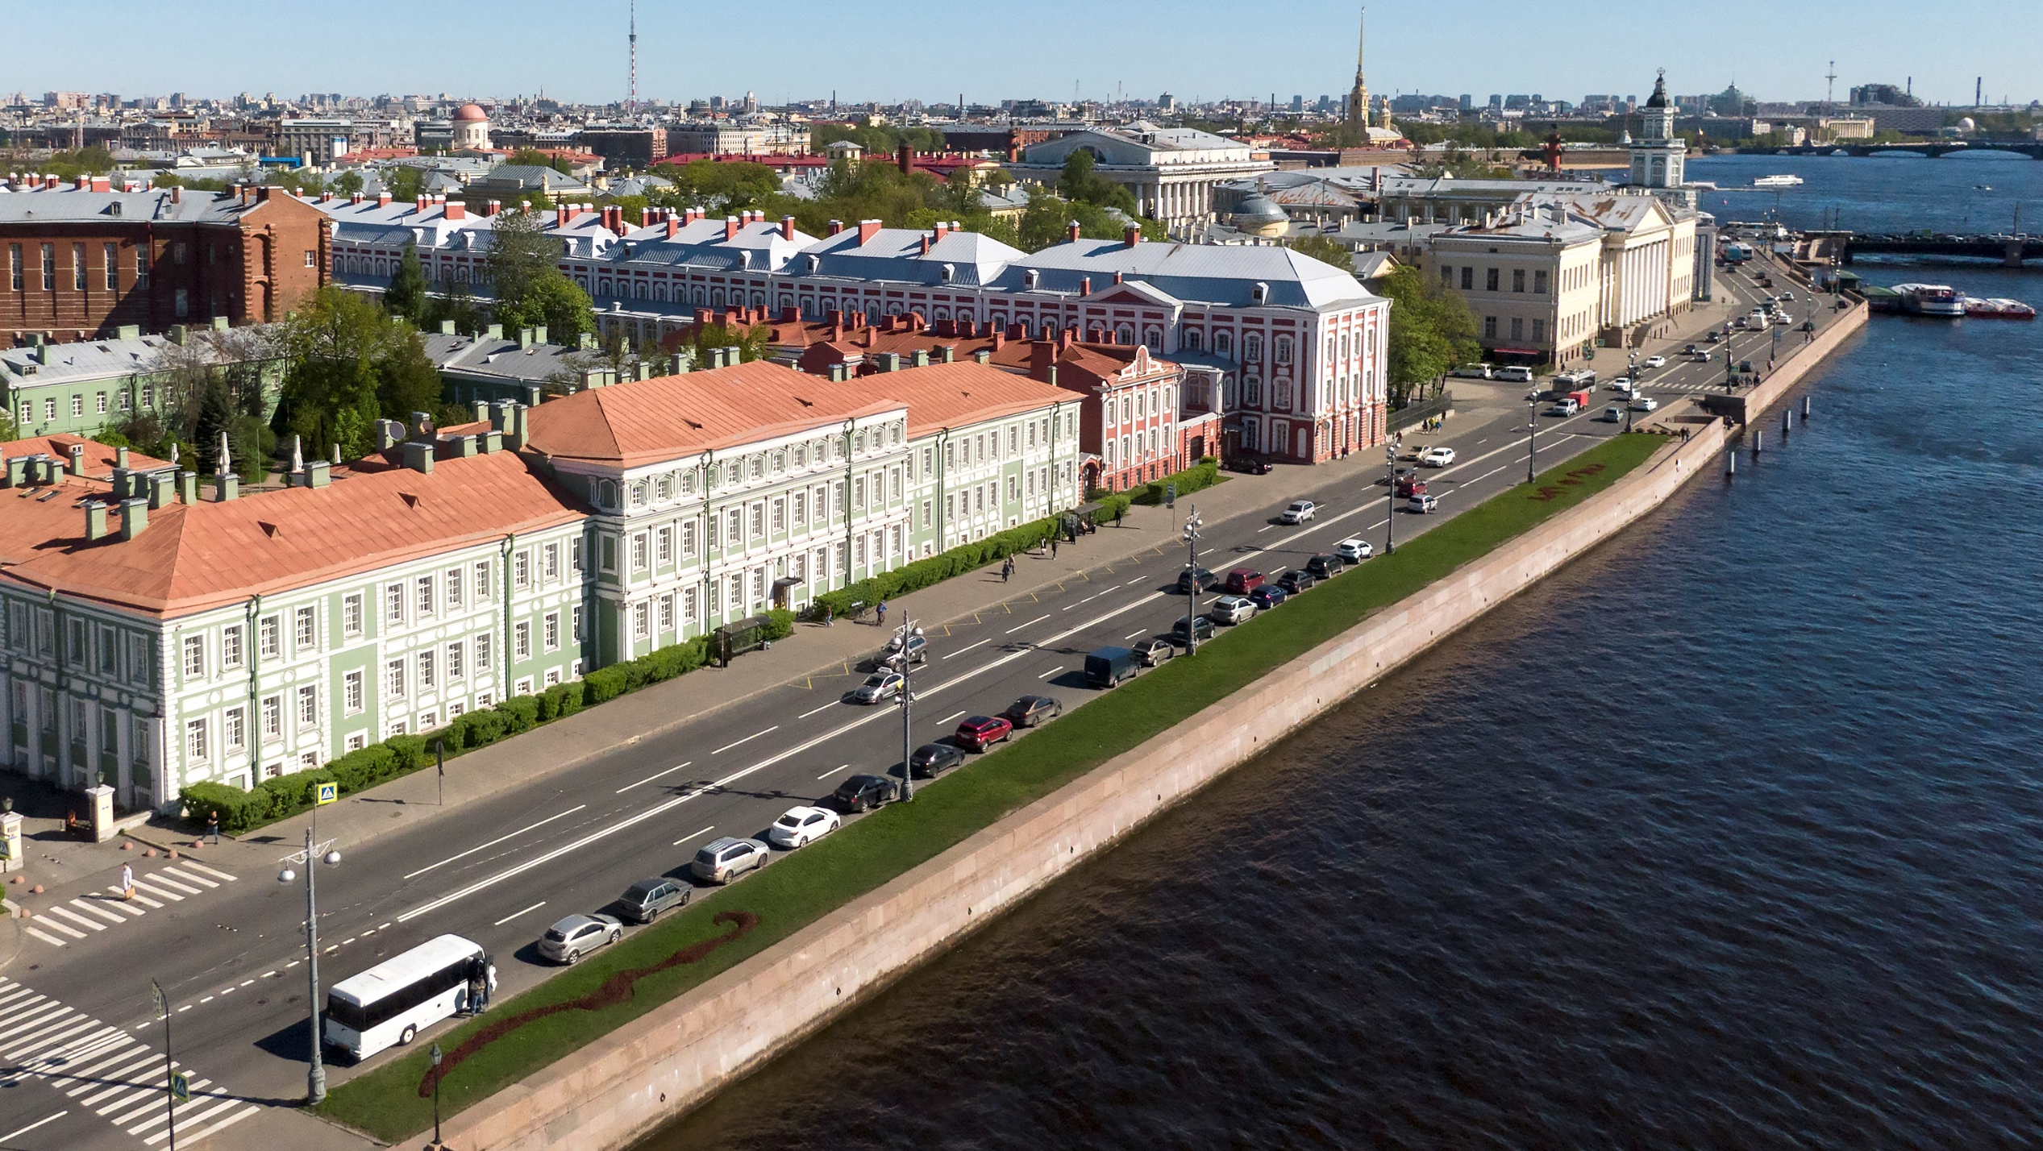
Thank you
mail: o.strizhitskaya@spbu.ru
10

