Slide 1

THE PROSPECTS FOR SINO-RUSSIAN COOPERATION ON THE DEVELOPMENT OF THE NORTHERN SEA ROUTE
ON THE ‘BLUE ECONOMY’ PRINCIPLES
Alexander Sergunin
St. Petersburg State University
The 13th China-Russia Arctic Workshop
Ocean University of China
Qingdao, China
October 23-25, 2024

Slide 2
Research agenda:
The objective of this paper is to examine potential areas of Sino-Russian cooperation on the modernization of the Northern Sea Route (NSR) based on the ‘blue economy’ principles.

Slide 3
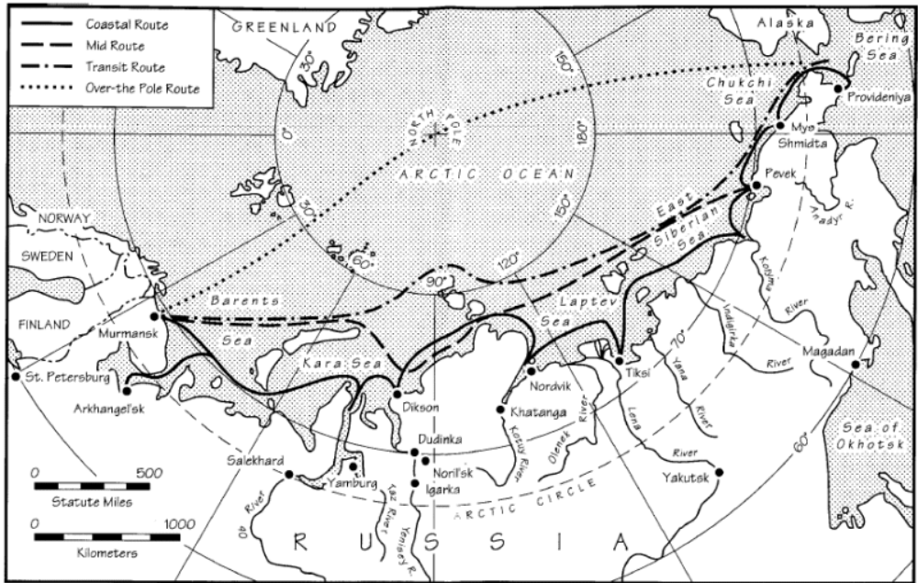
The Northern Sea Route

Slide 4
“Blue economy” definition
The term "blue economy" (BE) was first introduced in a report by German scientist Gunther Pauli to the Club of Rome (2009).
In the broadest sense, it refers to marine economic activities based on high environmental standards and the concept of sustainable development.
BE includes all sectors of the marine economy – fishing, shipping, shipbuilding, port infrastructure, aquaculture, marine tourism, mining, creation of artificial islands, laying pipelines and communication lines along the seabed, means of maritime navigation and much more.
The functioning of maritime transport corridors, which include the NSR, is also included in the BE concept.

Slide 5
In relation to the Northern Sea Route, two BE aspects are important:
The development of port infrastructure in accordance with this concept.
Ensuring the safety of navigation and reducing/preventing pollution of the marine environment (implementation of the IMO Polar Code of 2014-15).

Slide 6
The NSR port infrastructure
There are more than 20 large, medium and small ports along the NSR. Of these, the most important ports are Amderma, Anadyr, Baydaratskaya Bay, Dixon, Dudinka, Green Cape, Igarka, Cape Kamenny, Cape Schmidt, Novaya Zemlya, Pevek, Providence, Sabetta, Tiksi, Kharasaway, Khatanga and Egvekinot.
Some of them are situated on the Arctic Ocean’s coast, some are at the mouths of Siberian rivers or near them and the AZRF industrial centers.
Most of these ports were built in Soviet times. Ports such as Sabetta and the “Arctic Gate” have been built over the past decade. New ports are being built - terminal "Utrennee", "Bay North", coal terminal "Chaika", etc.

Slide 7
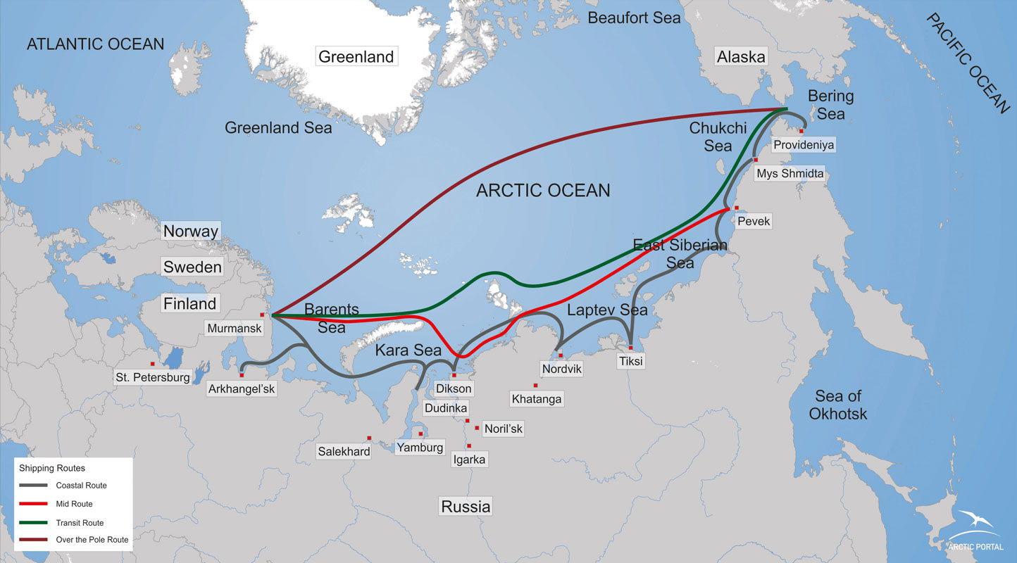

Slide 8
The NSR port infrastructure
The outdated Arctic port infrastructure is a serious barrier to the NSR’s integration into the world’s maritime transport system. Obviously, the old Arctic ports need reconstruction to create a world-class transport corridor in the High North.
The most recent NSR development plan (2022) suggests that 14 ports will be either modernized or build anew. The cost of this program is about 237 billion rubles.

Slide 9
The NSR port infrastructure
Unfortunately, the modernization plans for these ports aim more at increasing their efficiency (in particular, increasing their cargo turnover, receiving vessels of larger tonnage) than at complying with high international environmental standards. The only environmental problem that was mentioned in the 2022 NSR development strategy was pollution of atmospheric air and water areas during transshipment of dusty bulk cargo in the NSR ports.

Slide 10
The NSR cargo traffic, million tons (1933-2023 гг.).
1933 | 1943 | 1953 | 1963 | 1971 | 1981 | 1986 | 1991 | 1996 | 2006 | 2011 | 2013 | 2014 | 2015 | 2016 | 2017 | 2018 | 2019 | 2020 | 2021 | 2022 | 2023
130 | 289 | 505 | 1264 | 3032 | 5005 | 6455 | 4804 | 1800 | 1956 | 3111 | 3930 | 3982 | 5392 | 7265 | 10691 | 19700 | 31500 | 32970 | 34850 | 34034 | 36200

Slide 11
What should be done?
Make safer and environmentally cleaner the NSR ports and terminals dealing with dangerous and hazardous cargo such as crude oil, fuel, chemicals, coal, fertilizers, explosives, etc. The new ports have already been built in line with stricter safety and environmental standards, but old ports, such as Amderma, Anadyr, Dixon, Dudinka, Igarka, Pevek, Providence, Tiksi, Khatanga and Egvekinot badly need modernization. This is especially important for terminals that reload coal to ships travelling via the NSR.
Chinese expertise, technologies and investments are needed.

Slide 12
Towards a ‘smart Arctic port’?
The BE principles can be introduced to the port logistic system, including emission reduction schemes. The port logistics sector has a significant impact on global greenhouse gas emissions. In addition to greenhouse gases, the mobility and logistics sector also produces other emissions that are important parameters for making transportation more eco-friendly. These include noise, air pollutants, and particulate emissions. Opportunities to reduce emissions can be realized, for example, by increasing port transport efficiency, reducing transport volumes, optimizing routes, shifting transport to more environmentally friendly modes of transport, or using more energy-efficient vehicles.

Slide 13
Towards a ‘smart Arctic port’?
For example, the Hamburg Container Terminal Altenwerder (HCTA) model can be applicable to modernization of the NSR ports. HCTA uses 90 so-called automated guided vehicles (AGV) to move containers between the quay side and the yard. Until recently, AGVs were diesel-hydraulically and diesel-electrically driven. Since 2017, they started to use lithium-ion batteries. This technology has substantially reduced CO2 emissions, particulate matter, soot, nitrogen emissions and noise. These vehicles are refueled during off-peak hours to withdraw excess electric energy from the power grid. They also can feed energy back into the power grid as so-called primary control power. This is done to regulate load peaks in the power grid and make the network frequency stable. To implement this project, a number of charging stations was increased on the HCTA. A special control software to determine a number of AGVs required for container handling and optimize the charging strategies on the terminal was developed.

Slide 14
What should be done?
According to the BE concept, ‘smart ports’ should be supported by the environment-friendly coastal transport infrastructure. Currently, only four NSR ports are linked to Russia’s national transportation system via railways and 40% of Arctic ports are experiencing problems with the reception of large tonnage vessels. Many NSR ports are hardly accessible from the land because of their remote location: there are no railways or highways connecting them with the Russian urban and industrial centers located in ‘mainland’ Russia.

Slide 15
What should be done?
To solve this problem Moscow plans to build several railways that should connect major Arctic ports with the industrial centers of Ural and West and East Siberia. Among them the railways Belcomur (Arkhangelsk-Syktyvkar-Solikamsk (Perm)) that should connect the White Sea ports with Ural industrial centers, the Northern Latitudinal Railway in the Yamal-Nenets Autonomous District (Obskaya-Salekhard-Nadym-Novy Urengoy–Korotchaevo), Lavna-Vykhodnoe in the Murmansk Region, Siberian Meridian (connecting the AZRF ports with Asian harbors via Siberia).
Chinese investments and ‘blue technologies’ are welcome.

Slide 16
Polar Code requirements
Prohibition of any discharge into the sea of oil or oily mixtures from any ship travelling in Arctic waters.
For ships with large oil fuel capacity, all fuel tanks should be detached from the outer shell by a distance of not less than 0.76 meters.
For large tankers, the double bottom tanks are mandatory.
For most ships’ categories, all oily bilge water holding tanks and oil residue tanks shall be detached from the outer shell by a distance of not less than 0.76 meters.
Any discharge into the sea of noxious liquid substances, or mixtures having such substances, should not be allowed.
Discharges of sewage into the sea are not allowed with rare exceptions.
Some rules of discharge of garbage into polar waters were established.

Slide 17
2019 NSR Development Action Plan
Preparation of proposals for the mandatory use of the best available technologies to reduce pollution in the Arctic seas.
Preparation of proposals for the development of integrated monitoring of the Arctic lithosphere, biosphere, hydrosphere and atmosphere.
Creation of local monitoring systems to control pollution produced by loading and unloading operations in the NSR seaports.
Development of local observational meteorological networks in the Arctic seaports to provide hydrometeorological support for transport operations in the NSR waters.
Regular update of legal regulations aimed to prevent pollution from ships in line with the 1973 International Convention on the Prevention of Pollution from Ships (MARPOL 73/78) and the IMO’s Polar Code).

Slide 18
Russia’s Arctic Strategy-2035 (2020)
Encouraging shipping companies to use LNG and other kinds of light fuel for sea and river ships operating in the NSR waters and adjacent rivers.
Development of a state environmental monitoring system in the Russian Far North on the basis of cutting-edge information and communication technologies.
Based on the recommendations of the World Meteorological Organization, increasing the density of the observation network in the AZRF and improvement of the technical equipment of environmental monitoring systems.
Reduction of air and water emissions by the AZRF industries on the basis of the best available technologies.
Development of a unified state system to prevent and cope with emergency situations, including oil spills in the NSR water area.
Development of a network of SAR centers in the region.
Solving the problem of spent nuclear fuel and radioactive waste dumped in the Barents and Kara seas.

Slide 19
2022 NSR Development Action Plan
Establishing a state environmental monitoring system in the NSR water area.
Developing a long-term program for the removal of radioactive objects dumped in the Arctic seas.
Removal of six most dangerous sunken radioactive objects, including the nuclear submarines K-27 and B-159 with spent nuclear fuel aboard.
Organizing an environmental monitoring system to control air and water pollution caused by transshipment of dusty bulk cargo in the NSR ports.
Systemic monitoring and reducing environmental risks from cargo traffic along the NSR.

Slide 20
Potential venues for Sino-Russian cooperation in the Polar Code implementation:
Exchange of know-how between shipbuilders to construct new and refit existing Polar-class vessels in line with the PC’s safety and environmental requirements.
Training Chinese crews for navigation in icy waters.
Cooperation between national classification societies.

Slide 21
Sino-Russian cooperation on the Polar Code’s improvement
A new PC version should aim to radical reduction of shipping emissions. For example, many experts suggested that ships in the Arctic should use lighter and cleaner fuels such as LNG and distillates to reduce shipping emissions in the Arctic seas.
By the IMO’s recent decision a partial heavy fuel oil (HFO) ban was introduced in the Arctic since July 1, 2024 and a full ban by the end of the decade is planned. The new generation of oil and LNG tankers had already been used light fuel over several years.

Slide 22
The Polar Code’s improvement
Banning ballast and greywater discharge in the polar waters. The NSR operators together with private companies should build in the Arctic ports special facilities to receive, store and reprocess ballast and greywater.
Since the PC does not fully prevent disturbances of wildlife, the Code can include a requirement that vessels should avoid not only large marine mammals such as whales, walruses, narwals or polar bears but also the seabird colonies.
There are also should be measures in the PC to prevent the migration of invasive species to the Arctic Ocean and reduce underwater noise.

Slide 23
Conclusion
Currently, Russia has no a NSR development strategy based on the BE principles, which undoubtedly hinders the transition of this sea route to the path of sustainable development and reduction of environmental risks.
At the moment, Moscow is mainly concerned with two problems: (1) how to increase the NSR’s capacity and effectiveness and (2) how to ensure the further internationalization of the NSR with the aim to make it an important international transport corridor?
Therefore, the measures currently being taken by Russia to modernize its commercial fleet and the NSR port infrastructure are mainly technocratic in nature, aimed at increasing the NSR’s economic efficiency, and not at the environmental aspects of its functioning.

Slide 24
Conclusion
At the same time, a number of Russian legislative acts, conceptual documents and the NSR development plans contain elements of a BE strategy. This applies to measures to reduce shipping pollution and the risks of marine casualties and oil spills, as well as to modernize the NSR ports to reduce the anthropogenic load on the local environment and communities.
Generally speaking, there is a rather positive dynamics in Russian strategic thinking and planning: the BE concept is gradually taking root in this domain, including the further NSR development.

Slide 25
Conclusion
There is a high demand on China’s BE expertise in Russia because the PRC managed to develop the BE-type port infrastructure and partially convert its commercial fleet to light fuel.
If the BE principles are implemented in the NSR-related activities, this will become an important driver of sustainable development of the Russian northern regions and the entire Arctic.

