Slide 1



NMR studies of nanostructured ferroelectrics
Elena V. Charnaya¹, Nataliya I. Uskova^{1,2}, Denis Yu. Nefedov¹
¹ Physics Faculty, St.-Petersburg State University, St.-Petersburg, Russia
² Institute of Aerospace Instruments and Systems, St.-Petersburg State University of Aerospace Instrumentation, St.-Petersburg, Russia
In cooperation with:
Blagoveschensk State Pedagogical University, Blagoveschensk
Physics Department,
National Cheng Kung University, Tainan

Slide 2
Recently, many efforts were focused on designing nanocomposites with ferroelectric components.
The crucial problem, which stems upon exploring ferroelectric nanocomposites, concerns the persistence of ferroelectricity in small confined particles.
The phase transition temperatures change under nanoconfinement primarily owing to size effects. Interaction with the matrix environment, coupling between polar particles, the impact of strains and particle shape are also of great importance.
Two kinds of experiments: isolated particles and particles under nanoconfinement.
Ferroelectric nanocomposites consisting of polar particles embedded into non-ferroelectric matrices comprise a unique class of materials. They allow varying particle shape, size, interparticle distance etc.
We consider advantages of NMR in studying the impact of nanoconfinement on the ferroelectric transitions.

Slide 3
Table of contents
1. Porous matrices
2. KDP and DKDP
3. Organic ferroelectrics DIPAC, DIPAB, DIPAI
4. NaNO₂
5. Rochelle salt
6. Impact of coupling between nanoparticles

Slide 4
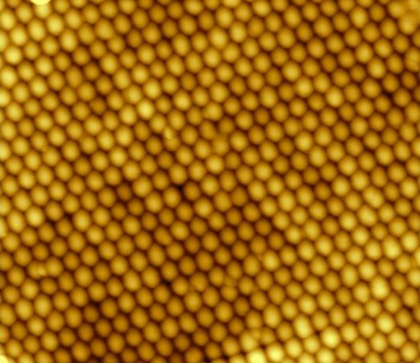
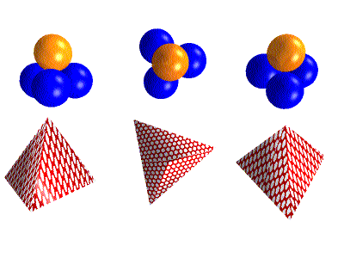
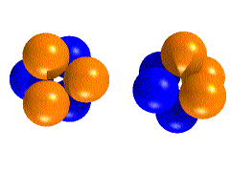
Porous matrices
Opals (photonic crystals)
Opal matrices or photonic crystals consist of close packed amorphous silica spheres.
Sphere radius R is of the order of 50 to 1000 nm
The ideal cubic packing has octahedral (0.414 R) and tetrahedral pores (0.225 R) between touched spheres.

Slide 5
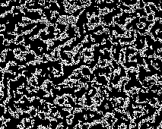
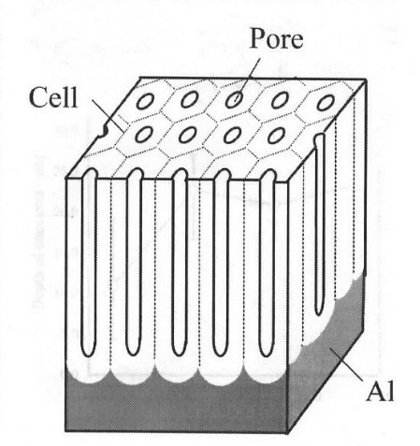
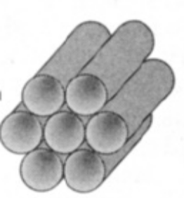
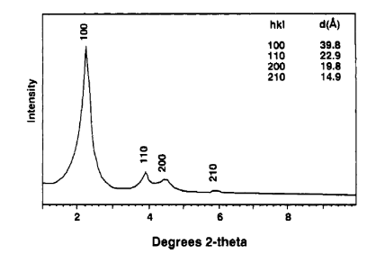
Porous glasses
Porous glasses are prepared from phase-separated soda borosilicate glasses with pore structure produced by acid leaching. The pore size varied from 2 to 200 nm.
The pore size for the glasses can be determined by mercury intrusion porosimetry and nitrogen adsorption.
Matrices with cylindrical pores
Porous alumina
Molecular sieves МСМ-41 and SBA-15.

Slide 6
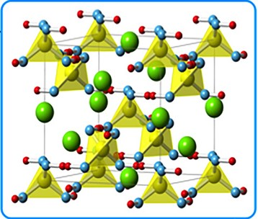
2. KDP and DKDP
At room temperature KDP (potassium dihydrogen phosphate KH₂PO₄) is in the paraelectric phase with a tetragonal symmetry
In the ferroelectric phase KDP has an orthorhombic symmetry
Experimental data for the phase transition temperature in confined KDP.
The experimental data were obtained by techniques sensitive to the macroscopic properties of nanocomposites averaged over their volumes (dielectric spectroscopy and heat capacity).
- Colla E.V. et al: Solid State Commun. 1997; 103: 127-130.
- Tarnavich V. et al: Optica Applicata. 2010; XL: 305-309.
- Ciżman A. et al: Phase Transitions. 2013; 86: 910-916.

Slide 7
Samples
crystalline powder of KDP
crystalline powders of B2 and B1
B2: deuteration was more than 95%
B1: deuteration was about 80%
opals loaded with B2 (O1) and with B1 (O2)
porous glass (7nm pore size) loaded with KDP
The ³¹P NMR and MAS NMR experiments were carried out.
³¹P nuclei have spin ½.
The NMR line position and lineshape are determined by the chemical shift.

Slide 8
The chemical shift tensor (CST) parameters in the Haeberlen notations are:
- the isotropic chemical shift
- anisotropy
- asymmetry
are principle components of CST
At room temperature KDP has a tetragonal symmetry, space group
In the ferroelectric phase KDP has an orthorhombic symmetry, space group
Fdd2
η ≠ 0

Slide 9
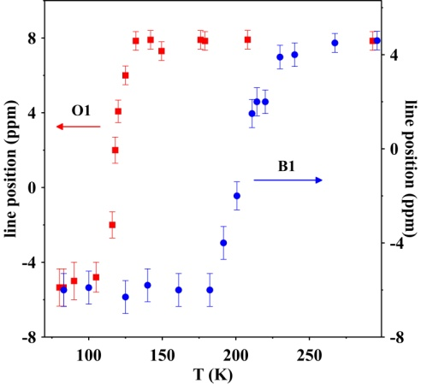
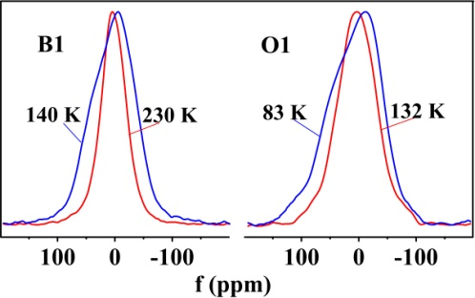
Changes of the ³¹P NMR lines for bulk B1 and O1 through the ferroelectric phase transition. | Temperature dependences of the static NMR line positions for O1 (squares, red, left axis) and B1 (circles, blue, right axis).

Slide 10
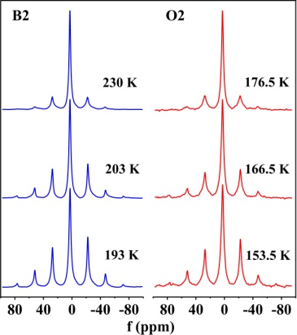
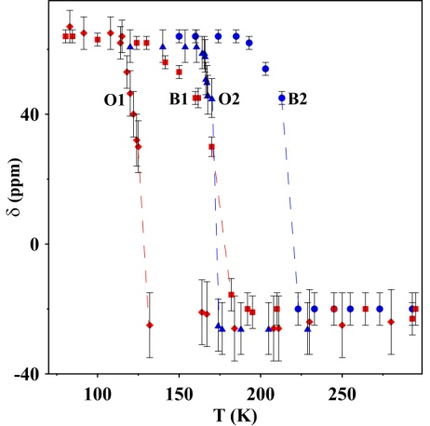
Temperature dependences of the anisotropy of the chemical shift tensor.
The ferroelectric phase transition shifts to low temperatures in the nanocomposites compared to the bulk counterparts. This result contradicts the previously reported shifts to high temperatures seen by dielectric methods and calorimetry.
NMR did not detect the ferroelectric phase transition down to 89 K for KDP within porous glass.
³¹P MAS NMR lines at temperatures shown in figures for bulk B2 and O2.
Similar studies were carried out for B1 and O1.
N. I. Uskova et al. Results in Physics 2021, 26, 104354
N. I. Uskova et al. Ferroelectrics 2017, 514, 50

Slide 11
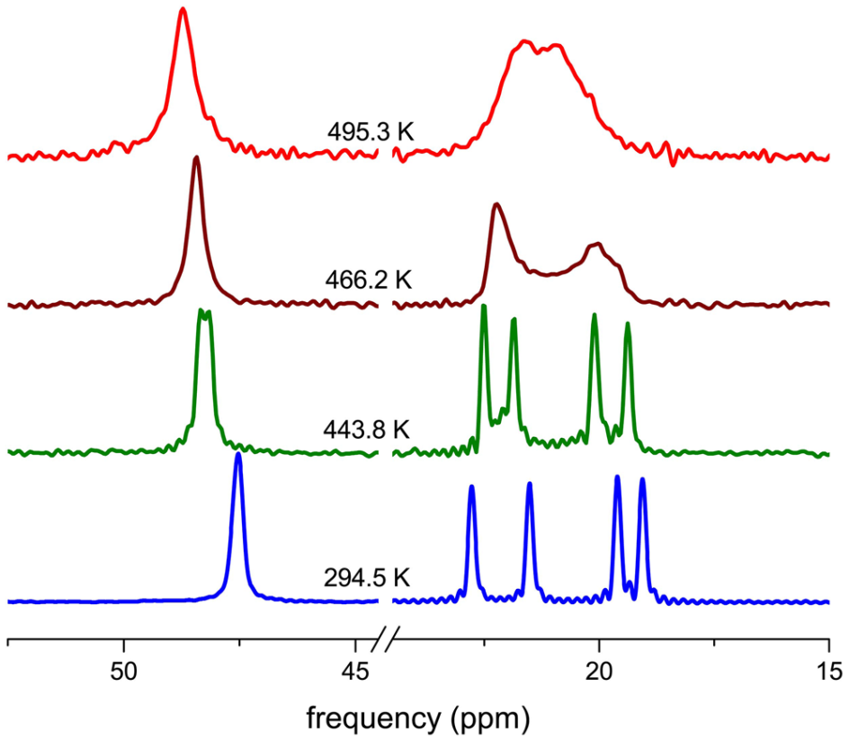
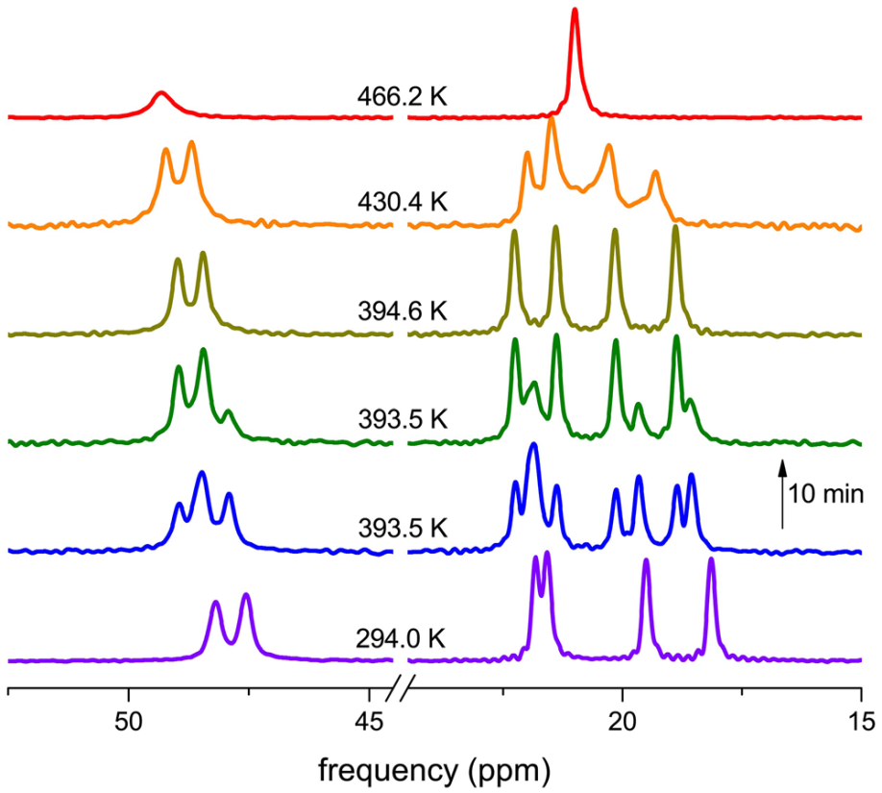
3. Molecular ferroelectrics: C6H16ClN (DIPAC), C6H12BrN (DIPAB), C6H16IN (DIPAI)
Bulk DIPAC
Bulk DIPAB
Evolution of the ¹³C CP MAS NMR spectra in DIPAC (left) and DIPAB (right) during heating.
N.I. Uskova, et al. Appl. Magn. Resonan. 51, 129 (2020).
N.I. Uskova, et al. J. Phys.: Condens. Matter 31, 505404 (2019).
N.I. Uskova, et al. Phys. Solid State 2020, 62, 1195.

Slide 12
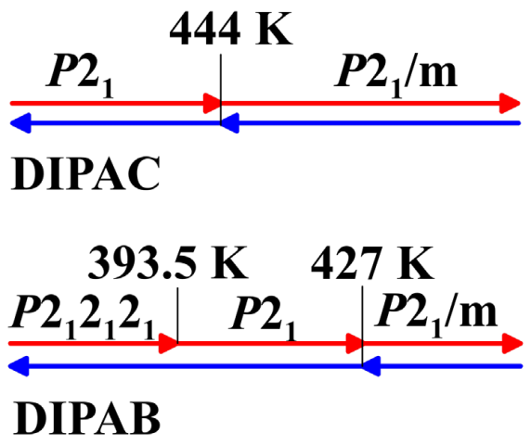
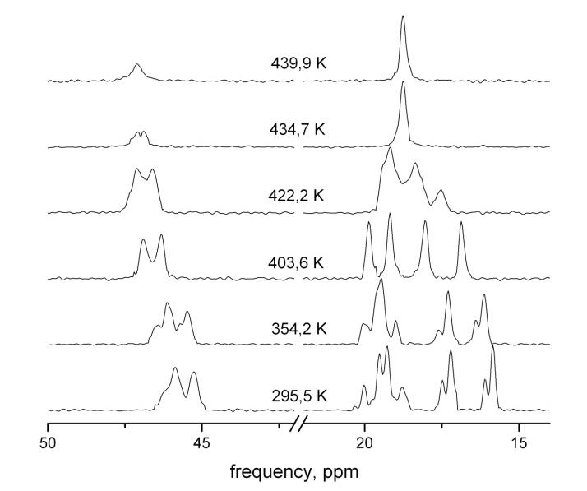
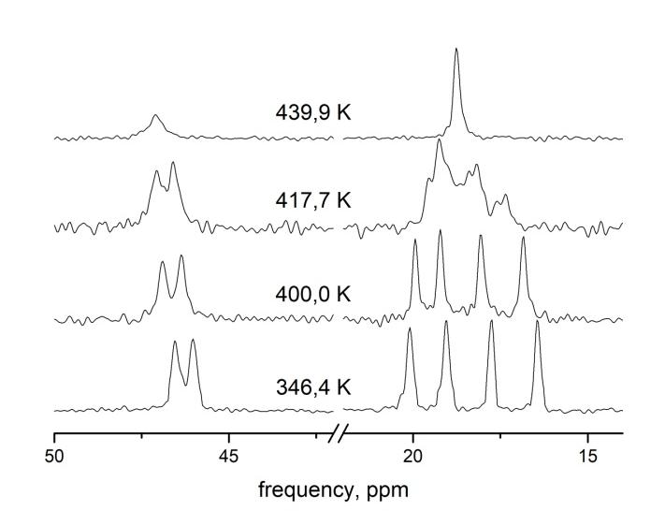
DIPAB confined to opal
Two phases coexist in a wide temperature range (P2₁2₁2₁ and P2₁) during the first heating, and under cooling the non-polar phase P2₁2₁2₁ disappears. The temperature of the ferroelectric phase transition (from P2₁ to P2₁/m) rises for about 8 K compared to the bulk sample.
Phase changes in DIPAC and DIPAB obtained by NMR.
first heating
cooling

Slide 13
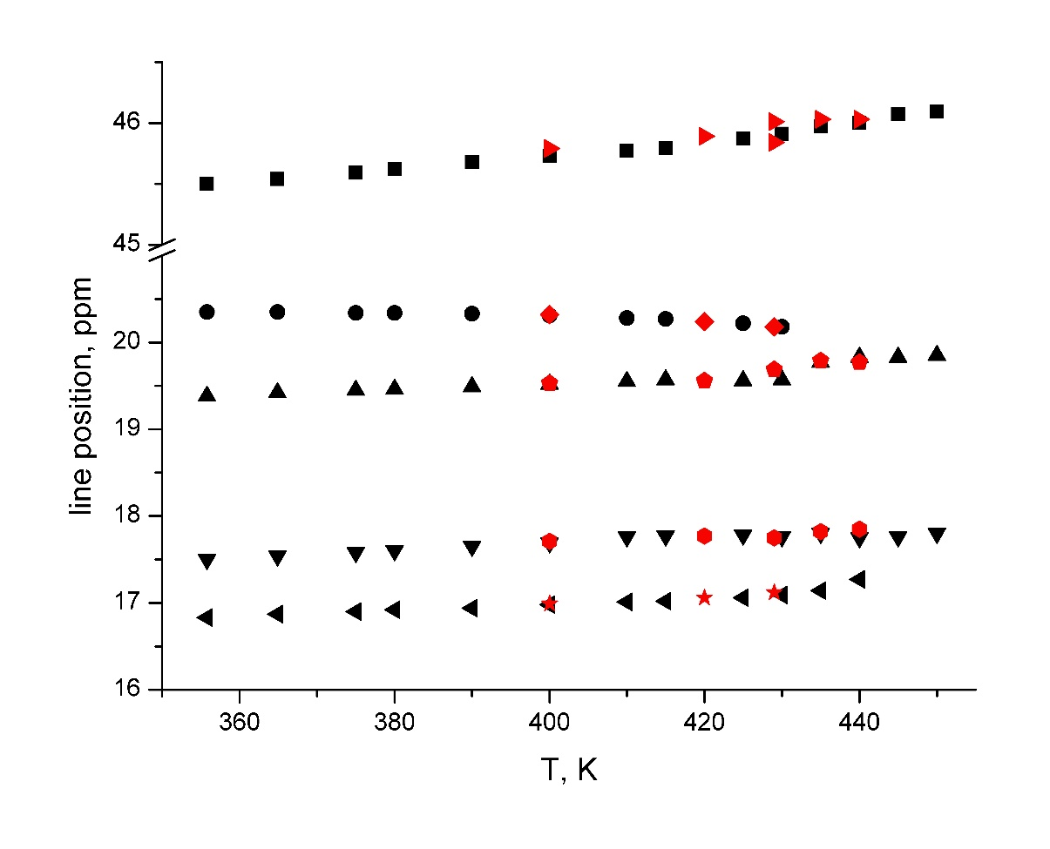
DIPAC in opal
Phase transition temperature was reduced compared to bulk

Slide 14
4. NaNO₂ particles embedded into molecular sieves MCM-41 and SBA-15 and into porous alumina
Spin-lattice relaxation measurements: ²³Na magnetization recovery after inversion.
Two phases of confined sodium nitrite: bulk-like one and one with high atomic mobility
C. Tien et al, Phys. Status Solidi b, 2009, 246, 2346
C. Tien et al, Ferroelectrics, 2008, 366, 74
C. Tien, et al, Phys. Rev. B 72, 104105 (2005).
MCM-41 and SBA-15

Slide 15
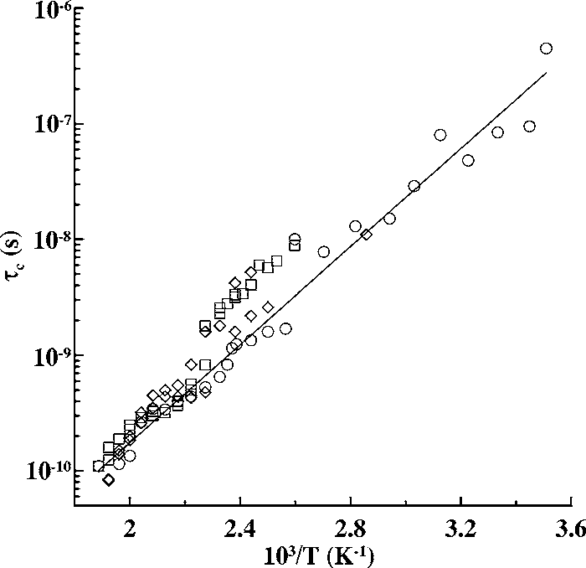
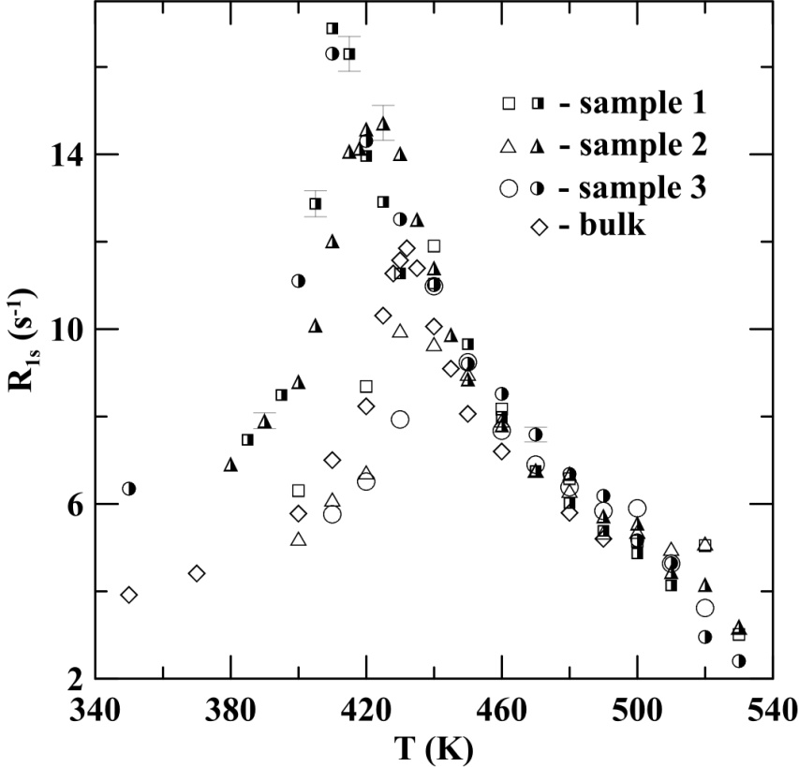

Slide 16
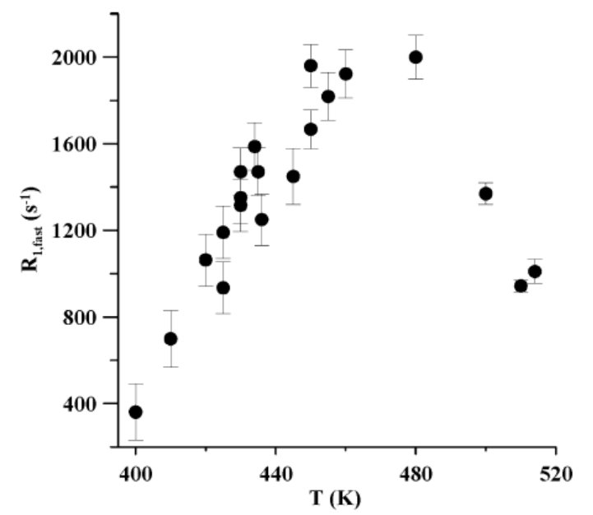
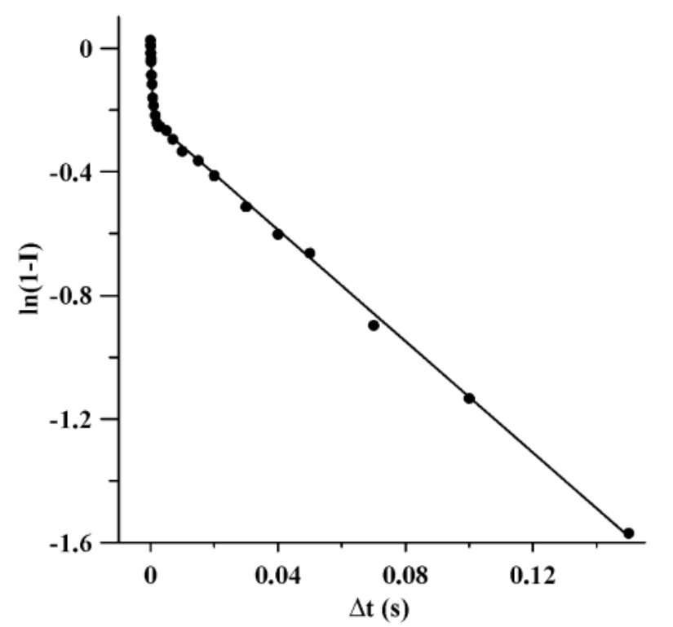
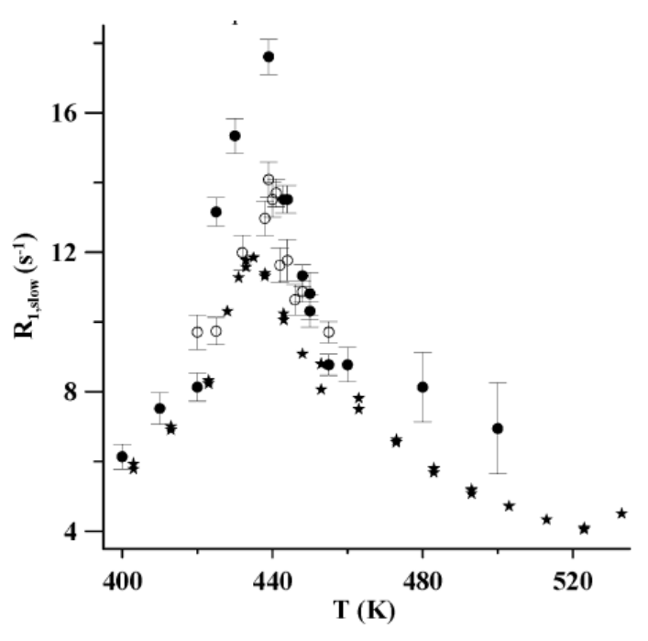
NaNO2 within porous alumina

Slide 17
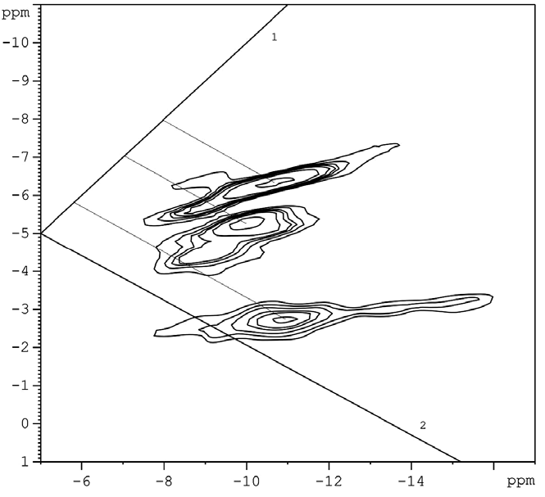
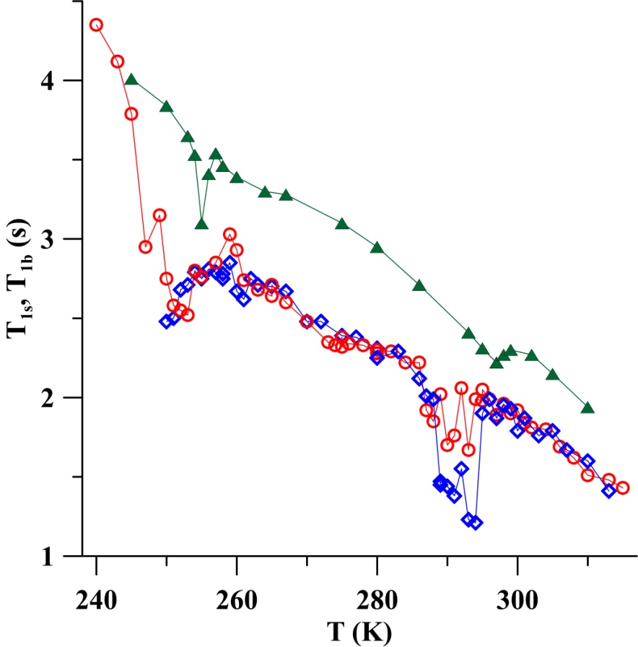
5. Rochelle salt, NaKC₄H₄O₆·4H₂O
Two transitions at 297 K and at 255 K in bulk
MCM-41 and SBA-16 molecular sieves
²³Na MQ MAS spectrum
for the sample with 37 °A pores,
evidence for additional structures.
²³Na relaxation time
MCM-41 with 26 °A pores (circles and diamonds) and in bulk Rochelle salt (triangles).
C. Tien et al, J. Phys.: Cond. Matter 20, 215205 (2008)

Slide 18
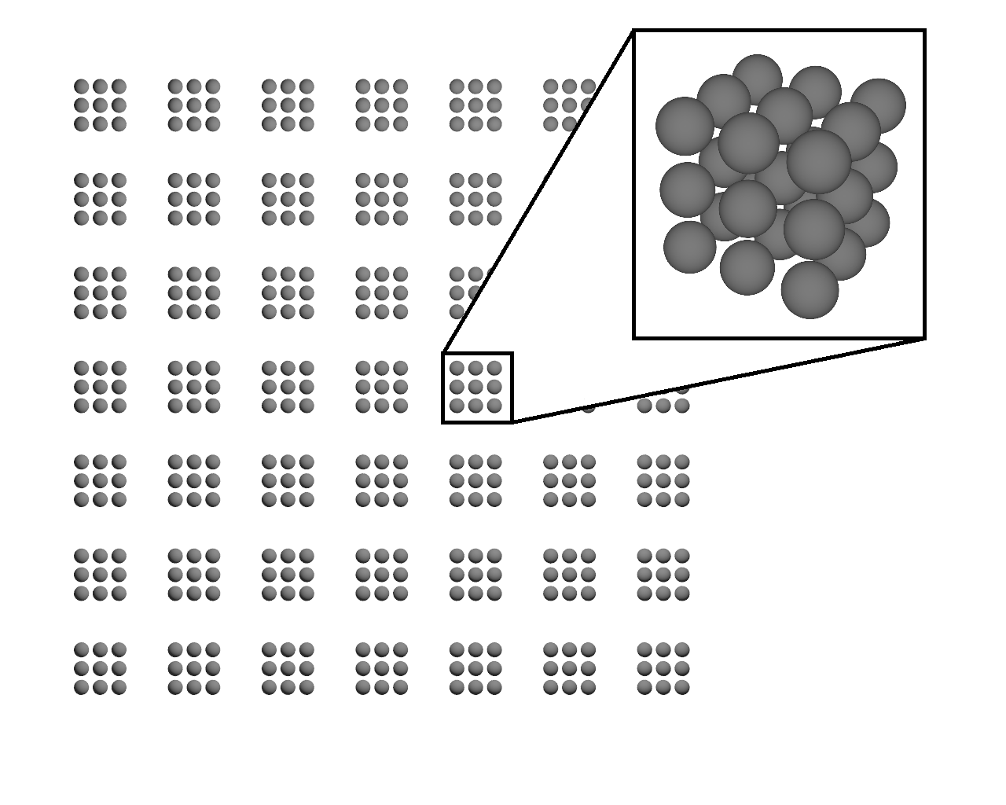
6. Impact of coupling between nanoparticles
The main difference between isolated particles and particles, which are components of nanocomposites (nanoceramics and loaded nanoporous matrices), arises due to coupling between adjacent small particles and with the matrix.
We used two approaches to treat the ferroelectric phase transition in a system of linked nanoparticles: phenomenological Landau theory and Ising model.
Cubic lattice of particles consisted of n=27 cubic cells
Dependence of the relative phase transition temperature in a tetragonal array of particles without tunneling on a/a' and c/a for different G.
A.V. Uskov, et al, Ferroelectrics, 2015, 482, 70
E.V. Charnaya et al, Ferroelectrics, 2007, 350, 75
A.L. Pirozerskii et al, Phys. Solid State 52, 620 (2010)

Slide 19
Thank you for your attention

