Slide 1


МЕТОДИКИ ИЗМЕРЕНИЯ АТМОСФЕРНОГО ОЗОНА
С БОРТА КА «МЕТЕОР М» №2
Поляков А.В^{.1}, Крюковских Е.П. ¹, Виролайнен ЯА. ¹, Акишина С.В. ¹, Неробелов Г.М.^{1,2,3,}
1) Санкт-Петербургский государственный университет, Санкт-Петербург, Россия),
2) Российский государственный гидрометеорологический университет, Санкт-Петербург, Россия;
3) НИЦ экологической безопасности РАН, Санкт-Петербург, Россия)
Techniques of atmospheric ozone determination from “Meteor M “ N2 satellite
Alexander Polyakov, Kate Kriukovskikh, Svetlana Akishina, Yana Virolainen, George Nerobelov

Slide 2
Outline
The role of atmospheric ozone,
Methods for ozone observations
IKFS-2 instrument aboard the “Meteor M N2” satellites series
4. Description of the technique and results of the ANN training
5. Validation of TOC retrieval, by comparison with:
  Ground-based and Satellite measurements data
  Ozonosonde data
6. Validation of TrOC retrieval, by comparison with NDACC data
7. Examples of the retrieved ozone distribution
8. Conclusions

Slide 3
The role of atmospheric ozone
Ozone plays a crucial role in climate formation, and it shields life on Earth from harmful UV radiation. Ozone in the troposphere is a pollutant and greenhouse gas. Therefore, it is essential to monitor both total and tropospheric ozone columns.
The global ozone monitoring system includes remote, ground-based, and local methods. Only satellite methods can be used to monitor the global distribution of ozone.
Satellite methods that use the measurements of outgoing thermal radiation provides information on ozone not depending on solar illumination.
We present the techniques for deriving information on total ozone columns (TOCs) and tropospheric ozone columns (TrOCs) from spectra of outgoing thermal radiation measured by the IKFS-2 instrument aboard the “Meteor-M” No. 2 satellite, which are based on the artificial neural network (ANN) approach and the principal component (PC) analysis.

Slide 4
Methods for measuring the atmospheric ozone content
In situ: near surface, aircraft, balloon (ozonesondes)
Remote
  Ground – based (local)
1. Direct Solar Radiation: IR,UV, VID, FTIR;
Dobson and Brewer instruments – «reference standard»
2. Scattered solar radiation UV, VID, NIR
3. Scattered solar radiation at low Sun (Umkehr)
4. Microwave thermal radiation
5. Lidars
2. Satellite (global)
    Scattered-reflected solar radiation (OMI, TROPOMI)
    Transmittance - Solar occultation (ACE-FTS), stars occultation
    Outgoing thermal IR radiation (IASI, CrIS, IKFS-2 etc)
    Microwave radiation (limb - MLS)
    Measurements of emissions in UV, VIS and NIR regions of the spectrum

Slide 5
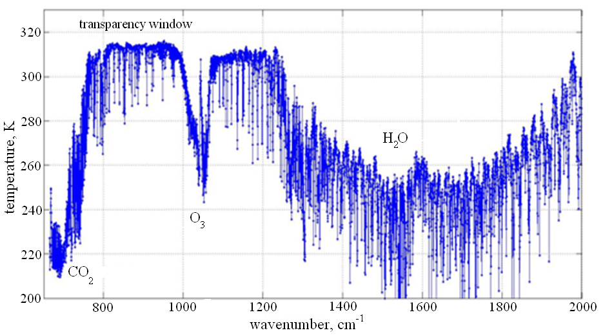
IKFS-2 instrument
The IKFS-2 spaceborne infrared Fourier-transform spectrometer measures outgoing infrared radiance and provides data on the atmosphere for numerical weather prediction and various applications in the field of atmospheric and climate sciences.
IKFS-2 is one of the key instruments of the Meteor-M №2 satellite. The instrument was developed by the Keldysh Research Center together with Krasnogorsky zavod and Bauman State Technical University (Moscow).
parameter | requirement
spectral range | 5-15 μm
spectral resolution | 0.4 cm⁻¹
calibration error, no more than | 0.5 К
NESR, [W⋅m⁻² sr⁻¹cm] | 3.5·10⁻⁴ , λ = 6 μm 1.5·10⁻⁴ , λ = 13 μm 4.5·10⁻⁴ , λ = 15 μm
spatial resolution at sub-satellite point | 35 km
swath width | 1000…2500 km
sampling period | 0.6 s

Slide 6
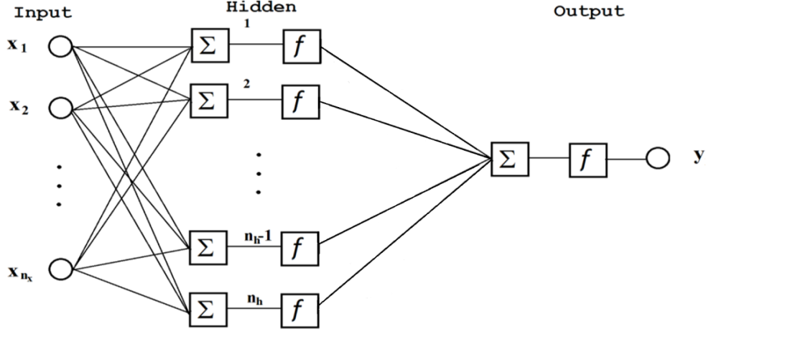
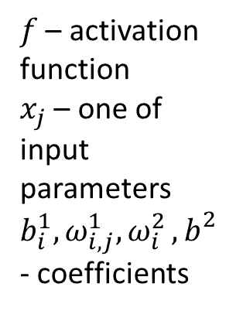
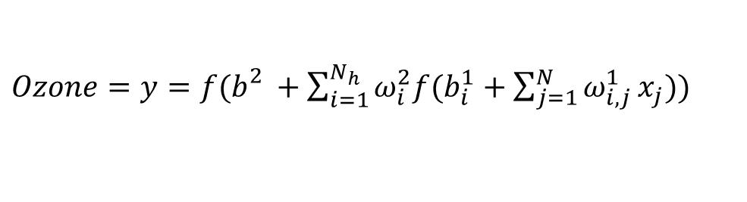
Ozone retrieval technique
$f$ – activation function
$x_{j}$ – one of input parameters
${b_{i}^{1}, ω}_{i,j}^{1}{, ω}_{i}^{2}{, b}_{}^{2}$ - coefficients
Artificial neural network (ANN) is a three-layer perceptron. Activation function is logistic.
$Ozone=y=f(b_{}^{2}+\sum_{i=1}^{N_{h}}{ω_{i}^{2}f(b_{i}^{1}+\sum_{j=1}^{N}{ω_{i,j}^{1}}x_{j}))}$
(1)

Slide 7
Description of the retrieval technique and procedure
Algorithm for constructing the solution operator
Preparation of data for the training sample
  Preparation of IKFS-2 spectral measurements (233, 673, 330 spectra from 2015 to December 2022 - all data with a swath width 1000 and 1500 km)
  Calculation of the average spectrum, covariance matrices, EOF.
  Preparation of ozone data, OMI data for TOC and ozonesonde data for TrOC
2. Building a training sample
1. Measurement pair matching,
2. Calculation of the PC and assembly of the training data sets
3. ANN training (expression (1) minimization)
4. Testing of various ANNs (different number of PCs, number of hidden layer neurons (NHLN), inclusion of latitudinal-seasonal parameters in predictors)
5. Validation

Slide 8
Results of the ANN training
Training for TOCs:
Training set was based on the OMI level 2 data.
Selection conditions: 70 km, 5 hours with OMI –>
20, 262, 148 pairs of the IKFS-2 spectra and OMI TOCs were selected.
Optimal predictors set: Satellite Zenith Angle, Day of the year, 50 PCs of ozone absorption band, 25 PCs of the whole measured spectrum, 40 NHLN.
approximation error calculated with the whole (100%) data set equals 8.8 DU
Training for TrOCs:
Training set was based on the HEGIFTOM ozonosonde data collection.
Selection conditions: 200km, 24 hours with ozonosondes –>
561, 625 pairs of IKFS-2 spectra and ozonosonde data were selected.
Optimal predictors set:
Satellite Zenith Angle, Day of year, 35 PC of whole measured spectrum, and 55 NHLN.
Training results: approximation error calculated with the whole (100%) data set equals
2.7 DU and 3.7 DU for layers lower 400 and 300 hPa

Slide 9
Validation of the IKFS-2 TOC retrieval by comparison with ground-based and satellite measurements
Satellite data |  | Ground-based data
TROPOMI, QF>0.9, TOCs >100 and TOCs < 650 DU |  | Dobson and Brewer, Direct Sun
6 hours, 35 km |  | 1 hour, 70 km
May 2018-Dec 2022 |  | March 2015 – Dec 2022
Bias, % | SDD, % | Bias, % | SDD, %
-2.22 | 2.73 | -0.41 | 2.67

Slide 10
Comparison of IKFS-2 TOC with ozone sounding data (100km, 24 hours)
станция | Широта, градусы | Озонозонды |  | ИКФС-2 |  | Разности абс. |  | Разности отн.
 |  | среднее | STD | среднее | STD | Δ, DU | Ϭ, DU | Δ, % | Ϭ, %
Alert | 82.5 | 336.3 | 58.1 | 342.1 | 63.3 | 5.8 | 31.7 | 2.0 | 10.8
Eureka | 79.99 | 365.7 | 81.4 | 372.8 | 91.4 | 7.1 | 32.9 | 1.7 | 8.8
Ny-Alesund | 78.93 | 342.6 | 65.6 | 336.7 | 66.36 | -5.9 | 26.1 | -1.6 | 7.2
Resolute | 74.71 | Мало данных
Scoresbysund | 70.48 | 331.5 | 55.9 | 339.8 | 52.7 | 8.3 | 27.3 | 3.0 | 8.0
Sodankyla | 67.36 | 340.0 | 61.9 | 335.8 | 58.2 | -4.2 | 26.2 | -0.7 | 9.0
Lerwiсk | 60.13 | 326.9 | 49.5 | 327.8 | 46.8 | 0.8 | 25.0 | 0.6 | 7.6
UCCLE | 50.48 | 321.2 | 44.3 | 318.9 | 40.3 | -2.3 | 23.7 | -0.3 | 7.3
Madrid | 40.47 | 313.4 | 34.2 | 309.5 | 33.1 | -3.9 | 17.2 | -1.1 | 5.3
Hohenpeisen | 47.8 | 299.0 | 33.7 | 318.8 | 33.4 | 19.8 | 19.4 | 6.9 | 6.8
Costa Rica | 9.980 | неадекватные данные (около 200 DU, тропики)
Ascension Is. | -7.970 | неадекватные данные (много менее 200 DU, тропики)
South Pole station not captured by IKFS-2 scan, minimum distance 150km

Slide 11
Validation of the IKFS-2 TOCs by comparison with ozonosonde data
Ozonosonde data: HEGIFTOM homogenized data
1 hour and 70 km distance (for South Pole 200 km distance)
March 2015 - Dec 2022 (for South Pole 2021-2022)
Single stations
Bias, % | SDD, %
-1.6 – 6.9 | 5.3 – 11
mean
Bias, % | SDD, %
1.2 | 7.9
The differences are consistent with the uncertainty of the TOC retrievals obtained from the ozone sounding data.
Specific conditions of comparison for the South Pole stations are caused by the Meteor-M N2 satellite orbit and the swath width of IKFS-2

Slide 12
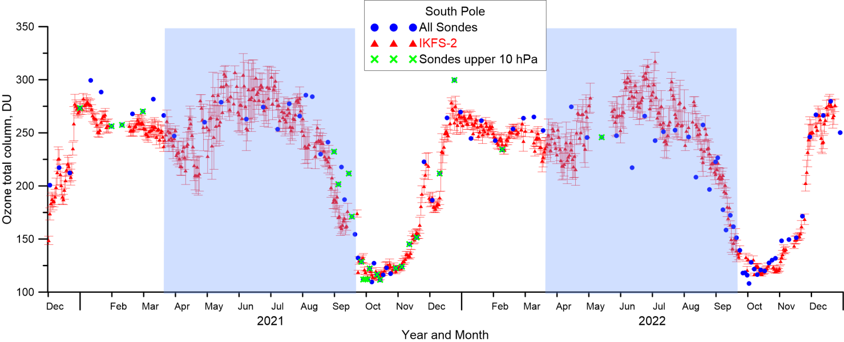
TOC from data of South Pole station and mean daily iKFS-2 TOС in a circle with a radius of 200 km. The vertical red lines show the standard deviation of TOC values during a day. The color indicates the periods of polar night.

Slide 13
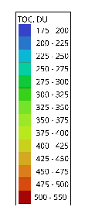
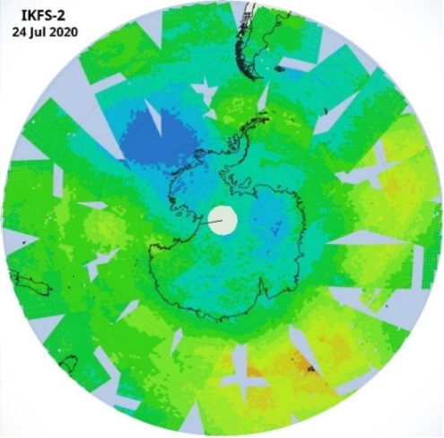
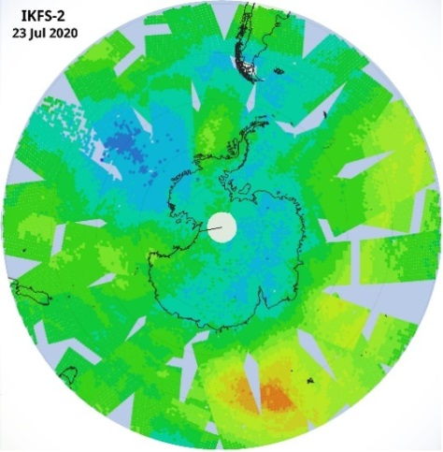
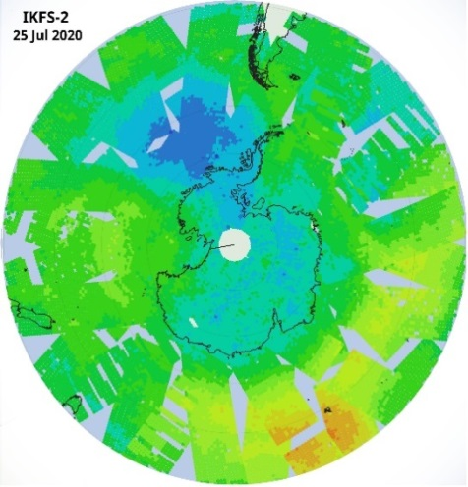
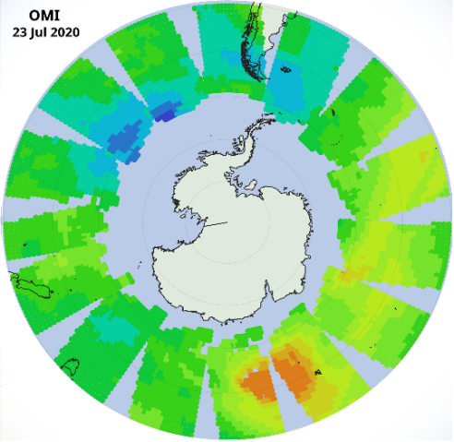
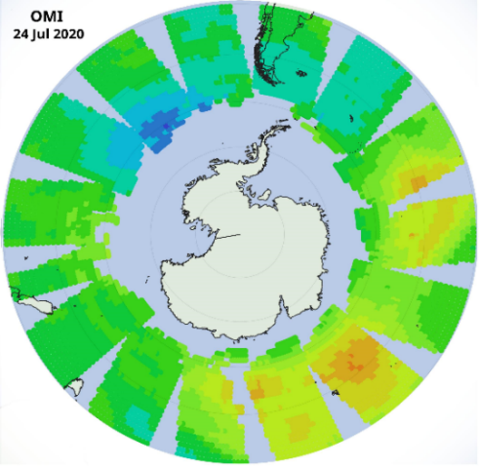
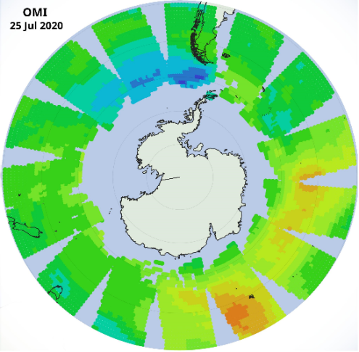
2020, July, IKFS-2
TOC retrievals
OMI and TROPOMI instruments, using solar radiation, unlike IKFS-2, cannot observe the occurrence of ozone anomalies in winter. As an example, let us present a figure with daily TO fields in the region of Antarctica in July 2020, which is characterized by the early appearance of ozone holes.
23
24
25
`
IKFS-2
OMI

Slide 14
Validation of the IKFS-2 TrOCs by comparison with the FTIR data
Bias and SDD,%
Site | N (200 km) | Lower 400 hPa
 |  | Δ | σ
Eureka | 282 | +3.6 | 4.2
Ny Ålesund | 120 | -0.13 | 4.4
Thule | 553 | +2.0 | 3.4
Kiruna | 491 | +1.3 | 3.8
Harestua | 153 | -0.41 | 2.5
St. Petersburg | 247 | +0.84 | 3.6
Bremen | 129 | +0.64 | 2.7
Zugspitze | 559 | ‑10.4 | 3.1
Jungfraujoch | 441 | ‑12.5 | 2.0
Toronto – TAO | 679 | +1.9 | 4.1
Rikubetsu | 100 | -1.2 | 3.5
Boulder | 367 | -1.9 | 2.2
Tsukuba | 184 | +2.6 | 4.1
Izaña | 395 | -8.2 | 2.0
Mauna Loa | 659 | -8.5 | 2.1
Altzomoni | 216 | ‑11.1 | 2.2
Maido | 342 | -5.8 | 2.1
Wollongong | 212 | +2.7 | 2.8
Lauder | 940 | +1.2 | 2.1
Total | 7069 |  | 2.99
Ground-based data
FTIR measurements, NDACC network, daily averaged TrOCs
IKFS-2 daily averaged TrOCs in a circle with a radius of 100 or 200 km to GB stations
March 2015-Dec 2022
Mean SDDs for sites
Lower | Averaging radius, km
 | 100 | 200
300 hPa | 2.91 DU | 2.95 DU
400 hPa | 3.00 DU | 2.99 DU

Slide 15
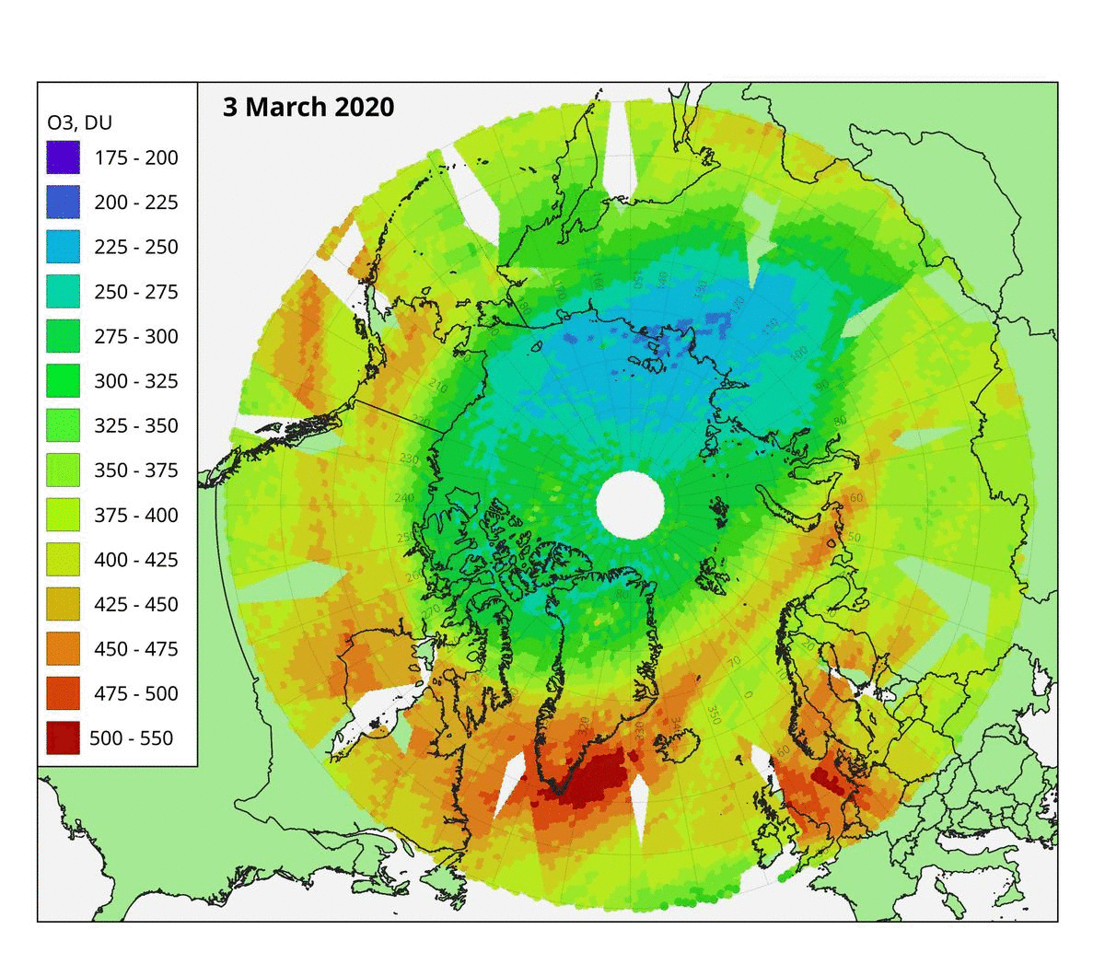
IKFS-2 TOCs in March 2020

Slide 16
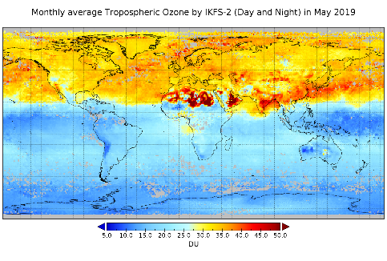
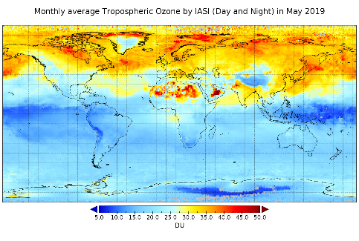
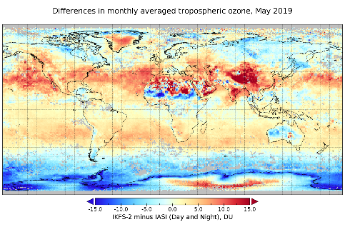
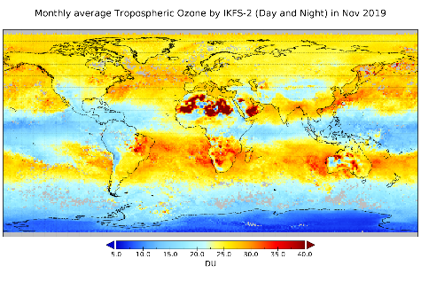
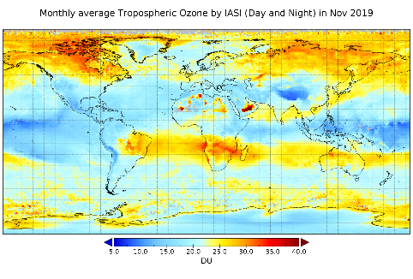
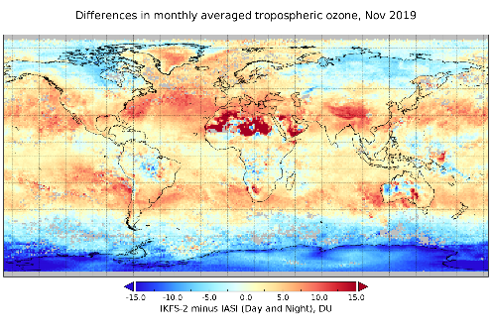
Comparison of TrOC (up to 300 mbar) distribution derived by IKFS-2 and IASI
IKFS-2 (left), IASI (middle) monthly mean TrOC values and their differences (right) for May (top) and November (bottom) 2019

Slide 17
Conclusions
A technique for estimating the TOCs and TrOCs from the IKFS-2 spectral measurements based on the PC and ANN methods has been developed
The mean errors in the approximation of the OMI TOC data by the technique developed for solving the inverse problem are 8.3 DU
The mean errors in the approximation of the ozonosonde TrOC data by the technique developed for solving the inverse problem are 2.7 DU and 3.7 DU for tropospheric layers below 400 and 300 hPa
According to the developed technique and ground-based measurement data, the average TOC differences range from -0.6 to -0.8%, and the standard deviations of these differences are usually less than 3%.
The average TOC differences between IKFS-2 and TROPOMI TOC measurements range from -2 to 0%, the standard deviations of the differences are from 2 to 4%
The advantage of the developed technique (IR method) over measurements with the OMI and TROPOMI equipment (method of scattered and reflected solar radiation) such as the possibility of measurements during the polar night is shown

Slide 18
References
Polyakov, A.; Virolainen, Y.; Nerobelov, G.; Kozlov, D.; Timofeyev, Y. Six Years of IKFS-2 Global Ozone Total Column Measurements // Remote Sens. 2023, 15, 2481. https://doi.org/10.3390/rs15092481
Polyakov, A., Virolainen, Y., Nerobelov, G., Timofeyev, Y. & Solomatnikova, A. Total ozone measurements using IKFS-2 spectrometer aboard MeteorM N2 satellite in 2019–2020 // International Journal of Remote Sensing. 42, 22, стр. 8709–8733, 2021
Yu. M. Timofeev, G. M. Nerobelov, A. V. Polyakov, and Ya.A. Virolainen, Satellite Monitoring of the Ozonosphere // Russian Meteorology and Hydrology, 2021, Vol. 46, No. 12, pp. 849–855. DOI: 10.3103/S1068373921120062
A. V. Polyakov, Y. M. Timofeyev, Y. A. Virolainen, D. A. Kozlov Atmospheric Ozone Monitoring with Russian Spectrometer IKFS-2 // Journal of Applied Spectroscopy, Vol. 86, No. 4, 650-654, DOI 10.1007/s10812-019-00873-7
A. S. Garkusha, A. V. Polyakov, Yu. M. Timofeev, Ya. A. Virolainen, and A. V. Kukharsky Determination of the Total Ozone Content in Cloudy Conditions based on Data from the IKFS-2 Spectrometer Onboard the Meteor-M no. 2 Satellite // Izvestiya, Atmospheric and Oceanic Physics, 54, No. 9(2018) 1244–1248.
Garkusha, A. S., Polyakov, Timofeev, Y. M., A. V. & Virolainen, Y. A. Determination of the total ozone content from data of satellite IR Fourier-spectrometer // Izvestiya, Atmospheric and Oceanic Physics. 2017, 53, 4, C. 433–440

Slide 19
Thank you for attention
We thank the GES DISC Data and Information Service Centre for providing access to TROPOMI and OMI data,
SRC “Planeta” for providing access to the results of IKFS-2 spectral measurements, and
the HEGIFTOM working group within the TOAR-II project for providing access to the harmonized data of ozonesonde measurements.
The authors acknowledge Russian Science Foundation, research grant No. 23-27-00166.

