Slide 1
Spin accumulation, anomalous Hall and spin-Hall effects in two-layer magnetic system
Mikhail Zhuravlev¹, A.A. Alexandrov², A.V. Vedyayev³
¹St. Petersburg State University, St. Petersburg 190000, Russia
² Moscow Institute of Physics and Technology, Dolgoprudny, Moscow Region 141700, Russia
³ Lomonosov Moscow State University, Moscow 119991, Russia
Barrier, SOC
FM

Slide 2

“COMMON” ANOMALOUS HALL EFFECT
PLANAR ANOMALOUS HALL EFFECT
Hall current
Hall current
Main current
Main current
two groups of the charges which interact with external fields differently
OUR TWO-LAYER SYSTEM: SOC +MAGNETIC ORDER+ FINITE THICKNESS 
ASYMMETRY BETWEEN k_{y} and –k_{y} states

Slide 3
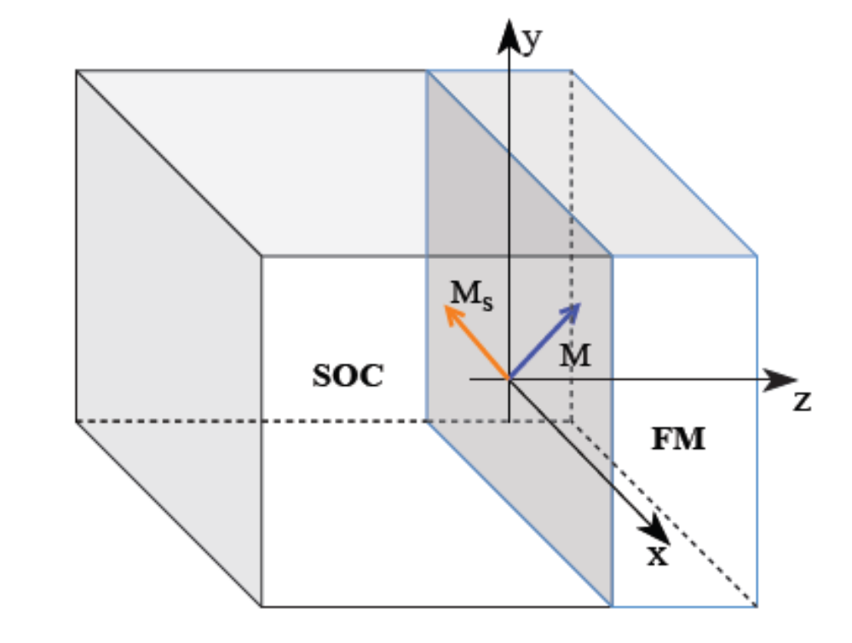

Current flows parallel to interface
Planar Hall current
Spin accumulation
Spin Hall effect
Hall current

Slide 4
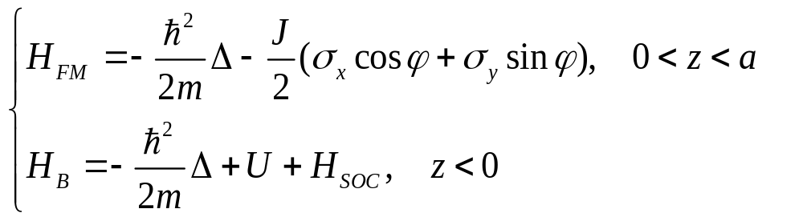
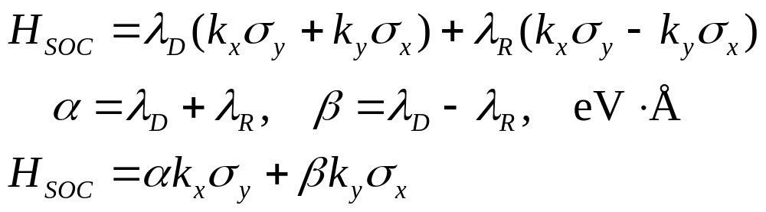
HAMILTONIAN
Rashba and Dresselhaus SOC linear in k are typical for ferroelectric materials of the C2v point group ( HfO₂ – ferroelectric)
T.S. Böscke, S. Teichert, D. Bräuhaus, J. Müller, U. Schröder,
U. Böttger and T. Mikolajick 2011 Appl. Phys. Lett. 99 112904
S. D. Ganichev and L. E. Golub, 2014 Physica Status Solidi (B) 251, 1801
spin-textured ferroelectrics
L.L. Tao, T.R. Paudel, A.A. Kovalev, and E.Y. Tsymbal 2017 Phys.Rev. B 95 245141
L.L. Tao, and E.Y. Tsymbal 2021 J. Phys. D: Appl. Phys. 54 113001

Slide 5
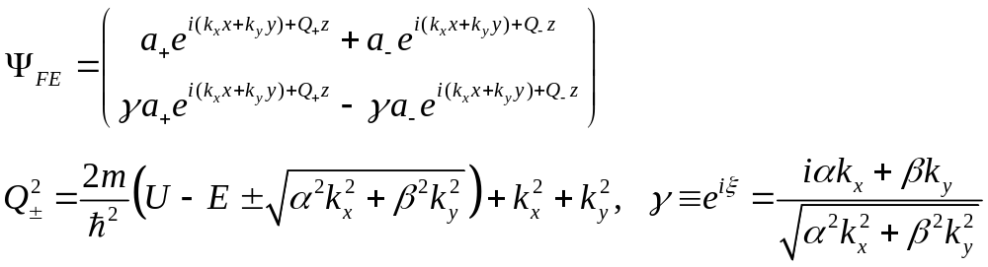
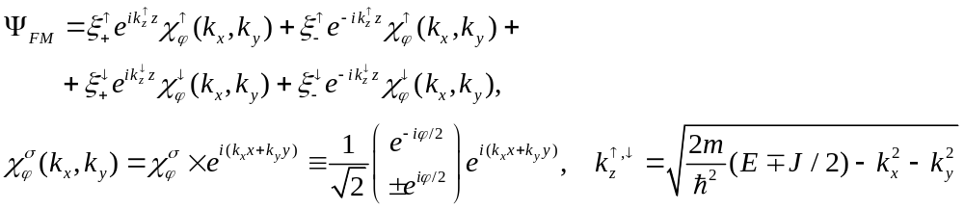
Wave function

Slide 6
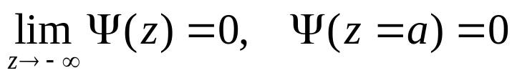
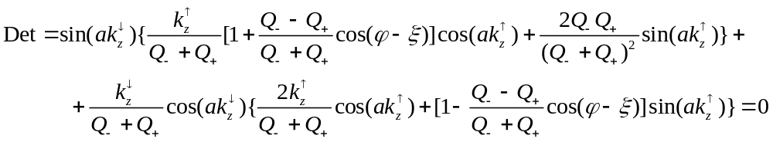
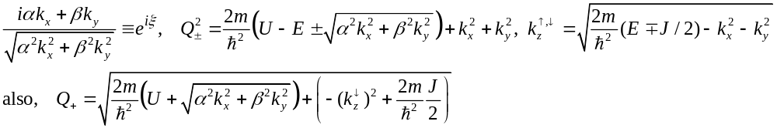
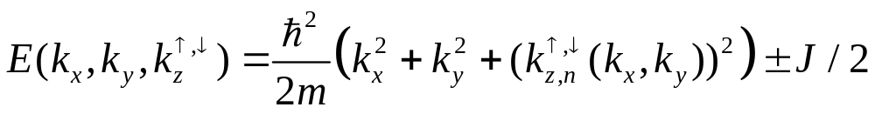
Electron Structure
matching on the interface z=0 + boundary conditions
Boundary conditions for wave function Ψ:
Determinant equals to zero
Planar Hall effect

Slide 7
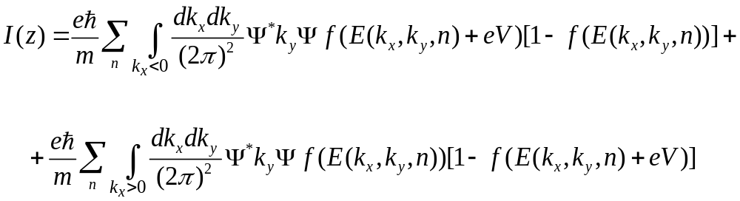
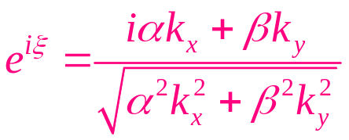
Planar Hall effect

Slide 8
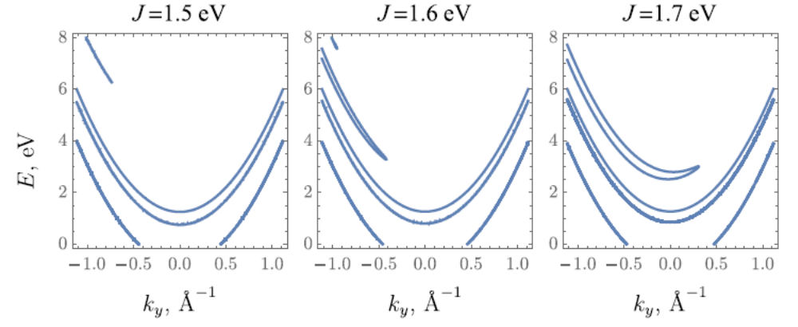
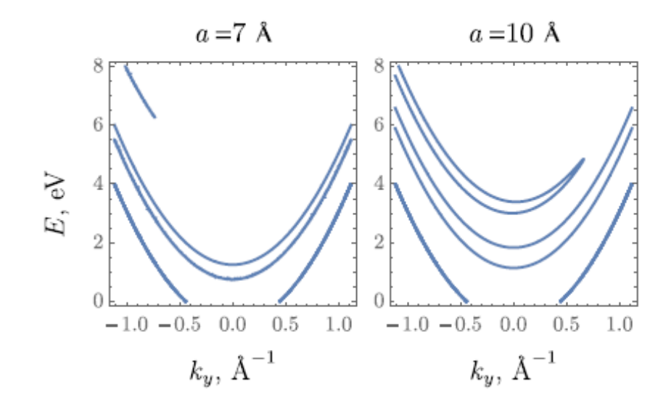
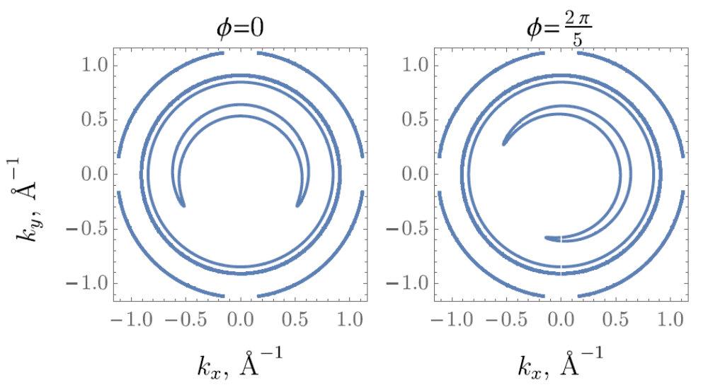
Electron structure
Asymmetry of electron band
Iso-energy lines

Slide 9
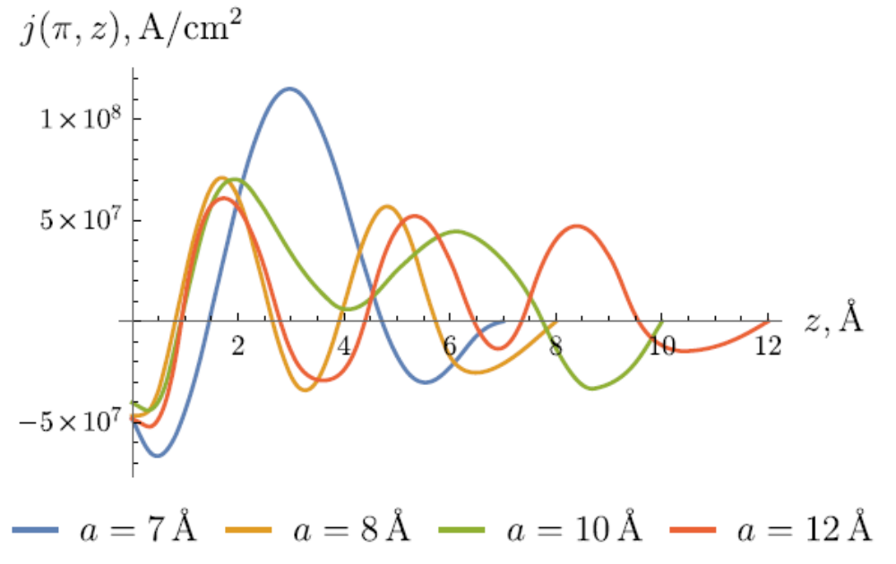
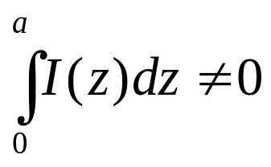
Current density as the function of z for different values of thickness a.
J = 1.5 eV, U =0.5 eV,
α = 0.35 eV Å, β = 0.40 eV Å

Slide 10
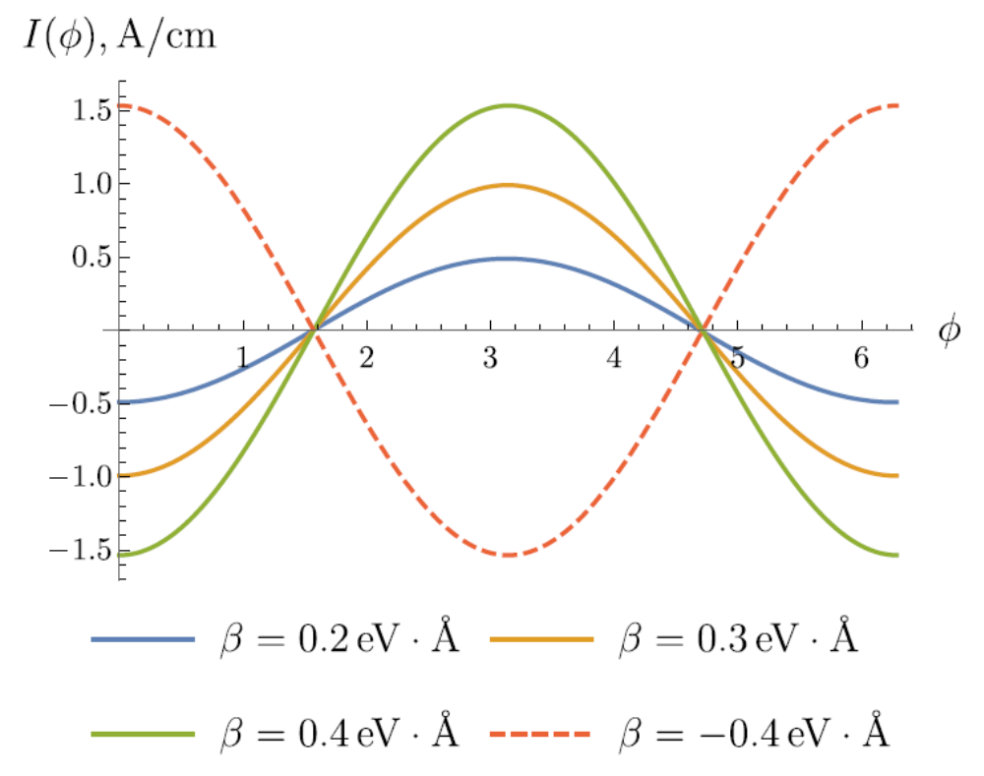
Current dependence on magnetization angle φ.
Effective SOC field is associated with crystallographic axes. Since spin accumulation is determined by the interplay between SOC and the initial magnetization, I(φ) substantially depends on the direction of the magnetization.

Slide 11
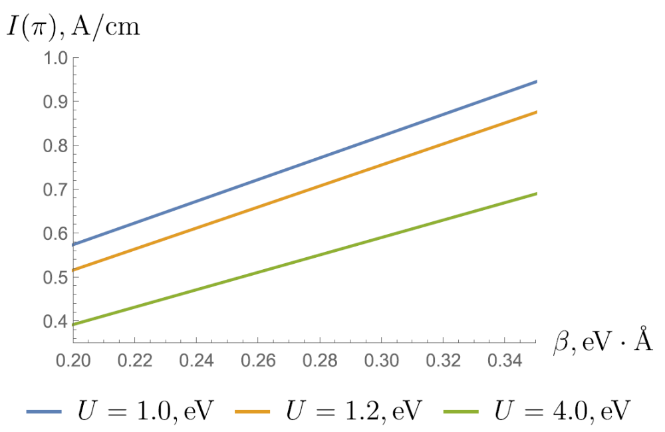
Dependence of Hall current I(φ=/4) on SOC constant β for the fixed parameters

Slide 12
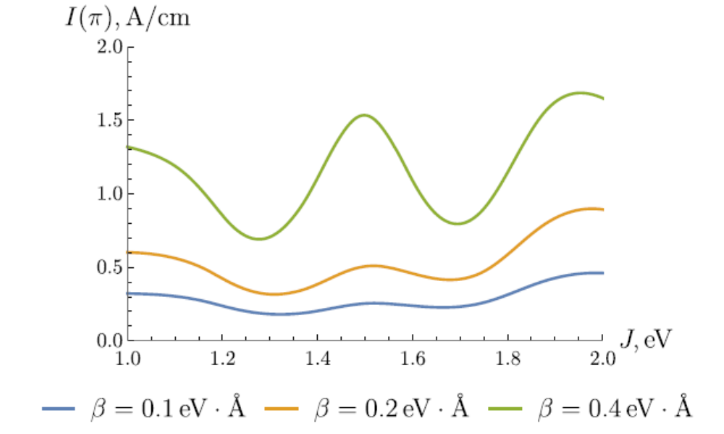

Dependence of Hall current on exchange constant

Slide 13
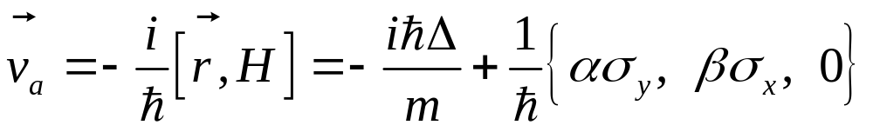
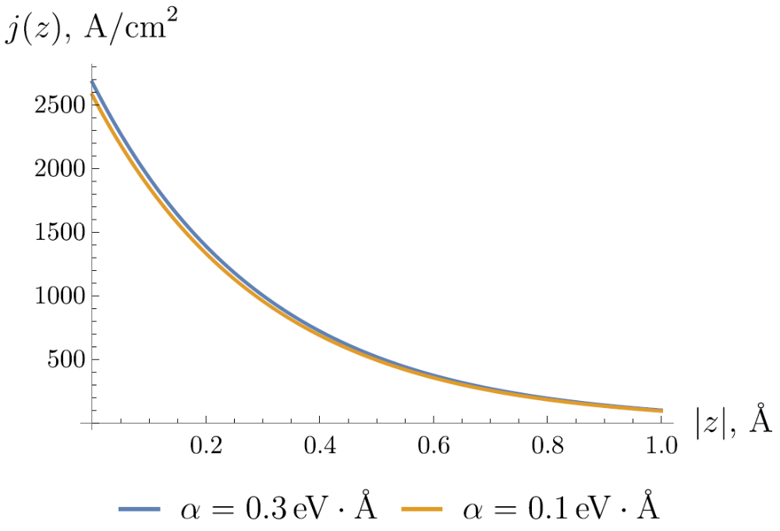
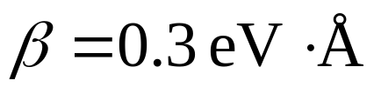
Additional velocity term originates from SOC. It leads to the appearance of Hall current in the barrier. This current demonstrates exponential decay.

Slide 14

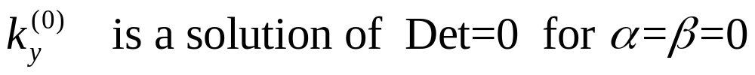
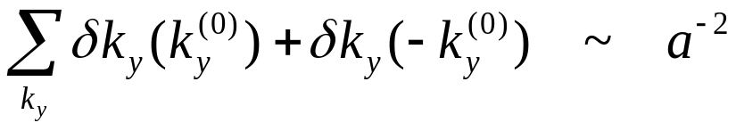
a   limit: ak_{F} >>1, aQ>>1

Slide 15
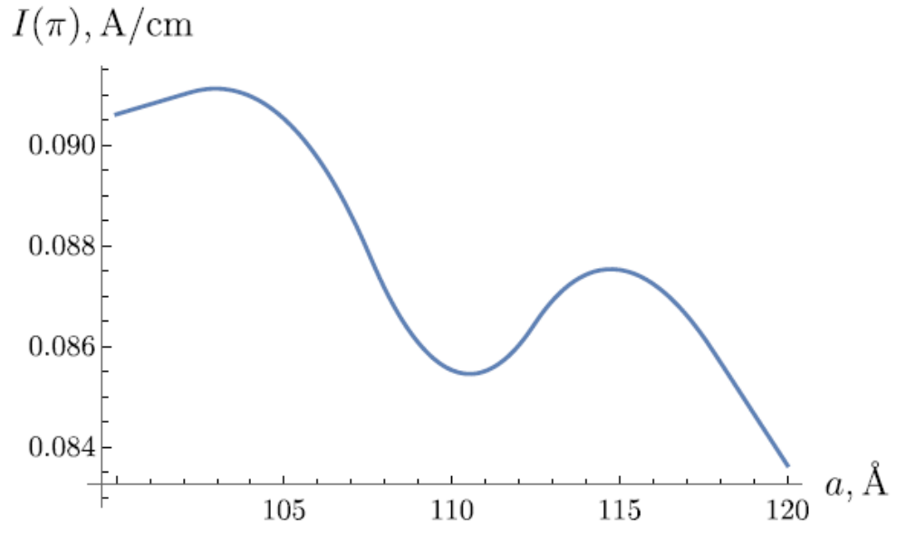

Current decay for large thickness

Slide 16
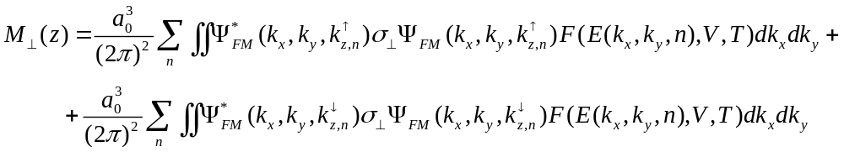

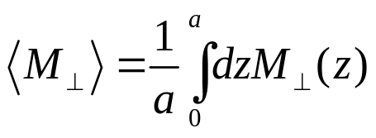
SPIN ACCUMULATION
Average spin accumulation:

Slide 17
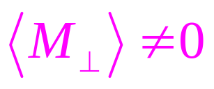
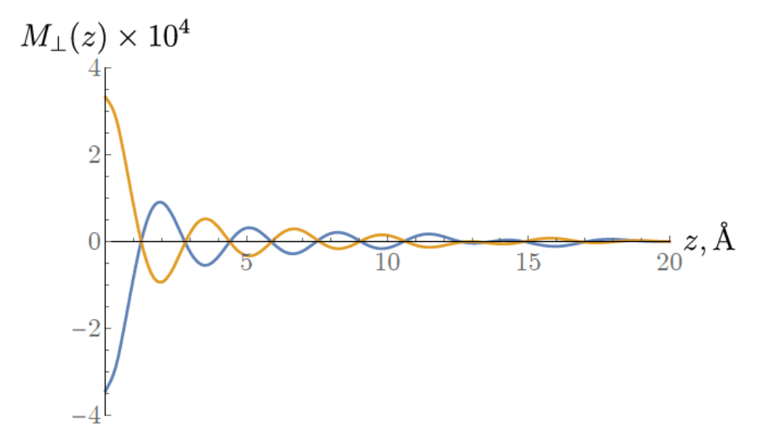

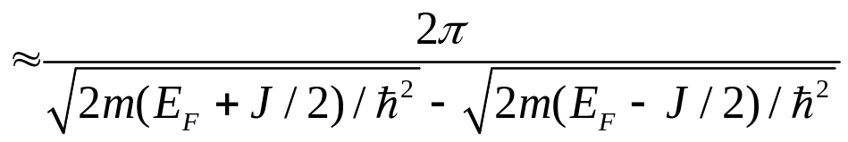
Distribution of spin accumulation in FM layer
We can estimate effective field in the direction perpendicular to the initial magnetization of FM layer by formula H_{eff} =J↑M/μ_{B}. Taking into account that we get ↑M as large as in our calculations, we estimate H_{eff} as 2‧10⁵ G. This field is of the same order as that in the estimation in the work [A. Manchon and S.Zhang, Physical Review B 79, 094422 (2009)], so, the magnetization switching can be realized in such two-layer system.
Oscillation period 

Slide 18
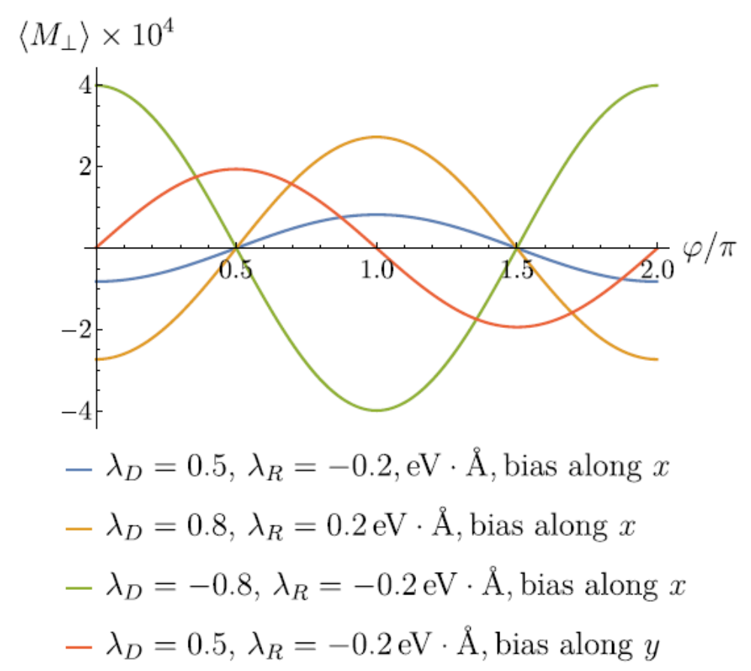
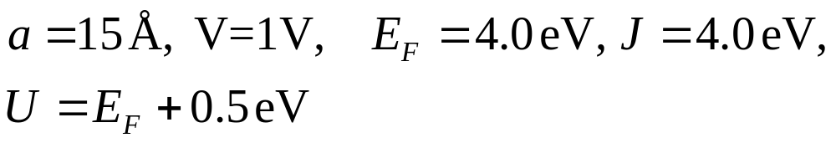
↑M as the function of magnetization angle φ.
When there are no anisotropy axes in ferromagnet, those values of φ, for which ↑M=0 can be considered as preferential directions of magnetization. Therefore, SOC together with the applied bias lead to the appearance of effective easy axes. Indeed, nonzero spin-accumulation in the direction perpendicular to the initial magnetization results in precession (the precession can be described by Landau-Lifshitz equation) which goes on until angle φ reaches the value for which the perpendicular component is absent.

Slide 19
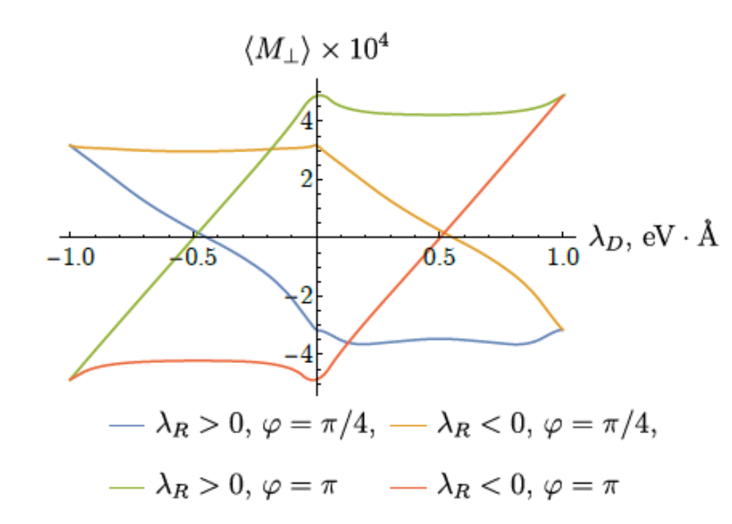
Dependence of ↑M on λ_{R} and λ_{D} such that | λ_{R} |+| λ_{D} | = 1 eV‧Å.
Each loop represents ↑M for λ_{R} > 0 and λ_{R} < 0
The form of the curves is determined by the interplay of several factors, namely, the applied bias, dispersion law asymmetry, SOC, and magnetization. As a result, the form of the curves in the Figure is not symmetric.

Slide 20
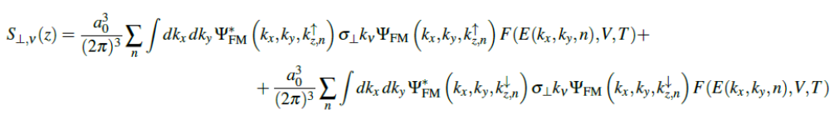
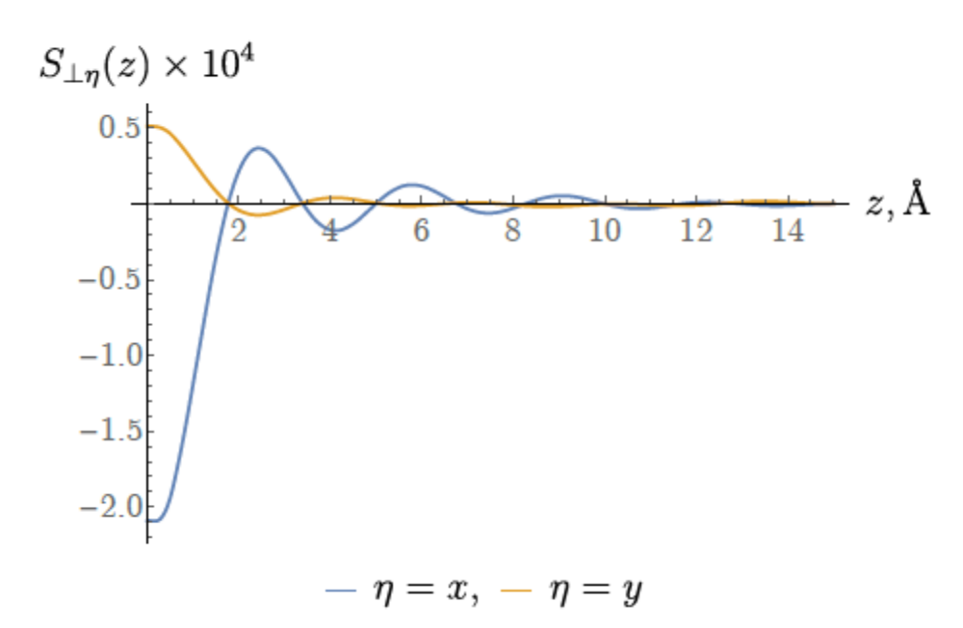
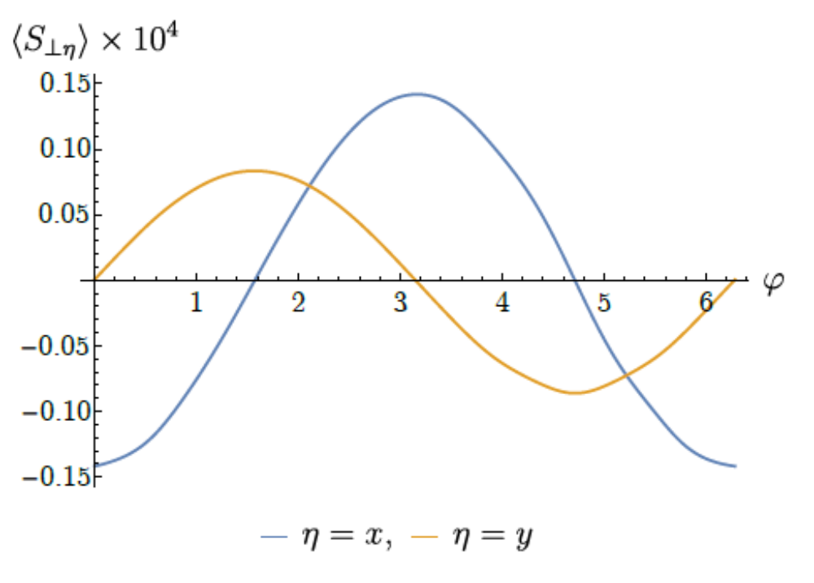

Spin Hall current in ferromagnetic layer
Spin Hall current in the system that we are considered appears only if both factors, namely,
SOC and applied bias, are present.
Dependence of S⊥,ν on  for EF = 4.0 eV, J = 2.0 eV, U = EF + 0.5 eV, λD = 0.8 eV Å, λR = 0.2 eV Å,
a = 15 Å, T = 5 × 10⁻³ eV, V = 1 V.

Slide 21
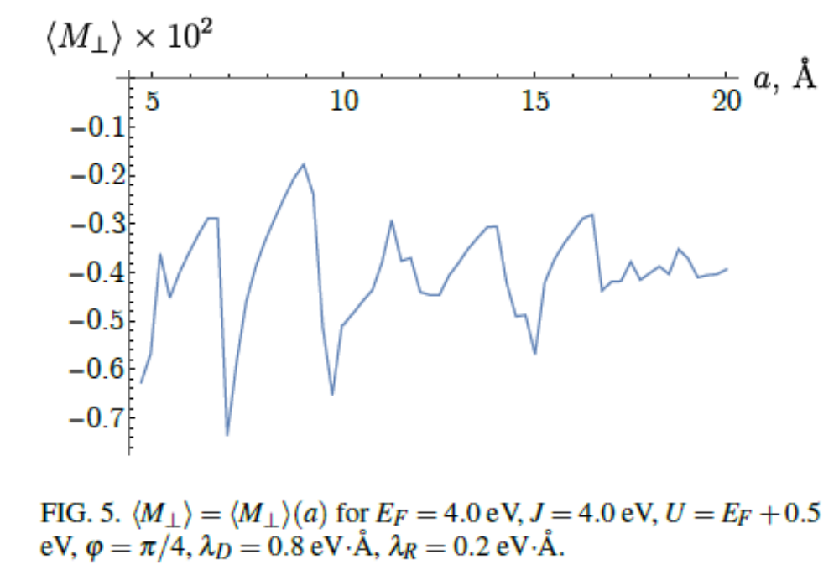
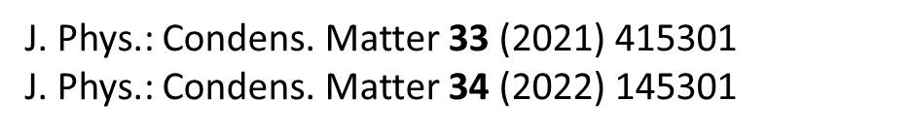
Dependence of Spin Accumulation on FM layer thickness

Slide 22
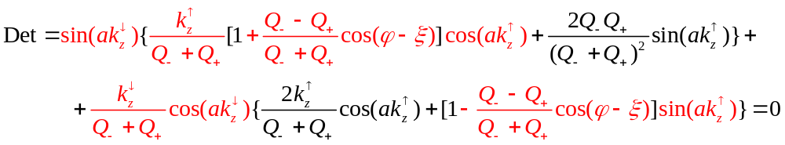
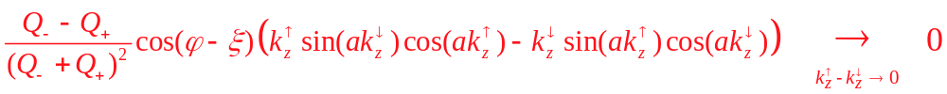
J0 limit
P. Gambardella, I.M. Miron, Phil. Trans. R. Soc. A (2011) 369, 3175–3197
Sometimes, we do not need exchange splitting to get AHE. The applied buas together with SOC results in spin accumulation which in turn leads to the appearance of Hall current

Slide 23

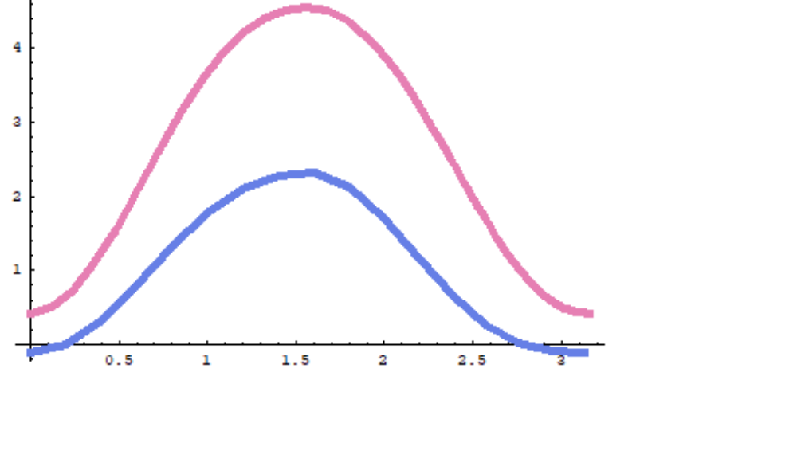
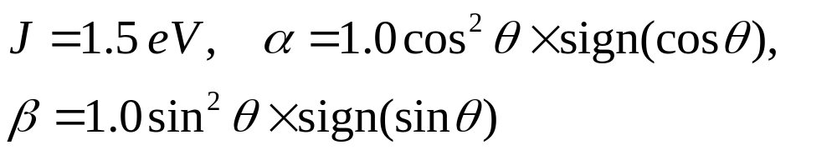
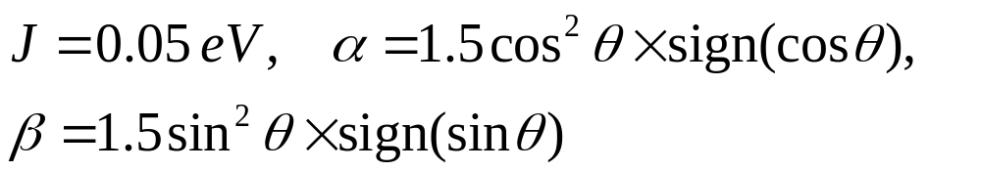
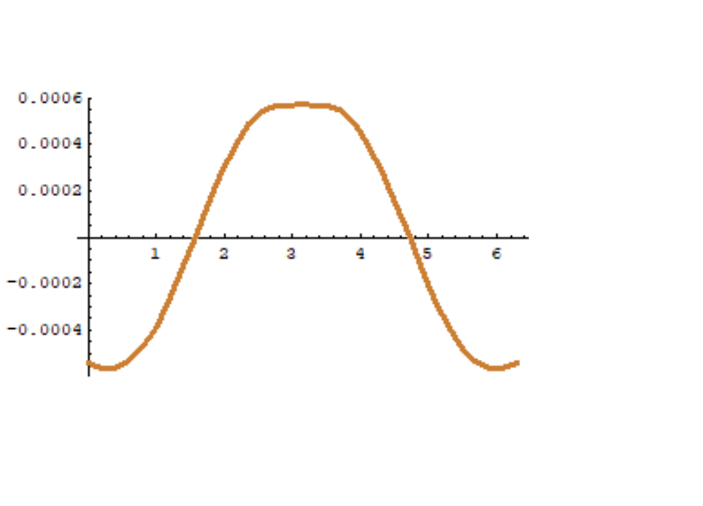




Slide 24


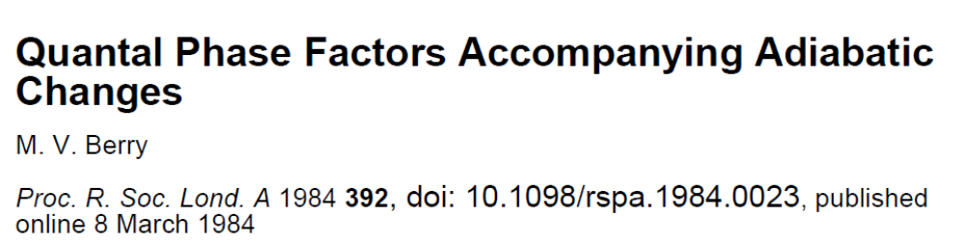


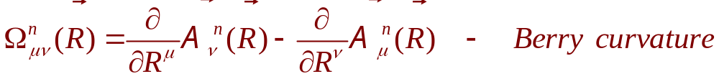
Berry connection, bundles, anomal velocity…

Slide 25
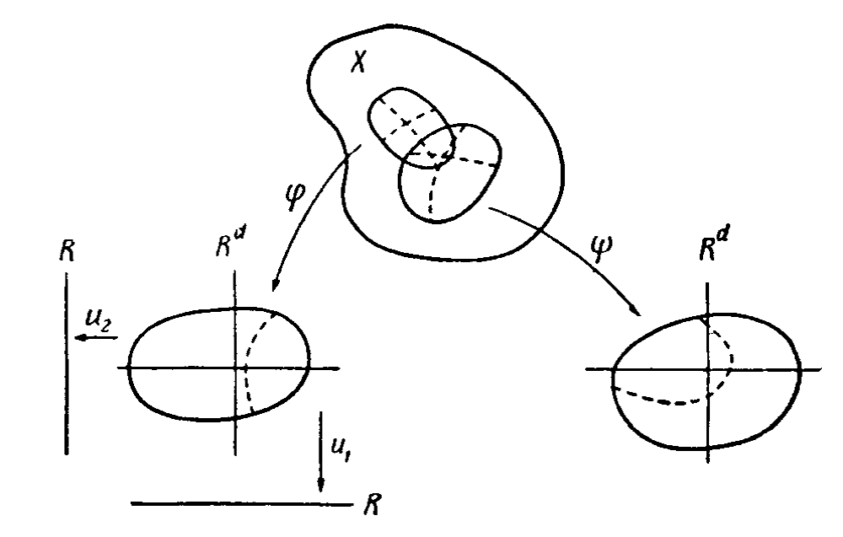
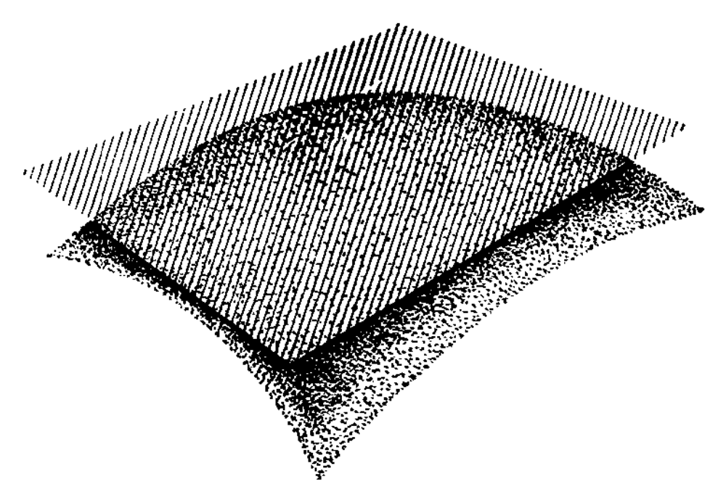
”Connection” supposes that we deal with a bundle. What is the bundle?
There are many types of the bundles in differential geometry.
Differential manifold Tangent bundle
Line bundle: the fibre is a real or complex one-dimensional vector space

Slide 26
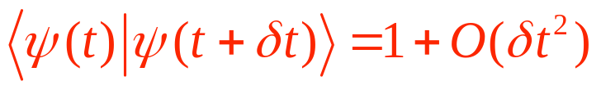
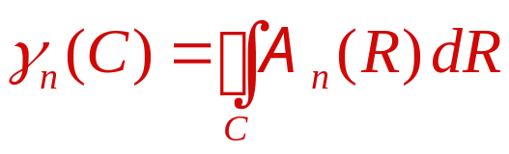
CONNECTION: PARALLEL TRANSPORT. We define parallel transport of a tangent vector along a curve. OR: We define a diffeomorphism of the fibres in the different points of a curve in the base.
Barry Simon, 1983: one-dimensional spaces of eigenfunctions of the non-degenerate eigenvalues.
RH manifold, parallel transport rule along closed cycle in the
parameter space R, ,

Slide 27








Projective Hilbert space (space of the rays) P, , : closed cycle
The same can be chosen for every curve C such that by appropriate choice of f (t). Therefore, is a geometrical property of

Slide 28



BERRY CONNECTION AND ANOMALOUS VELOCITY
Di Xiao, Ming-Che Chang, Qian Niu, Rev. Mod. Physics 82, 1959 (2010)

Slide 29




Guido van Miert, Vladimir Juričić, and Cristiane Morais Smith, «Tight-binding theory of spin-orbit coupling in graphynes», PRB 90, 195414 (2014);
Sergej Konschuh, Martin Gmitra, and Jaroslav Fabian, «Tight-binding theory of the spin-orbit coupling in graphene», PRB 82, 245412 (2010)
Simple Cubic Lattice
Wave function,

Slide 30
Our analysis demonstrates that Hall current, spin accumulation and spin current can be manipulated by changing the direction of the magnetization of FM layer with respect to the crystallographic axes of the ferroelectric barrier. The other way of manipulating spin accumulation results from the dependence of M(z) and ↑M on SOC constants’ signs, since the reversal of electric polarization of the ferroelectric barrier results in the change of the constants’ signs. The amplitude of spin accumulation substantially depends on the thickness of FM layer. Moreover, the finite thickness of FM layer leads to additional asymmetry of the electron structure which modifies M(z) and S(z). The effects survive for small exchange splitting.
We are grateful to Prof. E. Tsymbal for valuable discussion

