Slide 1
The problem of post-normal science and scientific knowledge-how
Lada V. Shipovalova
Department of Philosophy of Science and Technology. Saint Petersburg University, Saint Petersburg.
l.shipovalova@spbu.ru

Slide 2
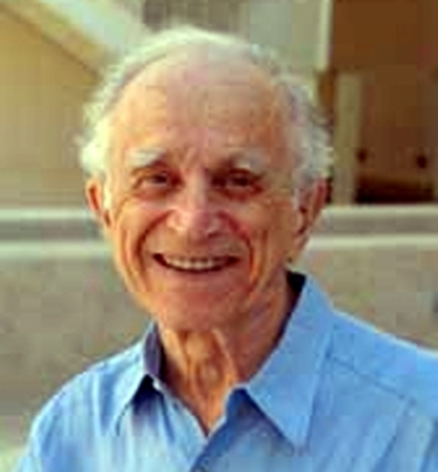
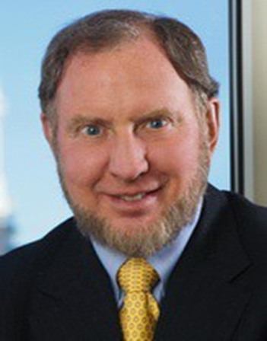
The concept of post-normal science
Post-normal science as a normative basis for the scientists' demand for the politicization of science
Easton, David “The New Revolution in Political Science”,
The American Political Science Review, 1969
“To know is to bear the responsibility for acting and to act is to engage in reshaping society. The intellectual as scientist bears the special obligation to put his knowledge to work”.
Putnam, Robert “APSA Presidential Address: The Public Role of Political Science", Perspectives on Politics, 2003
The “fundamental” component of scientists’ mission, along with the search for truth, should be "attention to the problems of fellow citizens".

Slide 3
The concept of post-normal science
“Facts are uncertain, values in dispute, stakes high and decisions urgent”
Funtowicz, S. O., and Ravetz, J. R. “Science for the post-normal age,” Future. 1993
The specificity of post-normal science
Extended peer community
  post-normal science transcends boundaries of epistemic and disciplinary stability
  disclosing of uncertainty fields
  including non-scientists as experts
Science for policy
  relation to the decision-making process
  urgency of decisions and no time for consensus

Slide 4
the problem of post-normal science
The formal side of the problem – demarcation
The post-normal science may lose the boundary that separates it from non-scientific knowledge.
The substantial side of the problem - mediation
The post-normal science links the generation of objectively true knowledge and the policy action of decision-making.
  What kind of policy action (decision-making) is possible in the face of unfinished discussions about scientific consensus?
  What kind of scientific knowledge aimed at the search for objectivity may be compatible with the assessment of quality of knowledge by an extended circle of experts (“extended peer community”)?

Slide 5
Mediation problem two questions
What practical policy action is possible in the condition of incomplete consensus and how can a scientist be included in it?
What requirements must scientific knowledge meet in order to allow and even demand discussions about its quality? How can we understand this scientific knowledge?

Slide 6
Solution of Mediation problem
Three forms of political activity of science
  instrumental subordination to the public good, where scientists by their advice legitimize specific political interests that ensure the interpretation of this good;
  technocratic supremacy secured by the power of universal scientific reason;
  mutual influence and interaction between scientists, the public and authorities, since it is possible to adequately formulate urgent problems only by identifying different interests and values, different types of knowledge and interpretations of facts and building a relationship between them.
  The post-normal scientist
  = participant and organizer of political interaction

Slide 7
Solution of mediation problem
Scientific knowledge discussed about its quality = knowledge-how
“Another reason for the lack of quality assurance of information derives from our dominant conception of knowledge. Traditionally 'knowing-that' something is true by some abstract argument has been considered far superior to 'knowing-how' to make something”.
Funtowicz S.O., Ravetz J.R. Uncertainty and Quality in Science for Policy, 1990.
The concept of knowledge - how
Logical Positivism – protocol sentence controversy; affirmations (M. Schlick)
Analytic philosophy – in the struggle with knowledge-that; ability to act (G. Ryle)
Funtowicz and Ravetz - informal, individualized, and involving uncertainty.
Studies of science expertize - method of expertise that involves openness to alternative projects and the ability to manage conflicting interactions.
Bammer G., O’Rourke M., O’Connell D. et al. “Expertise in research integration and implementation for tackling complex problems: when is it needed, where can it be found and how can it be strengthened?” Palgrave Communications, 2020, vol. 6, article no. 5.
  practical character, indicating activity carried out in a specific situation;
  meaningful incompleteness derived from this specificity;
  performativity, emphasizing the actionable nature of knowledge.

Slide 8
Solution of Demarcation problem
  Scientists themselves can competently define the limits or incompleteness of their knowledge.
  Scientific visualization as “boundary objects” – mediator between science, public and authorities.
  (Star S. L. (2010) This is Not a Boundary Object: Reflections on the Origin of a Concept. Science, Technology, & Human Values).

Slide 9
Conclusion
The solution of demarcation problem - emphasizing the presence of "boundary objects" in scientific cognition also understandable to non-specialists. This emphasizing enables to expand the peer community but preserve the scientific markers of knowledge.
The solution to the mediation problem is possible if the policy action of science is interpreted and practiced as the interaction of scientists, the public and authorities, and scientific validity is revealed through attention to the concept of scientific knowledge-how.

Slide 10
Thank you very much
for your attention
The participation was supported by St Petersburg University, project ID 104245464

