Slide 1
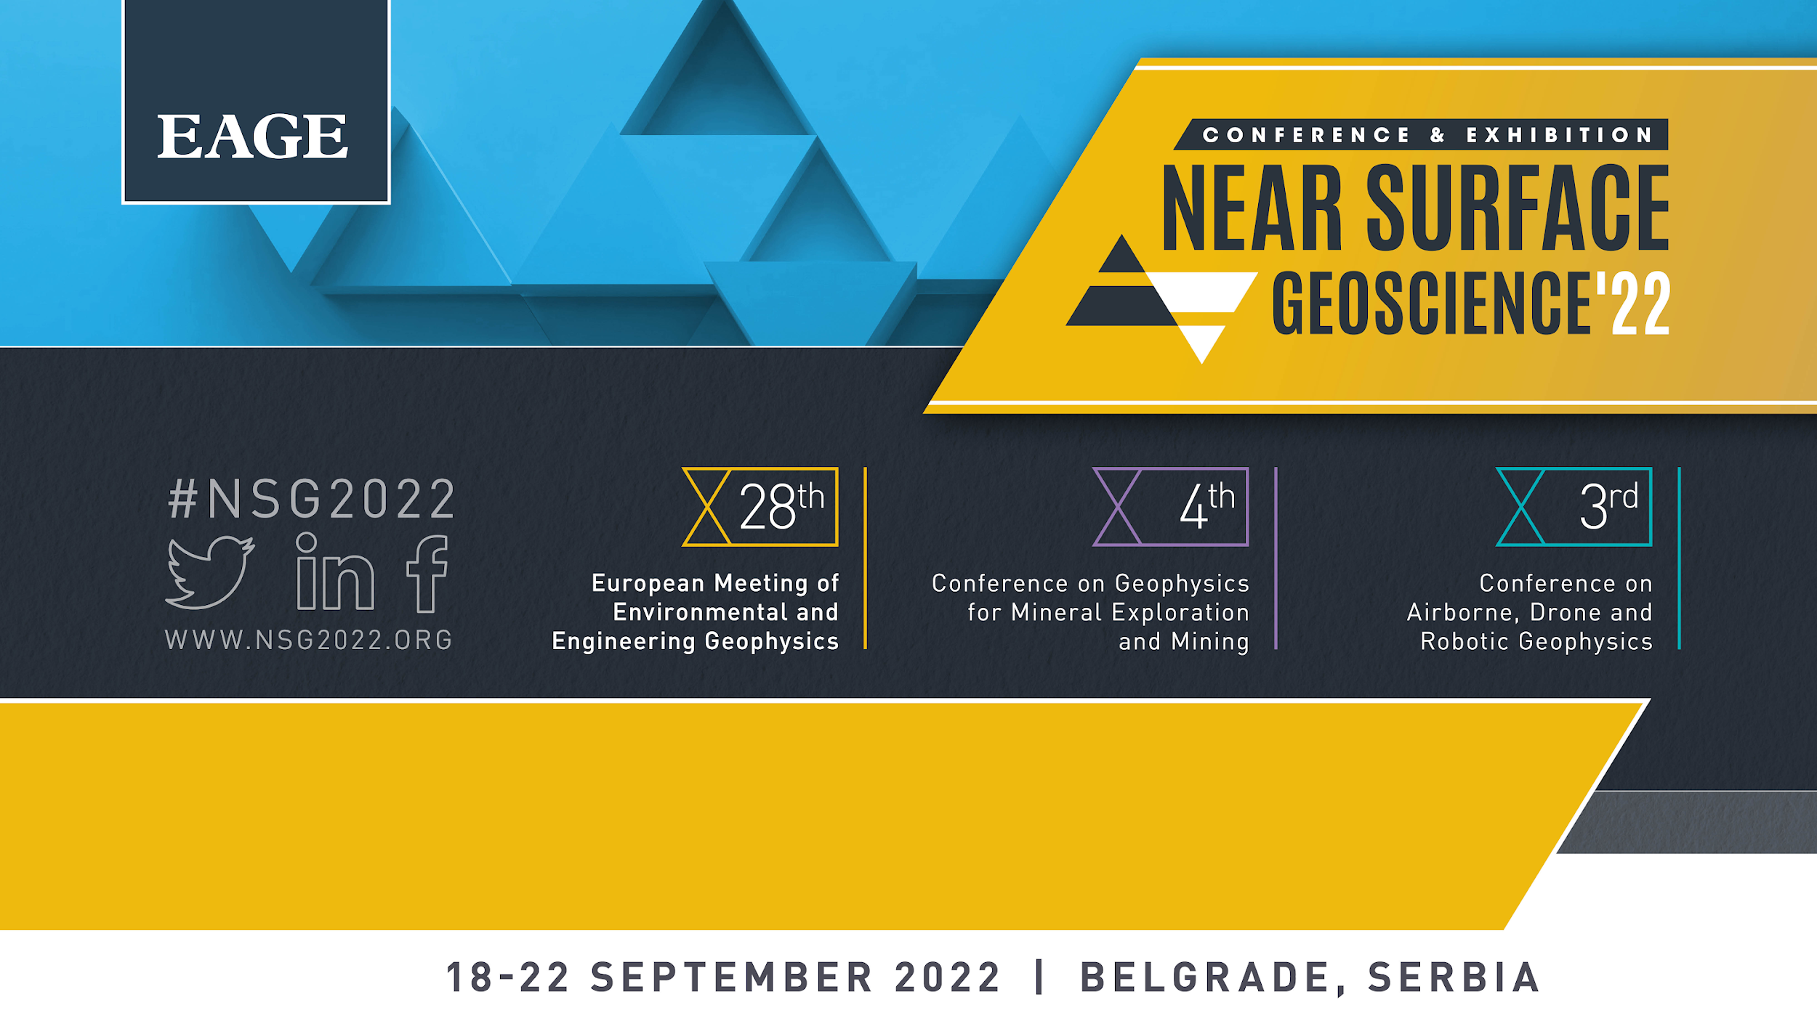
Complex electrical conductivity of kimberlites: a case of north-eastern Angola
V. Emelianov, V. Abramov, K.Titov, A. Revil

Slide 2

Outline
Motivation
Materials and Methods
Main results and discussion
— Real part of the complex conductivity versus pore water conductivity – multi-salinity
— Specific surface area and surface conductivity vs. cation exchange capacity
— Imaginary conductivity vs. surface conductivity from multi-salinity measurements
Conclusion

Slide 3

Motivation
some pipes exhibit no magnetic response
magnetic anomalies of the same shape and magnitude are produced by both kimberlite and non-kimberlite bodies
electrical methods are increasingly applied for kimberlite exploration
only scarce factual base concerning electrical properties of kimberlite is available to date
The main purpose of research is to study the complex electrical conductivity of six intact kimberlite samples of different types.

Slide 4
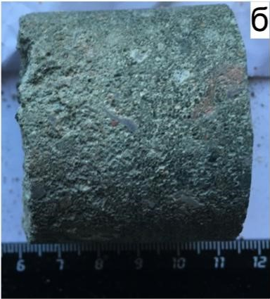
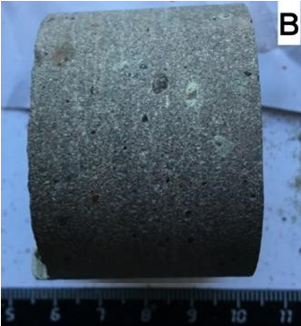
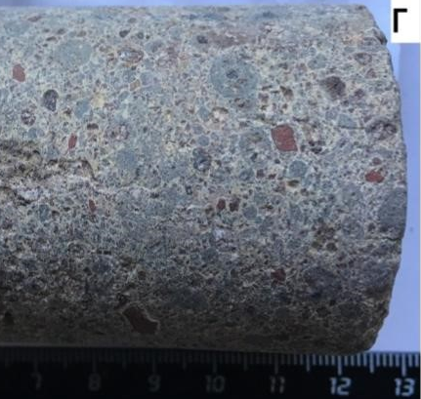
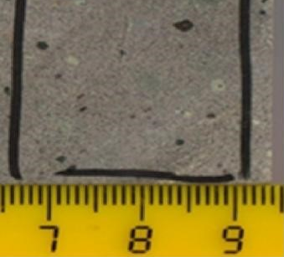
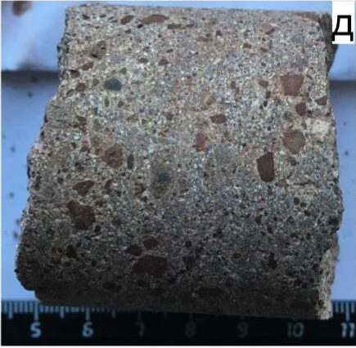
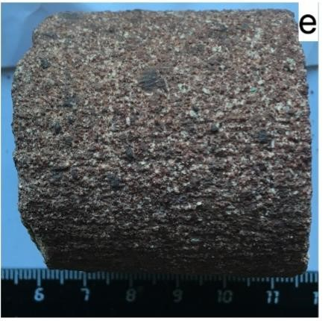
Materials
the samples of early cretaceous age within Alto-Сuilo deposit (Angola, Сassai shield)
cylindrical shape with 4.7 cm in diameter and 3.0-4.9 cm in length
A.
Autolithic breccias
Samples
АС 05-05/209
АС 254-01/104
AC 23-01/70
xenogenic clastic material
is presented by ferruginous marl, quartz-feldspar, biotite
olivine itself and pseudomorphoses are the main materials of autoliths
all olivine is serpentinized and chloritized
serpentinized pseudomorphoses are mostly weathered to clay (nontronite)
hematite, chrome-spinel, magnetite and probably ilmenite can be occur (~2%)
D.
Porphyritic kimberlite
Samples
АС 01-01/201
АС 01-01/182
the samples have a massive texture
the rock is composed by small (0.2-0.6 mm, rarely - 0.8-1.2 mm) ellipse shaped olivine pseudomorphs with a fibrous serpentine on the edges, often chloritized. сalcite or siderite can be noted in the inclusions
the whole mass is serpentine with calcite in some areas
grains of oxide-ore minerals (perovskite) are widespread (at least 8-10%)
B.
E.
Tuff-Sandstone
Sample
AC 60-08/364
psephite-psammitic structure
clayey (smectite group) cement
the clastic materials are
marl, quartz, some biotite, chlorite
phlogopite, garnet, ilmenite,
zircon – less than 2%
C.
F.

Slide 5
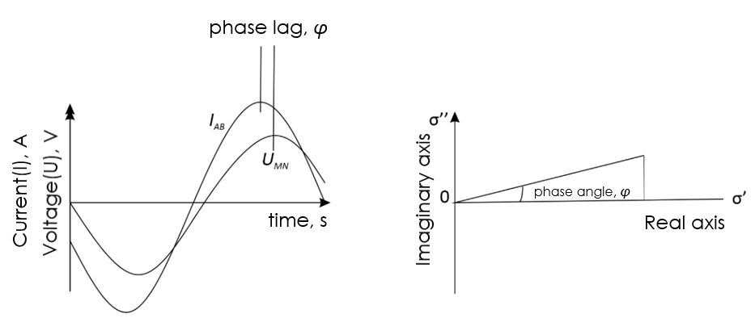
Methods
We saturated the samples with NaCl solutions with the electrical conductivity ranged from 0.11 to 2.4 S/m (~0.5-12 g/l), which allowed us to carry out the multi-salinity experiments
We measured the magnitude 𝑍(𝜔) and phase 𝜑(𝜔) of the complex impedance with SIP FUCHS III equipment by Radic Research.
The samples were in the tank containing fresher ambient water, and we waited for a next equilibrium state for several weeks
Additional methods:
Cation exchange capacity (CEC)
Specific surface area (SSA, BET)
Optical microscopy
Note: a small amount of ore minerals (magnetite, hematite) which can polarize by metallic particle mechanism was detected in optical microscopy images.
𝜌*(𝜔)=𝑘𝑍(𝜔), where 𝑘 is the predefined geometrical factor
𝜎*(𝜔)=1/𝜌*(𝜔)
The real (𝜎′) and imaginary (𝜎′′) parts of the complex conductivity can be calculated both based on the electrical conductivity magnitude and phase:
𝜎′ =|𝜎|cos𝜑 𝜎′′=|𝜎|sin𝜑
𝜎′ – measure of conductance (long distance charge passage)
𝜎′′ – measure of induced polarization (short distance charge passage)

Slide 6
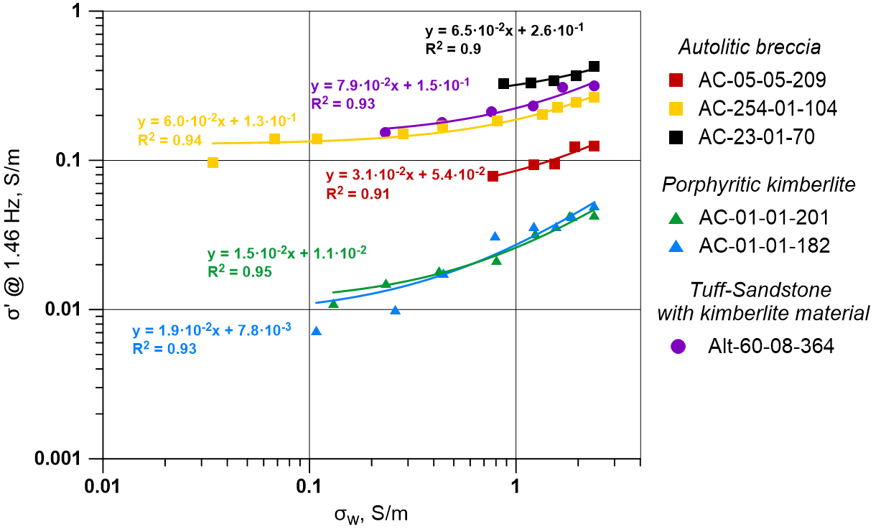
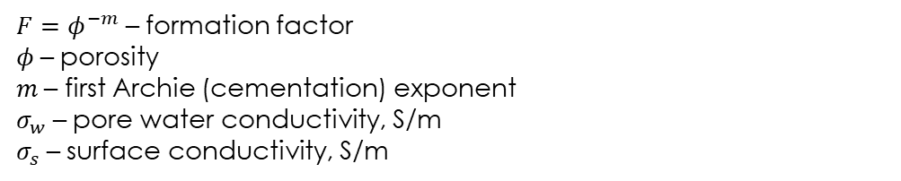
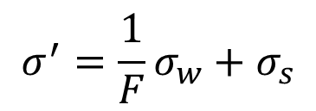
Real part of the complex conductivity versus pore water conductivity
The linear fit corresponds to Archie's (1942) law considering an effect of the surface conductivity
(see e.g., (Binley and Slater, 2021):
$$σ^{′}=\frac{1}{F}σ_{w}+σ_{s}$$
$F={\text{φ}}^{−m}$ – formation factor
𝜙 – porosity
𝑚 – first Archie (cementation) exponent
$σ_{w}$ – pore water conductivity, S/m
$σ_{s}$ – surface conductivity, S/m

Slide 7
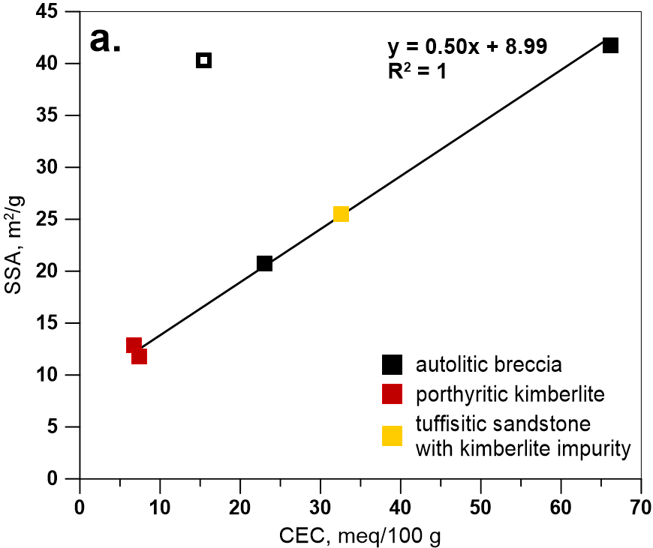
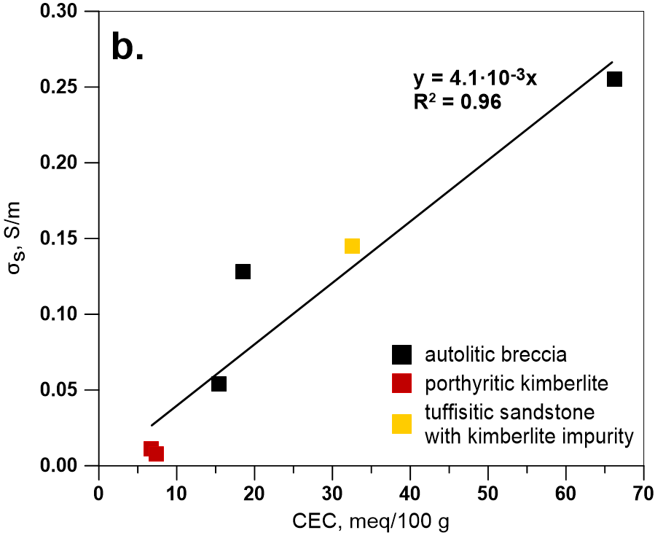
Specific surface area and surface conductivity vs. cation exchange capacity

Slide 8
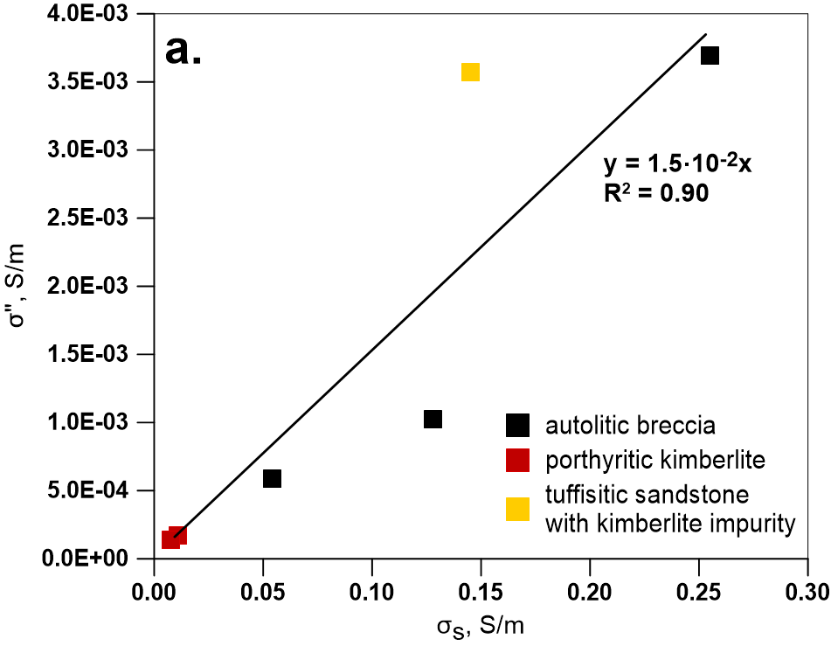
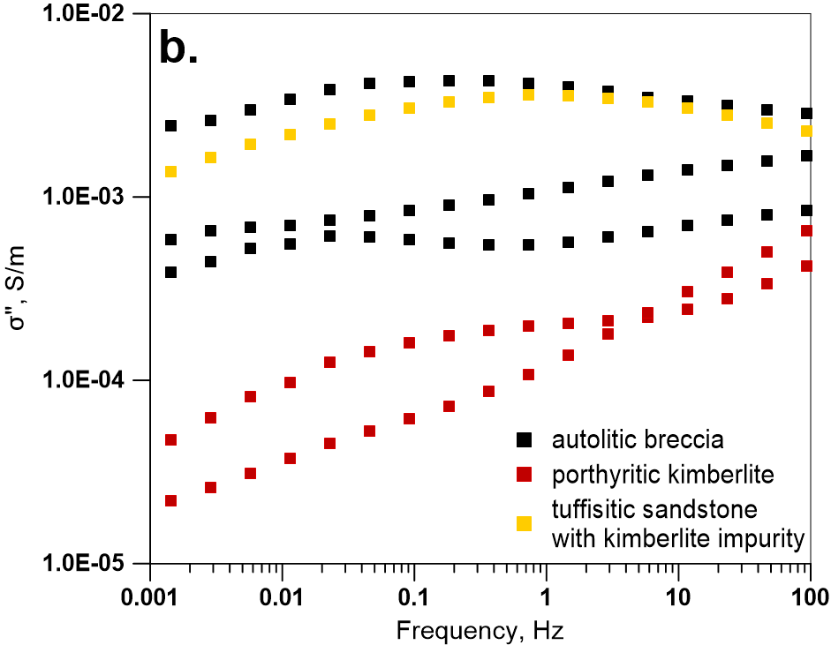
Imaginary conductivity vs. surface conductivity

Slide 9
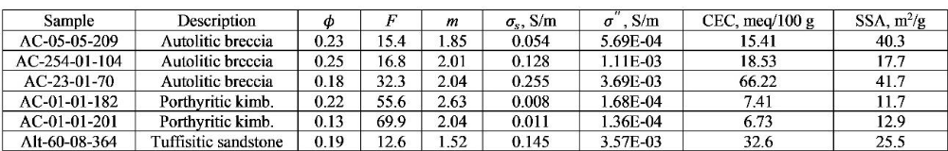
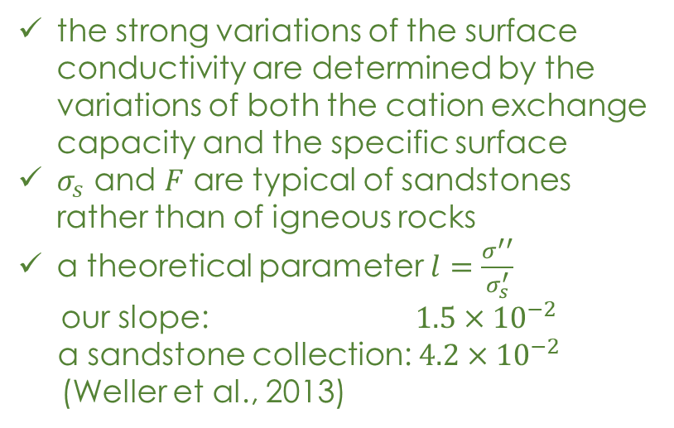
Discussion
The origin of so high values of the imaginary conductivity: presence of conductive ore minerals (like magnetite) or some “optimal” content of “sand” and clay material within the rock matrix?
IP nature
ion-conducting rocks
(Stern layer or membrane polarization)
metallic particles
the strong variations of the surface conductivity are determined by the variations of both the cation exchange capacity and the specific surface
$σ_{s}$ and $F$ are typical of sandstones rather than of igneous rocks
a theoretical parameter $l=\frac{σ^{′′}}{σ_{s}^{′}}$
our slope: $1.5×{10}^{−2}$
a sandstone collection: $4.2×{10}^{−2}$
(Weller et al., 2013)
a strong relationship between the peak position in the phase spectra and the water salinity (Gurin et al., 2015)

Slide 10
Conclusions
significantly different electrical properties characterize different types of kimberlites
the highest values of the formation factor and the lowest values of the surface conductivity correspond to porphyritic kimberlites
other samples of our collection present large surface conductivity and IP effects
the nature of IP is not associated with inclusions of conductive ore minerals
the intensity of surface conductivity and polarization are determined by the specific surface area and cation exchange capacity, which is typical of sandstones with various clay content

Slide 11
Thank you!
V. Emelianov* (1), V. Abramov (1), K.Titov (1), A. Revil (2)
(1)-Saint Petersburg State University
(2)-Laboratoire EDYTEM - UMR CNRS 5204 - Université Savoie Mont Blanc
Acknowledgements
This work was supported by Russian Science Foundation through the grant “Development of the induced polarization theory with application to exploration of strategic raw materials”. We also thank the “Geomodel” core center for the equipment used in the experiments.
References
1. Archie, G. E. [1942] The electrical resistivity log as an aid in determining some reservoir characteristics, Trans. A.I.M.E., 146, 54-62.
2. Binley A. and Slater L. [2021]. Resistivity and Induced Polarization: Theory and Applications to the Near-Surface Earth. Cambridge: Cambridge University Press. doi:10.1017/9781108685955
3. Cunion E. [2009]. Comparison of ground TEM and VTEM responses over kimberlites in the Kalahari of Botswana. Exploration Geophysics, 40(4), 308-319.
4. Kaminski V. and Viezzoli A. [2016]. Airborne IP: examples from the Mount Milligan deposit, Canada, and the Amakinskaya kimberlite pipe, Russia. Exploration Geophysics. 47(4), 269-278.
5. Gurin, G., Titov, K., Ilyin, Yu., and Tarasov, A. [2015] Induced polarization of disseminated electronically conductive minerals: a semi-empirical model. Geophysical Journal International, 200, 1555-1565. doi: 10.1093/gji/ggu490
6. Leroy P, Revul A., Kemna A., Cosenza P., and Ghorbani A. [2008] Complex conductivity of water-saturated packs of glass beads. Journal of Colloid and Interface Science 321 103–117.
7. Macnae J. [1995] Applications of geophysics for the detection and exploration of kimberlites and lamproites. J. Geochemical Explor., 53, 213-243.
8. Revil A., et al. [2017] Complex conductivity of soils. Water Resour. Res., 53, 7121-7147.
9. Titov K., Emelianov V., Abramov V., and Revil A. [2021] Complex electrical conductivity of kimberlite. Conference Proceedings, Near Surface Geophysics 2021, 27th European Meeting of Environmental and Engineering Geophysics, Aug 2021, Volume 2021, p.1 - 5.
10. Titov K., Komarov V., Tarasov V., and Levitski A. [2002] Theoretical and experimental study of time domain-induced polarization in water-saturated sands. Journal of Applied Geophysics, 2002, 50(4), 417–433. doi:10.1016/s0926-9851(02)00168-4
11. Weller A. and Slater L. [2012]. Salinity dependence of complex conductivity of unconsolidated and consolidated materials: comparisons with electrical double layer models. Geophysics 77, 185- 198.
12. Weller A., Slater L. and Nordsiek S. [2013]. On the relationship between induced polarization and surface conductivity: implications for petrophysical interpretation of electrical measurements. Geophysics 78, 315-325.
13. Zinchuk N., Bondarenko A. and Garat M. [2002]. Petrophysics of kimberlites and host rocks. Moscow: ООО «Nedra-Biznesсenter» (In Russian).

