Slide 1
Cumulative distortions in usability testing:
Combined impact of assessors’ traits and conditions
of experiment upon user states
Alexandr V. Yakunin
Svetlana S. Bodrunova
St.Petersburg State University

Slide 2
The ‘contextual fidelity’ model
in usability testing
Four-factor ‘contextual fidelity’ model:
test conditions
participants’ traits
the properties of the tested product
task features

Slide 3
Research gaps
Most studies:
evaluate the impact of individual ‘contextual fidelity’ factors and do not consider their cumulative impact
focus on a specific aspect of the testing environment, user experience, task, or product and do not attempt to establish relationships between these factors

Slide 4
Research premises
1. Test environment studies
differences in the efficiency of field vs. laboratory testing (Sauer & Sonderegger, 2011)
the impact of remote testing on the overall user experience (Madathil & Greenstein, 2011)

Slide 5
Research premises
2. Product-focused research
the impact of usability on user productivity and perceived usability (Sonderegger et al., 2012)
the impact of usability on perceived aesthetics (Tuch et al., 2012)
Gaps: causal relationship between the two factors of usability testing (product properties and user state), which is unidirectional in nature - the relationship of product properties with the testing context and task features are not considered

Slide 6
Research premises
3. Studies of the features of the task
quantitative features of tasks: user performance when solving single and dual tasks is compared (Sauer & Sonderegger, 2011)
Gap: qualitative features of tasks and their relations with the testing environment are not specifically considered

Slide 7
Research premises
4. The research on user experience
particular characteristics of experience and their causal relationship with each other – e.g., the impact of user incompetence on user motivation and self-efficacy (Jones et al., 2005; Partala & Surakka, 2004)
Gap: the interaction of user experience with other testing factors is not considered

Slide 8
Research premises
5. Impact of product features upon the user
The focus is on the effects of the impact of the aesthetic quality of design on user experience when solving a problem
  combined effects of product features (web aesthetics) and task features upon assessor performance and satisfaction (Bodrunova & Yakunin, 2021)
  Gap: the impact of social environment upon task fulfillment was not investigated

Slide 9
The research design:
study objectives
combinational effects in the synchronous interaction of three testing factors upon functional user states:
1) test environment
2) type of task
3) product properties

Slide 10
The research design: user state change indicator
functional state of a user as an integral complex of neurological features that determine the efficiency of problem solution
Two extreme manifestations of dysfunction:
monotony
anxiety

Slide 11
Мonotony vs. anxiety
Monotony
is created by monotonous tasks
manifests via:
  apathy
  insignificant creativity
  drop of self-control
  boredom
  stereotyped action
  a large number of simple and monotonous movements
Anxiety
develops in:
  conditions of a lack of time and information when solving a problem
  due to sharp increase in task complexity or change in performance conditions
  manifests via:
  hyper-reaction
  impaired concentration
  accelerating the pace of work with a simultaneous increase in errors
  stress

Slide 12
The research design: two types of test tasks
Monotonous task
contributes to the formation of a state of fatigue
based on a sense of the uncertainty of time
contains a significant number of repetitive operations
Forced task
creates the state of anxiety
forms a time deficit induced by an unforeseen change in timing
implies rapid growth of task complexity combined with growing time pressure

Slide 13


Measuring product properties
The aesthetic quality of web design was assessed via an integral website usability index - U-index (Bodrunova & Yakunin, 2017)
Websites of two universities with different levels of aesthetic perfection – high (Umax) and low (Umin) – were employed
Umax
Umin

Slide 14
Measuring user state
intellectual lability as a metric of the productivity of cognitive operations
the level of emotional stress before and after the task (Wessman & Ricks, 1966)
two test environment formats - individual and group

Slide 15
The Research Hypotheses
H1: in the conditions of group problem solving, the effects due to the simultaneous influence of the aesthetics of the website and the characteristics of the task on the user's state will be cumulative, i.e. will intensify – WHY ONLY IN GROUPS? MAYBE WE NEED H1A AND H1B FOR GROUP AND INDIVIDUAL EFFECTS?
Н2: the interaction of the high aesthetic quality of the product and tasks of both types in the conditions of group testing leads to a decrease in cognitive efficiency and an increase in emotional stress (anxiety) WHY ONLY IN GROUPS?
H3: the interaction of the low aesthetic quality of the product and tasks of both types under conditions of group testing leads to unfavorable emotional states corresponding to the nature of the tasks (an increase in anxiety for a forced task and fatigue for a monotonous one), while cognitive efficiency decreases in both cases – WHY ONLY IN GROUP? MAYBE THE EFFECT IS JUST MORE EVIDENT IN GROUPS BUT IS PRESENT IN BOTH GROUP AND INDIVIDUAL TESTING?

Slide 16

  Experimental Design and Procedures
Test tasks were performed in two groups, one of which performed the task under conditions of joint activity and the other comprised individual remote testing.
Within each group, sub-groups were assigned either anxiety-inducing or fatigue-inducing tasks. For each task, subgroups worked with webpages of either high (U-index > 17) or low (U-index < 8) aesthetic quality.
HOW MANY ASSESSORS WERE THERE?

Slide 17
  RESULTS: AN OVERVIEW
ПОМЕСТИТЬ СЮДА ТАБЛИЧКУ ИЗ СТАТЬИ, В КОТОРОЙ ПОКАЗАНЫ ВСЕ РЕЗУЛЬТАТЫ, И ВЫДЕЛИТЬ СТРЕЛКАМИ ВВЕРХ/ВНИЗ (НАПРИМЕР, ЗЕЛЕНЫМИ/КРАСНЫМИ, КАК Я ДЕЛАЛА РАНЬШЕ) ТЕ РЕЗУЛЬТАТЫ, КОТОРЫЕ ОТКЛОНЯЮТСЯ В ТУ ИЛИ ИНУЮ СТОРОНУ

Slide 18
Results: H1 & H2
H1: partially confirmed
  the group format does not always enhance the effects of both website aesthetics and task features on user states. However, it shows up thanks to a combination of factors ‘low quality usability + tasks of both types + group testing environment’ = cumulative effect
  however, the combination ‘high usability + group environment + monotonous task’ provides for an antagonistic effect:
    the decrease in cognitive efficiency in the individual test (187/183) is compensated in the group test (187/185)
    the level of emotional stress in the conditions of the group test also decreases
Conclusion: the aesthetic quality of the product in group environments when solving monotonous tasks has a compensatory effect. It slows down the development of stressful conditions and supports cognitive efficiency.
This also indicates a partial confirmation of H2 НА ОТД. СЛАЙД – ЧТО ИМЕННО ПОДТВЕРДИЛОСЬ!

Slide 19
Results: H3
fully confirmed
the combination ‘low aesthetic quality of the product + tasks of both types + group testing’ leads to unfavorable emotional states corresponding to the nature of the tasks (an increase in anxiety for a forced task and fatigue for a monotonous one), while cognitive efficiency decreases in both cases НЕПОНЯТНО, В КАКИХ ИМЕННО ДВУХ СЛУЧАЯХ

Slide 20
Conclusion
Which of the factors, along with the group testing environment, contributes most to the development of cumulative testing effects and the unfavorable functional states caused by them?
task type: when solving a forced task, the cumulative effect
is observed regardless of the product usability
the functional state of anxiety
impulsiveness in decision-making
narrowing of the operational memory
increase in the sensory threshold
destruction of productive thinking strategies

Slide 21
Conclusion
What could be the reason for the difference in the rate of decline in intellectual lability for a monotonous task?
  the higher the product usability, the stronger the compensatory effect of design on the developing state of monotony
  low quality design increases sensitivity to distractions in a group environment and contributes to drops in cognitive performance

Slide 22
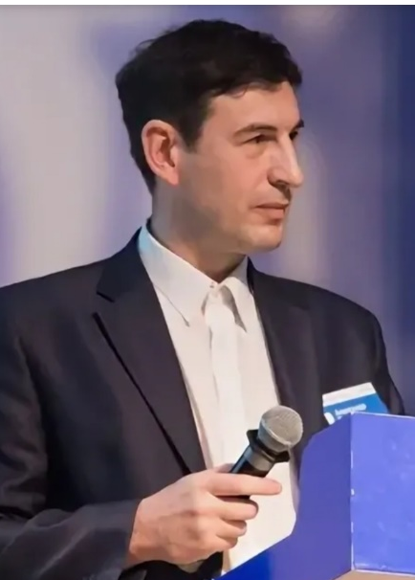

Saint Petersburg
State University
Thank you! Be safe!
a.yakunin@spbu.ru
s.bodrunova@spbu.ru
Notes:
Affective publics

